Slide 1

Business Process Automation
with Power Automate and Copilot Studio Agents
WSQ Course Code: TGS-2022017524 · 2-Day Hands-On Training · Modules 1–5 · 18 Labs
Built entirely in the new Copilot Studio — workflows, agents, skills, tools, channels
Conducted by Tertiary Infotech Academy Pte Ltd · UEN 201200696W
Version 8.1 (4 September 2026) · www.tertiarycourses.com.sg · https://lms-tms.tertiaryinfotech.com/
Business Process Automation with Power Automate & Copilot Studio Agents · TGS-2022017524 · © 2026 Tertiary Infotech Academy Pte Ltd
1

Slide 2
TRAQOM · SSG DIGITAL ATTENDANCE
Digital Attendance (Mandatory)
AM, PM and Assessment
The SSG QR code
It is mandatory to take the AM, PM and Assessment digital attendance for WSQ-funded courses.
The trainer/administrator displays the digital attendance QR code from the SSG portal.
1
2
Scan and submit
75% minimum
Scan the QR code with your mobile phone camera and submit your attendance.
A minimum of 75% attendance is required to be eligible for assessment and funding.
3
4
TRAQOM is the SSG digital attendance system — take it three times a day, every day.
Business Process Automation with Power Automate & Copilot Studio Agents · TGS-2022017524 · © 2026 Tertiary Infotech Academy Pte Ltd
2

Slide 3
YOUR TRAINER · GENERAL
About the Trainer
NAME
________________________________________________
?
TITLE / DESIGNATION
________________________________________________
QUALIFICATIONS
________________________________________________
Your Trainer
AREAS OF EXPERTISE
________________________________________________
General Trainer template —
to be completed by the trainer
TRAINING & INDUSTRY EXPERIENCE
________________________________________________
CONTACT
________________________________________________
Business Process Automation with Power Automate & Copilot Studio Agents · TGS-2022017524 · © 2026 Tertiary Infotech Academy Pte Ltd
3

Slide 4
YOUR TRAINER
About the Trainer
ROLE
Principal Trainer, Tertiary Infotech Academy Pte. Ltd.
AA
CERTIFICATION
Microsoft Power Platform, AI and data analytics — 20+ years of training experience.
Dr. Alfred Ang
DELIVERS
WSQ courses on AI, business automation, data science and software engineering.
Principal Trainer
Tertiary Infotech Academy Pte. Ltd.
FOUNDER
Founder and lead instructor at Tertiary Infotech / Tertiary Courses.
Business Process Automation with Power Automate & Copilot Studio Agents · TGS-2022017524 · © 2026 Tertiary Infotech Academy Pte Ltd
4

Slide 5
ICE-BREAKER
Let's Know Each Other
Who you are
1
Your name and your organisation / role.
What you have used
2
Your experience with Power Automate, Copilot Studio or other automation tools (if any).
What you want to automate
3
One repetitive business process you would love to automate after this course.
Keep the process in mind — by Day 2 you will know which parts of it should be a workflow, an agent, or a person.
Business Process Automation with Power Automate & Copilot Studio Agents · TGS-2022017524 · © 2026 Tertiary Infotech Academy Pte Ltd
5

Slide 6
HOUSEKEEPING
Ground Rules
Set your mobile phone to silent mode.
Participate actively — no question is too small.
1
2
Mutual respect: agree to disagree.
One conversation at a time.
3
4
Be punctual; return from breaks on time.
75% attendance is required.
5
6
Business Process Automation with Power Automate & Copilot Studio Agents · TGS-2022017524 · © 2026 Tertiary Infotech Academy Pte Ltd
6

Slide 7
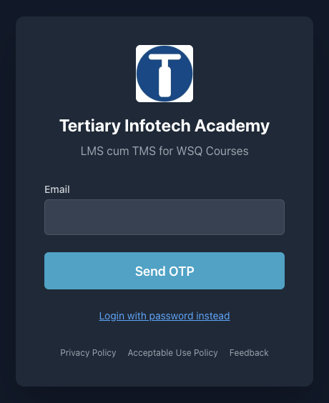
COURSE PORTAL · LMS-TMS.TERTIARYINFOTECH.COM
Download Course Material
1 · Sign in
3 · Submit answers
lms-tms.tertiaryinfotech.com — log in with your registered email (OTP or password).
Upload your Written Assessment and Practical Performance answers on the LMS.
2 · Download materials
4 · TRAQOM survey
Slides (PDF) and the Learner Guide from the course page — your open-book references.
Complete the TRAQOM survey via the QR code shown on the LMS.
https://lms-tms.tertiaryinfotech.com/
Business Process Automation with Power Automate & Copilot Studio Agents · TGS-2022017524 · © 2026 Tertiary Infotech Academy Pte Ltd
7

Slide 8
SCHEDULE · 9:30AM–6:30PM
Lesson Plan — Day 1
Morning · Day 1 — Automate, then add the agent
Afternoon · Day 1 — Automate, then add the agent
9:30 – 10:00
Welcome, admin, course map
30m
1:25 – 1:50
Module 2 — Control flow and human in the loop
25m
10:00 – 10:50
Module 1 — BPA, Power Platform, the new Copilot Studio, workflows
50m
1:50 – 2:25
Lab 3 — Leave Application Approval
35m
10:50 – 11:05
Tea break
15m
2:25 – 3:10
Lab 4 — Email Classification
45m
11:05 – 11:25
Lab 0 — Environment Setup
20m
3:10 – 3:25
Tea break
15m
11:25 – 11:55
Lab 1 — Trigger and Actions
30m
3:25 – 4:10
Module 3 — Copilot Studio agents
45m
11:55 – 12:25
Lab 2 — Log to Excel
30m
4:10 – 4:45
Lab 5 — Your First Agent
35m
12:25 – 1:25
Lunch
60m
4:45 – 5:20
Lab 6 — Procurement Agent with Tools
35m
5:20 – 5:50
Lab 7 — Sales Agent with Knowledge
30m
5:50 – 6:20
Lab 8 — IT Support Agent with Skills
30m
6:20 – 6:30
Day 1 recap
10m
Business Process Automation with Power Automate & Copilot Studio Agents · TGS-2022017524 · © 2026 Tertiary Infotech Academy Pte Ltd
8

Slide 9
SCHEDULE · 9:30AM–6:30PM
Lesson Plan — Day 2
Morning · Day 2 — Connect, supervise, ground, publish
Afternoon · Day 2 — Connect, supervise, ground, publish
9:30 – 9:35
Day 2 recap
5m
1:25 – 1:55
Lab 13 — HTTP and Chatbot
30m
9:35 – 10:10
Lab 9 — Multi-Agent Content Team
35m
1:55 – 2:30
Lab 14 — HTTP and Human Review
35m
10:10 – 10:35
Lab 10 — Calling Agent from Workflow
25m
2:30 – 2:45
Module 5 — Retrieval Augmented Generation
15m
10:35 – 11:00
Lab 11 — Calling Workflow from Agent
25m
2:45 – 3:15
Lab 15 — RAG with Knowledge Base
30m
11:00 – 11:15
Tea break
15m
3:15 – 3:45
Lab 16 — RAG with Pinecone
30m
11:15 – 11:40
Module 4 — HTTP, autonomous processes, boundary of agency
25m
3:45 – 4:00
Tea break
15m
11:40 – 12:25
Lab 12 — HTTP and Application Approval Agent
45m
4:00 – 4:25
Lab 17 — Publish to Teams, M365 Copilot and the Web
25m
12:25 – 1:25
Lunch
60m
4:25 – 4:30
Synthesis
5m
4:30 – 5:30
Written Assessment (SAQ)
60m
5:30 – 6:30
Practical Performance (PP)
60m
Business Process Automation with Power Automate & Copilot Studio Agents · TGS-2022017524 · © 2026 Tertiary Infotech Academy Pte Ltd
9

Slide 10
LEARNING OUTCOMES
What You'll Learn
add AI
expose it
make it true
ship it
Automate
the workflow
Add the
agent
Connect it
over HTTP
Ground it
with RAG
Publish it
to channels
1
Design
2
Build
3
Govern
Read a business process and decide which parts must be deterministic, which may be AI, and where a person must sit.
Create Copilot Studio workflows and agents with instructions, knowledge, skills, tools and connected agents.
Place the human where the consequence lands, test what the agent must refuse, and publish only what is safe.
By the end you can build the automation, add the agent, and defend where you put the human.
Business Process Automation with Power Automate & Copilot Studio Agents · TGS-2022017524 · © 2026 Tertiary Infotech Academy Pte Ltd
10

Slide 11
BEFORE THE ASSESSMENT
Briefing for Assessment
Place phones and other materials under the table or on the floor.
No photos or recording of assessment scripts.
1
2
No discussion during the assessment.
Use a black/blue pen for hard-copy assessments.
3
4
No liquid paper / correction tape.
Scripts are collected when time is up.
5
6
Business Process Automation with Power Automate & Copilot Studio Agents · TGS-2022017524 · © 2026 Tertiary Infotech Academy Pte Ltd
11

Slide 12
FINAL ASSESSMENT
Assessment & Funding
1
Written Assessment
2
Practical Performance
3
Evidence & funding
1 hour · open book
Short-answer questions on Modules 1–5 and the lab concepts.
1 hour · open book
Build and verify a working workflow and agent in the training environment.
Submit on the LMS.
A Competent result plus the attendance requirement releases the WSQ funding.
Day 2, 4:30 – 6:30 PM: Written Assessment (SAQ) 1 hr, then Practical Performance 1 hr.
OPEN BOOK
Slides, Learner Guide and approved materials only. An appeal process is available if required.
Business Process Automation with Power Automate & Copilot Studio Agents · TGS-2022017524 · © 2026 Tertiary Infotech Academy Pte Ltd
12

Slide 13
ON ASSESSMENT DAY
Assessment Flow
1
2
3
4
5
TRAQOM survey — scan the QR code on the LMS
Assessment digital attendance — scan the SSG QR
Sit WA (SAQ) then PP — open book
Submit your answers on the LMS
Sign the Assessment Summary Record
Business Process Automation with Power Automate & Copilot Studio Agents · TGS-2022017524 · © 2026 Tertiary Infotech Academy Pte Ltd
13

Slide 14
THE JOURNEY · LABS 0–8
Eighteen Connected Labs — Day 1
0
Environment Setup
1
Trigger and Actions
2
Log to Excel
Training Class Sandbox, Dataverse, credits
Forms trigger → Outlook; dynamic content
Excel row first, then the email
3
Leave Application Approval
4
Email Classification
5
Your First Agent
Approvals: the workflow pauses for a manager
Classify node, five ports, Human review in Teams
HR agent: instructions + knowledge + Preview
6
Procurement Agent with Tools
7
Sales Agent with Knowledge
8
IT Support Agent with Skills
Skills + a workflow as a tool + Excel audit row
20 brochures in SharePoint; refuse to invent
Five SKILL.md packages; the rule none enforce
Day 1: build the workflow, add control flow and a human, then build four agents.
Business Process Automation with Power Automate & Copilot Studio Agents · TGS-2022017524 · © 2026 Tertiary Infotech Academy Pte Ltd
14

Slide 15
THE JOURNEY · LABS 9–17
Eighteen Connected Labs — Day 2
9
Multi-Agent Content Team
10
Calling Agent from Workflow
11
Calling Workflow from Agent
Manager → Research → Blog → Review
Workflow calls M365 Copilot, posts to Teams
Agent calls a workflow tool (When an agent calls the flow)
12
HTTP and Application Approval Agent
13
HTTP and Chatbot
14
HTTP and Human Review
HTTP POST, structured output, SharePoint, four decisions
HTTP chatbot alone in public
HTTP + Human review gate + handover log
15
RAG with Knowledge Base
16
RAG with Pinecone
17
Publish to Teams, Microsoft 365 Copilot and the Web
Knowledge source in the Agent node
Pinecone: chunk, embed, top_k
Channels +: Teams, M365 Copilot, demo website
Day 2: agents and workflows call each other, go over HTTP, get grounded, and get published.
Business Process Automation with Power Automate & Copilot Studio Agents · TGS-2022017524 · © 2026 Tertiary Infotech Academy Pte Ltd
15

Slide 16
LEARNING APPROACH
How This Course Works
1
Concept
2
Pattern
3
Lab
4
Probe
5
Reuse
The idea and the decision rule, before the product is opened.
The same idea drawn as a business workflow you could hand to a colleague.
You build it, in the numbered lab named on the concept slide.
You try to break it — the refusals and wrong answers are the lesson.
The working artefact becomes the starting point of the next lab.
Concepts first. Every lab in this course is an application of a concept you have already seen.
The probes matter as much as the builds. An agent that answers ten questions correctly and the eleventh confidently wrong has not been tested — it has been demonstrated.
Business Process Automation with Power Automate & Copilot Studio Agents · TGS-2022017524 · © 2026 Tertiary Infotech Academy Pte Ltd
16

Slide 17
COURSE ENVIRONMENT
Three Environments — Where You Build
Three environments back this course. You build in exactly one of them — and it is not the one holding the reference copies.
Environment
Type
What it is for
Training Class 1 / 2 / 3
Sandbox
YOURS — every lab you build goes here. One per class; the trainer resets it between cohorts
TGS-2022017524-Business Process
Automation…
Sandbox
Master reference environment: the trainer's Lab N - … (DO NOT DELETE) workflows and agents. Read-only — open to compare, never edit
Copilot Studio Training
Developer
The original build environment. Retired from classroom use — a Developer environment is single-user
Developer
Sandbox
Trial
One user only. Free, persistent — but a class cannot share it.
Multi-user AND resettable in one click. What every class uses.
Self-deletes after 30 days, taking the class's work with it.
Sandbox is the only type that is both multi-user and resettable — so your class environment is disposable on purpose.
Business Process Automation with Power Automate & Copilot Studio Agents · TGS-2022017524 · © 2026 Tertiary Infotech Academy Pte Ltd
17

Slide 18
COURSE ENVIRONMENT
Naming Convention in the Tenant
Everything in the tenant is named after its lab, so a learner, a trainer and an auditor can all find it.
Artefact
Exact name
Rule
Trainer's reference copy
Lab 6 - Raise Requisition (DO NOT DELETE) · Lab 6 - Proc (DO NOT DELETE)
In the master reference Sandbox. Workflows AND agents end (DO NOT DELETE); agent base names are shortened to fit the 30-character cap
Your own build
Lab 6 - Procurement Agent
In your Training Class environment. Name it exactly as the Learner Guide does
Helper workflow
Lab 6 - Raise Requisition
The lab prefix, then the workflow's job
Data artefact
Lab 6 - Requisition Log.xlsx · Lab 12 - Customers
Excel, SharePoint lists and folders carry the prefix too
Pinecone index
lab16-course-brochures
Lower-case, hyphenated — the only exception, imposed by Pinecone
YOUR CLASS ENVIRONMENT, ONE DESIGNER
You build in the Training Class Sandbox your trainer assigned (e.g. Training Class 1), in the new Copilot Studio designer at copilotstudio.microsoft.com. The (DO NOT DELETE) reference copies live in a separate master reference Sandbox — open to compare, never to edit.
Business Process Automation with Power Automate & Copilot Studio Agents · TGS-2022017524 · © 2026 Tertiary Infotech Academy Pte Ltd
18

Slide 19
COURSE ENVIRONMENT
Your Training Account
One assigned Microsoft 365 training account per learner — the same login for every lab, in your class environment.
training1@tertiaryinfotech.onmicrosoft.com
Reserved for the trainer
training2@tertiaryinfotech.onmicrosoft.com
Learner account 1
training3@tertiaryinfotech.onmicrosoft.com
Learner account 2
training4@tertiaryinfotech.onmicrosoft.com
Learner account 3
training5@tertiaryinfotech.onmicrosoft.com
Learner account 4
training6@tertiaryinfotech.onmicrosoft.com
Learner account 5
training7@tertiaryinfotech.onmicrosoft.com
Learner account 6
training8@tertiaryinfotech.onmicrosoft.com
Learner account 7
training9@tertiaryinfotech.onmicrosoft.com
Learner account 8
training10@tertiaryinfotech.onmicrosoft.com
Learner account 9
Password for training2 – training10: Tertiary@0808
STAY IN YOUR CLASS ENVIRONMENT
Confirm your Training Class environment (e.g. Training Class 1) shows bottom-left before you build anything.
Business Process Automation with Power Automate & Copilot Studio Agents · TGS-2022017524 · © 2026 Tertiary Infotech Academy Pte Ltd
19

Slide 20
COURSE REPOSITORY
Access the Hands-On Labs
1
18 labs
3
Test data
labs/Lab N - <Title>/index.md — Lab 0 setup plus Labs 1–17, each with its own step-by-step guide, assets and screenshots.
Sample emails, question sets and probe cases written to make each workflow and agent fail.
2
Ready assets
4
Learner Guide + LMS
Forms, Excel workbooks, brochure PDFs, HTML pages, JSON schemas, SKILL.md packages and agent instructions.
The Learner Guide reproduces every lab; download it and the slides from lms-tms.tertiaryinfotech.com.
Work in order. Every lab reuses the one before it; nothing is rebuilt from scratch.
Business Process Automation with Power Automate & Copilot Studio Agents · TGS-2022017524 · © 2026 Tertiary Infotech Academy Pte Ltd
20

Slide 21
MODULE 1
Business Process Automation and Power Automate
What automation removes · the Power Platform · the new Copilot Studio · workflows, triggers, actions, connections · dynamic content, Activity, commit order · Copilot Credits
Applied in Lab 0, Lab 1 and Lab 2
Business Process Automation with Power Automate & Copilot Studio Agents · TGS-2022017524 · © 2026 Tertiary Infotech Academy Pte Ltd
21

Slide 22
MODULE 1 · CONCEPT
What Business Process Automation Removes
Business process automation is not "software that does work faster". It removes the hand-off where a person re-types what another system already knows.
MANUAL
Form filled in
Someone reads it
Re-typed into Excel
Someone remembers
to reply
AUTOMATED
Form submitted
Workflow triggered
Row written
Reply sent
Consistency
Traceability
Capacity
The same input produces the same output, every time, at 3am.
Every run leaves an Activity record someone can read a year later.
People are moved to the judgement calls the machine cannot make.
Business Process Automation with Power Automate & Copilot Studio Agents · TGS-2022017524 · © 2026 Tertiary Infotech Academy Pte Ltd
22

Slide 23
MODULE 1 · CONCEPT
The Power Platform, and the Environment That Holds It
1
Copilot Studio
2
Power Automate
3
Dataverse
4
Connectors
Agents AND workflows, in one designer at copilotstudio.microsoft.com.
The connector engine underneath every workflow step — you never open it directly.
The managed data store behind the environment; agents and workflows live in it.
Outlook, Forms, Excel, SharePoint, Teams, Approvals, HTTP — 1,000+.
Every lab
Labs 1–4, 10–16
Lab 0
Every lab
THE ENVIRONMENT IS THE CONTAINER
Workflows, agents and data all live inside one Power Platform environment. You build in the Training Class Sandbox assigned to your class — with Dataverse and Copilot Credits. Build in the Default environment and the first Agent node fails with InsufficientMcsCredits.
LAB 0
Lab 0 — Environment Setup
Training Class Sandbox (assigned by your trainer) · Power Platform admin centre + Copilot Studio · 20 min
Business Process Automation with Power Automate & Copilot Studio Agents · TGS-2022017524 · © 2026 Tertiary Infotech Academy Pte Ltd
23

Slide 24
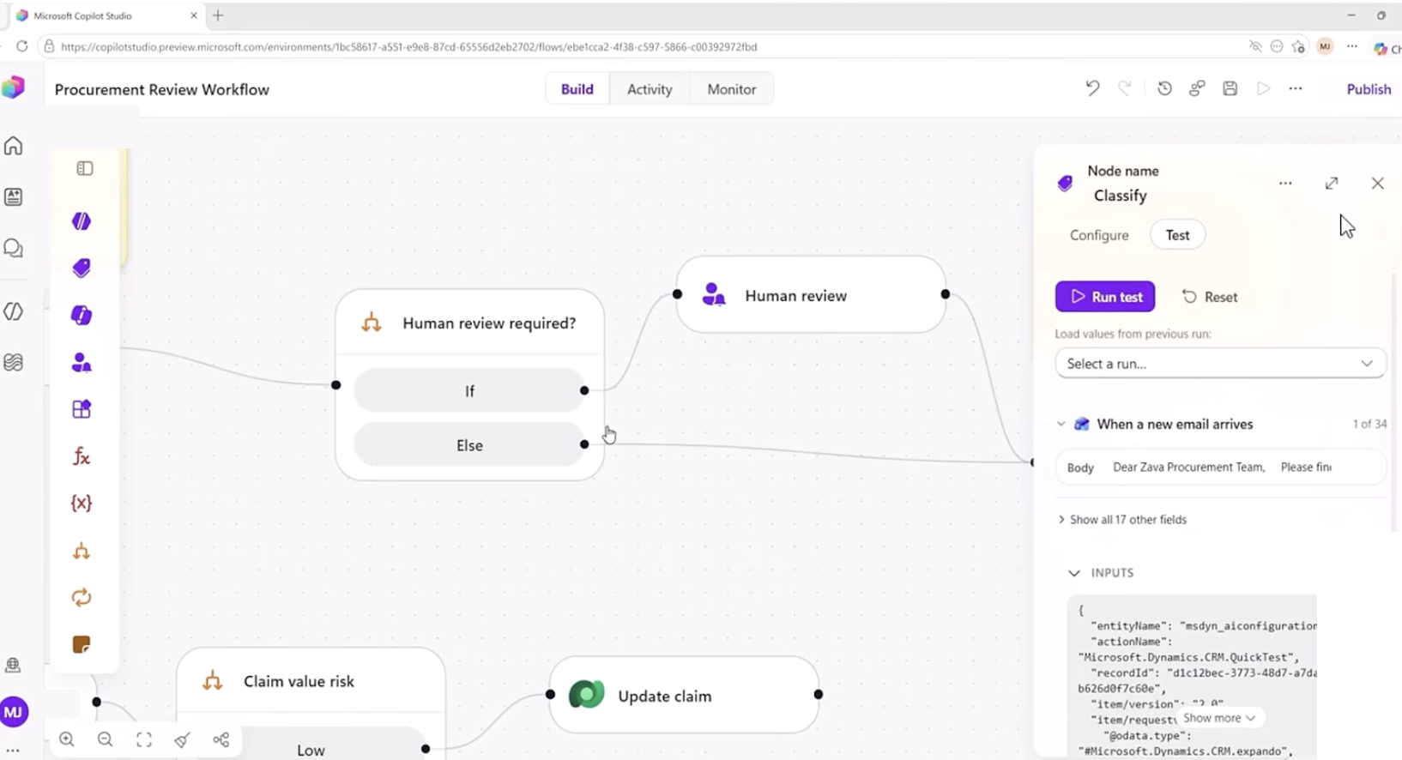
MODULE 1 · CONCEPT
The New Copilot Studio — Home, Agents, Workflows
copilotstudio.microsoft.com — the New experience toggle (top right) switches the whole product to the GitHub Copilot harness.
Home
A natural-language box: describe the process and Copilot Studio proposes an agent, a workflow, or both (Steps and Artifacts panel).
Agents
New agent → the designer with Build / Preview / Evaluate / Monitor tabs.
Workflows
New workflow → the canvas with a Start node and Add a step. Columns: Name · Status · Owner · Enabled.
Other ways to build
The standard harness (topics, agent flows) is still there — we do not use it in this course.
Environment name bottom-left. Check it before every build: your Training Class environment.
Business Process Automation with Power Automate & Copilot Studio Agents · TGS-2022017524 · © 2026 Tertiary Infotech Academy Pte Ltd
24

Slide 25
MODULE 1 · CONCEPT
Three Harnesses — Pick One per Agent
"The harness sits between the AI model and the agent or workflow you build" — you choose one per agent, and cannot convert later.
GitHub Copilot harness (GA 3 Aug 2026)
Standard harness
Copilot chat harness
Best for
Complex, multi-step business processes
Rule-based agents, structured conversations
Extending Microsoft 365 Copilot Chat
How it works
Reasons through a goal step by step; retries, finds alternative paths
Follows the topics and rules you define
Connects enterprise knowledge to Copilot Chat
Files
Creates and edits Word, Excel, PowerPoint, PDF in a sandbox
Not a focus
Not a focus
Skills & memory
Yes
Not a focus
Not a focus
Automation
Workflows (visual canvas, agent nodes)
Agent flows (Power Automate designer)
—
Billing
Copilot Credits — usage-based, from the moment you build
Fixed rate card; M365 Copilot fair use
Consumption or M365 Copilot licence
This course: every agent and workflow uses the GitHub Copilot harness — the "new experience".
Business Process Automation with Power Automate & Copilot Studio Agents · TGS-2022017524 · © 2026 Tertiary Infotech Academy Pte Ltd
25

Slide 26
MODULE 1 · CONCEPT
Old Vocabulary → New Vocabulary
If you learned Copilot Studio before 2026, translate as you go.
Standard harness (classic)
GitHub Copilot harness (new experience)
Topics, triggers, branching nodes
Instructions — natural language, always-on enhanced orchestration
Agent flows (Power Automate designer)
Workflows — Start node, Add a step, node-level Test
Prompts (Prompt builder)
Inline Agent node in a workflow, or a skill in an agent
Child agents
Connected agents
Actions / plugins
Tools = Connectors, MCP servers, Workflows
Overview / Settings pages
Build · Preview · Evaluate · Monitor tabs
Test pane
Preview tab with End user preview toggle and the reasoning card
Messages / capacity
Copilot Credits
Business Process Automation with Power Automate & Copilot Studio Agents · TGS-2022017524 · © 2026 Tertiary Infotech Academy Pte Ltd
26

Slide 27
MODULE 1 · CONCEPT
Anatomy of a Workflow — the Start Node and Its Triggers
outputs
outputs
outputs
START
the trigger
STEP
do the work
STEP
decide or wait
END / RESPOND
notify or return
Click the Start node to choose the trigger type. Every workflow in every lab is this shape.
Start node trigger type
What starts the run
Where
Manual
A person runs it on demand; you define typed inputs
Lab 10 (Topic)
Recurrence
A schedule — set the time zone or it runs on UTC
Reference
Connector
An event in a system: new Forms response, new email, new SharePoint item
Labs 1–4
HTTP request
When a HTTP request is received — a website or app calls in with JSON
Labs 12–16
When an agent calls the flow
An agent decides to use this workflow as a tool
Labs 6, 11
Business Process Automation with Power Automate & Copilot Studio Agents · TGS-2022017524 · © 2026 Tertiary Infotech Academy Pte Ltd
27

Slide 28
MODULE 1 · CONCEPT
The Add-Step Palette
The + after any node opens the Add panel. Everything you can put on the canvas is one of these.
Agent
Classify
M365 Copilot
Human review
An inline or existing agent — the model, inside the workflow
Sort text into categories; each becomes an output port
Send a prompt to Microsoft 365 Copilot or one of its agents
Request for information — pause for a person (Teams / Outlook)
Connector
Function
Variable
If/Else
Any of 1,000+ connector actions: Outlook, Excel, SharePoint, Teams, HTTP
Data Operations (Compose, Parse JSON, Select), text, date/time
Initialize, Set, Append — a named value that changes during the run
One condition, two branches
Switch
Loop
Respond to the agent
End
One value, many cases plus a default
For each item in an array; Do until
Return outputs to the calling agent (tool workflows)
Stop the run; send the HTTP Response
Business Process Automation with Power Automate & Copilot Studio Agents · TGS-2022017524 · © 2026 Tertiary Infotech Academy Pte Ltd
28

Slide 29
MODULE 1 · CONCEPT
Triggers — What Is Allowed to Start a Process
Four trigger families. The one you choose is a statement about who or what is allowed to start the process.
Manual
Scheduled
Automated
Request
A person presses Run
A clock reaches a time
An event happens
in a system
Something calls in
from outside
Typed inputs on the Start node;
Test → Enter manual trigger inputs
Recurrence — the schedule starts
when you publish
New form response · new email ·
new SharePoint item · new file
When a HTTP request is received ·
When an agent calls the flow
Trigger used in this course
Where
What it means
Connector — When a new response is submitted (Forms)
Labs 1, 2, 3
A business event starts the process
Connector — When a new email arrives (V3) (Outlook)
Lab 4
The inbox is the queue
HTTP request — When a HTTP request is received
Labs 12–16
A website posts JSON and waits for JSON back
When an agent calls the flow
Labs 6, 11
A conversation decides to call a tool
Business Process Automation with Power Automate & Copilot Studio Agents · TGS-2022017524 · © 2026 Tertiary Infotech Academy Pte Ltd
29

Slide 30
MODULE 1 · CONCEPT
Actions — The Six Families You Will Use
A step either moves data, decides something, waits for a person, calls the model, or reaches outside the workflow.
Data — Function
Connector actions
Control
Compose · Parse JSON · Select ·
Filter array · Join · expressions
Send an email (V2) · Add a row into a table ·
Create item · Post message in a chat or channel
If/Else · Switch · Loop ·
Variable · End
Shape and normalise values before anything trusts them.
Do the real work in a business system.
Decide which path the run takes.
Human in the loop
AI
Integration
Human review (Request for information) ·
Approvals: Start and wait for an approval
Agent node · Classify · M365 Copilot ·
structured output
HTTP · Response / End · Respond to the agent ·
child workflows
Suspend the run until a person responds.
Let the model decide, inside a workflow that does not.
Reach outside the platform, or answer the caller.
You will use every one of these families by the end of Lab 16.
Business Process Automation with Power Automate & Copilot Studio Agents · TGS-2022017524 · © 2026 Tertiary Infotech Academy Pte Ltd
30

Slide 31
MODULE 1 · CONCEPT
Connections — Who the Step Runs As
A connector action runs as somebody. The connection is that somebody — and it is created once, then reused.
first time
OAuth
Add a connector
step
Connection row
shows no tick
Create new
connection
Sign in as the
course account
Green tick —
step can run
Per connector, per user
Tenant boundary
Outlook, Excel Online (Business), SharePoint, Teams, Forms and Approvals each need their own connection.
Human review and Approvals can only be assigned to people in the tenant — external addresses fail at run time.
Whose mailbox?
Publish installs them
Send an email (V2) sends from the connection's account. In class that is your training account.
Run flow test saves, publishes and installs connections before it triggers.
Business Process Automation with Power Automate & Copilot Studio Agents · TGS-2022017524 · © 2026 Tertiary Infotech Academy Pte Ltd
31

Slide 32
MODULE 1 · CONCEPT
Dynamic Content — The Token, Not the Text
produces
⚡ picker
resolved
Trigger runs
Outputs exist
Later step
references them
Value arrives
at run time
✓ INSERTED WITH THE ⚡ PICKER (or / command)
✗ TYPED BY HAND, OR PASTED @{...}
• Renders as a coloured token in the field
• Stays dead text — the run is green, the value arrives empty
• Resolves at run time to what the earlier step produced
• A reference to nothing resolves to empty, not to an error
• The picker shows sample values from the last completed run
• Rich-text boxes mangle pasted expressions
Typed expressions belong in the </> expression editor (concat, formatDateTime, utcNow) — never in a rich-text Instructions box.
LAB 1
Lab 1 — Trigger and Actions
Form to email confirmation · Copilot Studio workflow + Microsoft Forms + Outlook · 30 min
Business Process Automation with Power Automate & Copilot Studio Agents · TGS-2022017524 · © 2026 Tertiary Infotech Academy Pte Ltd
32

Slide 33
MODULE 1 · CONCEPT
Activity, Run Details and Node-Level Testing
Two ways to test, and one honest record. Every lab is verified from Activity, not from the chat window.
What you want to verify
How
What you see
A single node in isolation
Test this node — the Test tab in the node's side panel; Load values from previous run
Runs the node against the connector's API
The full workflow
Run flow test — the play button top right; saves, publishes, installs connections
Manual/HTTP → enter inputs; connector → Waiting for trigger…
What happened
Activity panel — Running · Waiting · Succeeded · Failed · Canceled; open a run, expand each node
Inputs and Outputs per node; the reasoning of every AI node
THE THREE STATES THAT LOOK ALIKE
Succeeded with the right data · Succeeded with empty data · Still Running because it is waiting for a person.
Only the first is done. The second is the dangerous one — read the upstream node's Outputs, not the failing node's error.
LAB 2
Lab 2 — Log to Excel
Log the enquiry, then send the email · Copilot Studio workflow + Excel Online · 30 min
Business Process Automation with Power Automate & Copilot Studio Agents · TGS-2022017524 · © 2026 Tertiary Infotech Academy Pte Ltd
33

Slide 34
MODULE 1 · CONCEPT
Order Matters — Commit Before You Confirm
The order of two steps is a business decision, not a technical one.
LOG, THEN CONFIRM ✓
CONFIRM, THEN LOG ✗
• Add a row into a table (Excel)
• Send an email (V2)
• then Send an email (V2)
• then Add a row into a table
• If the email fails, the enquiry is still on the register and someone can chase it
• If the row fails, you have promised a reply that nobody can see — the evidence is gone
Commit the record of the obligation before you create the obligation. This is Lab 2 in one sentence.
Same rule on Day 2: Lab 12 writes the Onboarding Log before the email; Lab 14 logs the draft before the Human review gate.
LAB 2
Lab 2 — Log to Excel
Log the enquiry, then send the email · Copilot Studio workflow + Excel Online · 30 min
Business Process Automation with Power Automate & Copilot Studio Agents · TGS-2022017524 · © 2026 Tertiary Infotech Academy Pte Ltd
34

Slide 35
MODULE 1 · CONCEPT
Copilot Credits and Billing — What Changed on 1 September 2026
"Billing starts when you start building." Copilot Credits cover LLM tokens, tools (including knowledge and MCP) and the harness itself.
Feature
Covered by an M365 Copilot licence?
When Copilot Credits are billed
GitHub Copilot harness agents
No
Billed for all usage — build, Preview, Evaluate, run
Workflows
Only inside a standard-harness agent, licensed user
All other cases — every action consumes capacity
Standard harness agents
Yes, in Microsoft 365 channels
No M365 Copilot licence, or a channel outside M365
Computer use (CUA)
No
All usage
1 Sep 2026
Where to look
Zero credits = every reply fails
Developer and trial environments moved to usage-based billing. Our class Sandbox environments are billed per run.
Agent → Monitor tab; PPAC → Licensing → Copilot Studio → Manage Agents; Copilot Credits estimator.
"You need credits to continue … Error code: EnforcementUsageCredits" in Preview, the demo website and every Agent/Classify/Copilot node. Build and Publish still work; allocate credits in PPAC first.
Business Process Automation with Power Automate & Copilot Studio Agents · TGS-2022017524 · © 2026 Tertiary Infotech Academy Pte Ltd
35

Slide 36
MODULE 1 · CONCEPT
Power Platform Admin Center — Settings for This Course
What the admin set up in the Power Platform admin center (PPAC) before class — and why each setting matters.
Class environment
Copilot Credits allocation
1
One Training Class Sandbox per cohort, with Dataverse. Reset between classes. Never the Default environment.
2
Licensing → Copilot Studio → Manage Copilot Credits → this environment; Draw from the available capacity in my tenant.
Agent limits
External models
3
Manage Agents → Set limit → monthly limit, notification threshold, Stop usage toggle.
4
Turn on external models (Anthropic, Mistral, xAI) + M365 admin consent — needed for Claude Opus 5.
Preview / cross-region
Entra Agent ID
5
Preview and experimental AI models; Move data across regions (Singapore models are cross-geo).
6
Automatic for every agent since July 2026 — Conditional Access and DLP per agent; Harness column in Manage → Copilot Studio.
Business Process Automation with Power Automate & Copilot Studio Agents · TGS-2022017524 · © 2026 Tertiary Infotech Academy Pte Ltd
36

Slide 37
MODULE 1 · CONCEPT
What's New in 2026 — The Timeline
2026 in five words: harness, skills, memory, workflows, governance. One line per month.
2026
What shipped
Jan
Evaluation enhancements; activity maps; CSV test-set template; Copilot Studio extension for VS Code (GA)
Feb
Ticket-based Graph connectors; Claude models per prompt in Prompt builder
Mar
Agent node in flows; agent evaluations GA + multi-turn tests; Work IQ tools (preview); Claude Sonnet 4.6 / Opus GA
Apr
Agent-to-agent (A2A) protocol GA; evaluations via REST API; agent usage estimator; GPT-5.5 Reasoning (Deep)
May
Computer use GA; Prompt node and Microsoft 365 Copilot node in workflows; Entra Agent IDs (preview); agent inventory schema
Jun
The new experience (GitHub Copilot harness) production-ready preview; Skills; Memory; connected agents; Claude Sonnet 5 / GPT-5.5 Chat GA
Jul
Entra Agent ID automatic for every agent; workflows and MCP servers as tools; files in and files out (preview)
Aug
GitHub Copilot harness GA (3 Aug); Skills GA; September billing change announced for developer and trial environments
Trajectory: topics (2024) → generative orchestration + agent flows (2025) → harness choice, skills, memory, workflows, connected agents (2026).
Business Process Automation with Power Automate & Copilot Studio Agents · TGS-2022017524 · © 2026 Tertiary Infotech Academy Pte Ltd
37

Slide 38
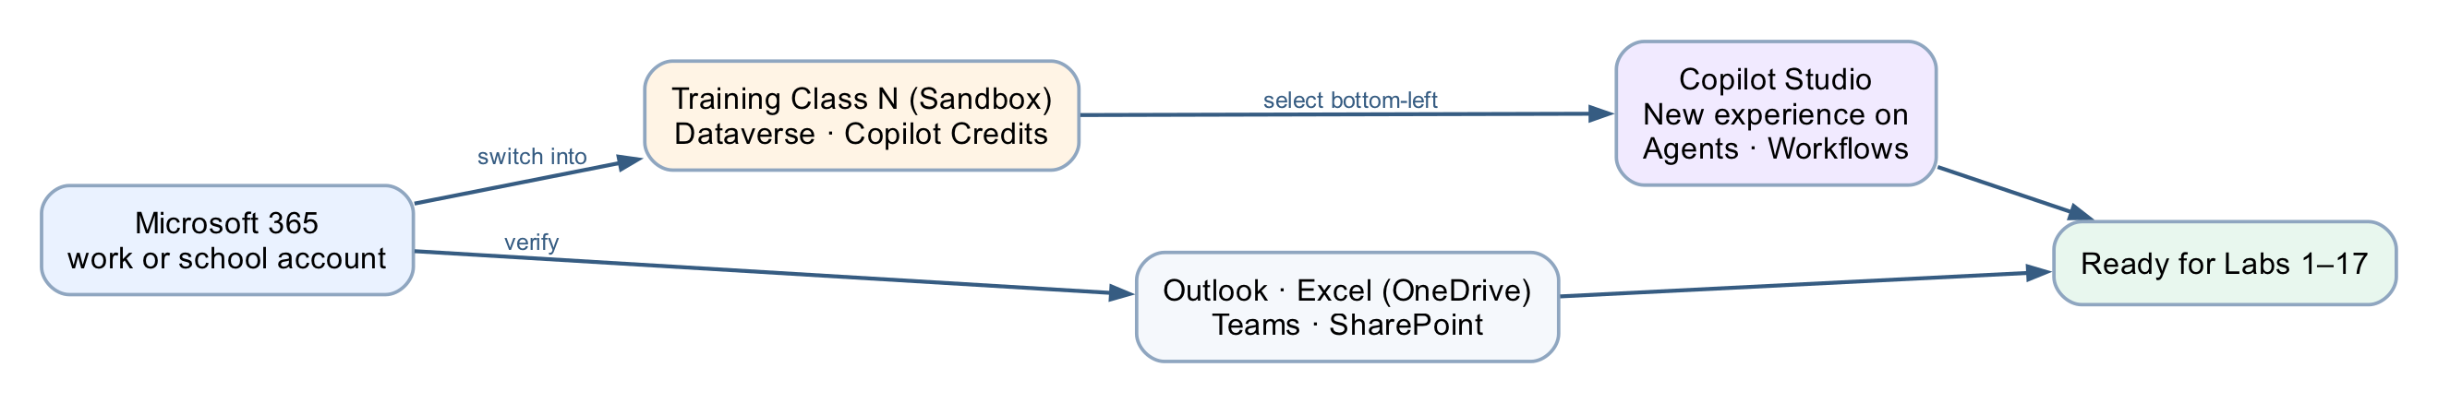
MODULE 1 · LAB 0 · HANDS-ON
Lab 0 — Environment Setup
LAB 0
20 MIN
DAY 1
Training Class Sandbox (assigned by your trainer)
What it teaches
One Training Class Sandbox, with Dataverse and Copilot Credits, stands behind every later lab — and one designer builds everything.
Platform
Power Platform admin centre + Copilot Studio
Tenant artefact names
(no tenant artefact — admin centre only)
Trainer copies end (DO NOT DELETE). Name yours plainly — agent names 30 characters or fewer.
Business Process Automation with Power Automate & Copilot Studio Agents · TGS-2022017524 · © 2026 Tertiary Infotech Academy Pte Ltd
38

Slide 39
MODULE 1 · LAB 0 · BUILD
Lab 0 — Build Steps
Sign in to Microsoft 365 and confirm Outlook, Excel and Teams open with the training account.
Trainer provisions one Training Class Sandbox per cohort (Dataverse on); learners do not create an environment.
1
2
Open copilotstudio.microsoft.com; pick your Training Class environment bottom-left; turn the New experience toggle on.
Confirm Agents and Workflows appear in the left navigation and New agent / New workflow are available.
3
4
Confirm Copilot Credits are allocated to your class environment (trainer: PPAC → Licensing → Copilot Studio).
Verify: open the trainer's Lab 1 - Trigger and Actions (DO NOT DELETE) and read its canvas without editing.
5
6
Business Process Automation with Power Automate & Copilot Studio Agents · TGS-2022017524 · © 2026 Tertiary Infotech Academy Pte Ltd
39

Slide 40
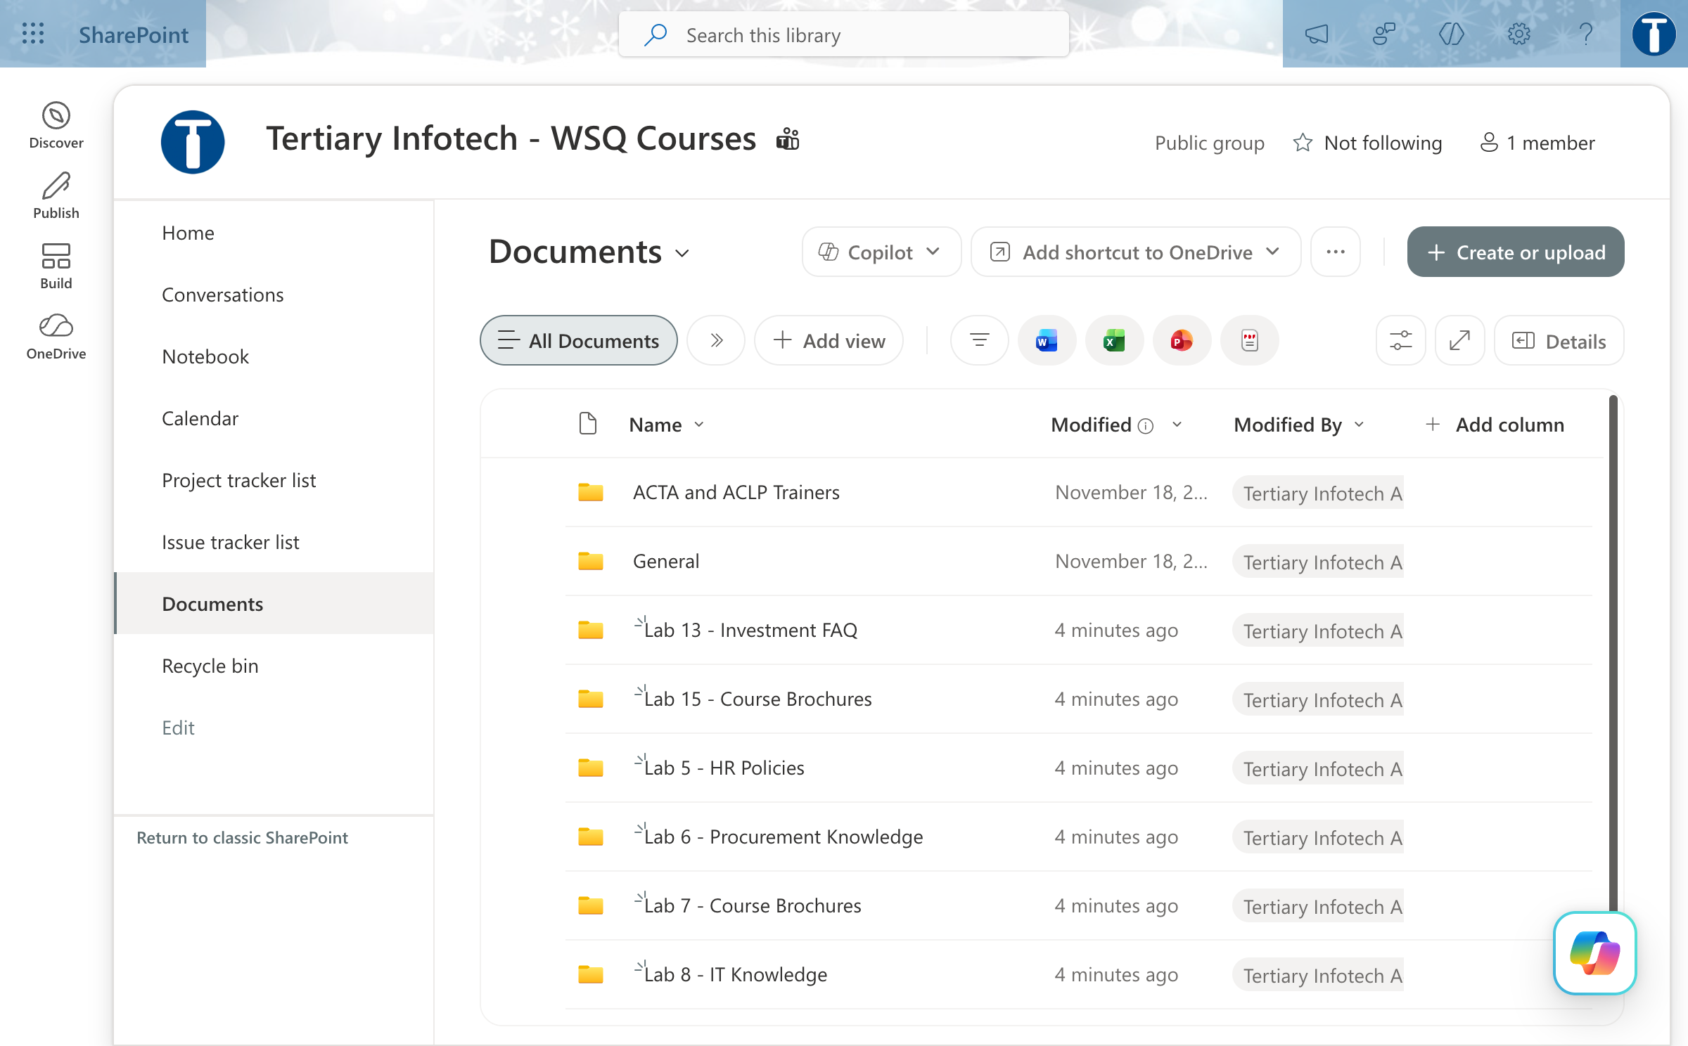
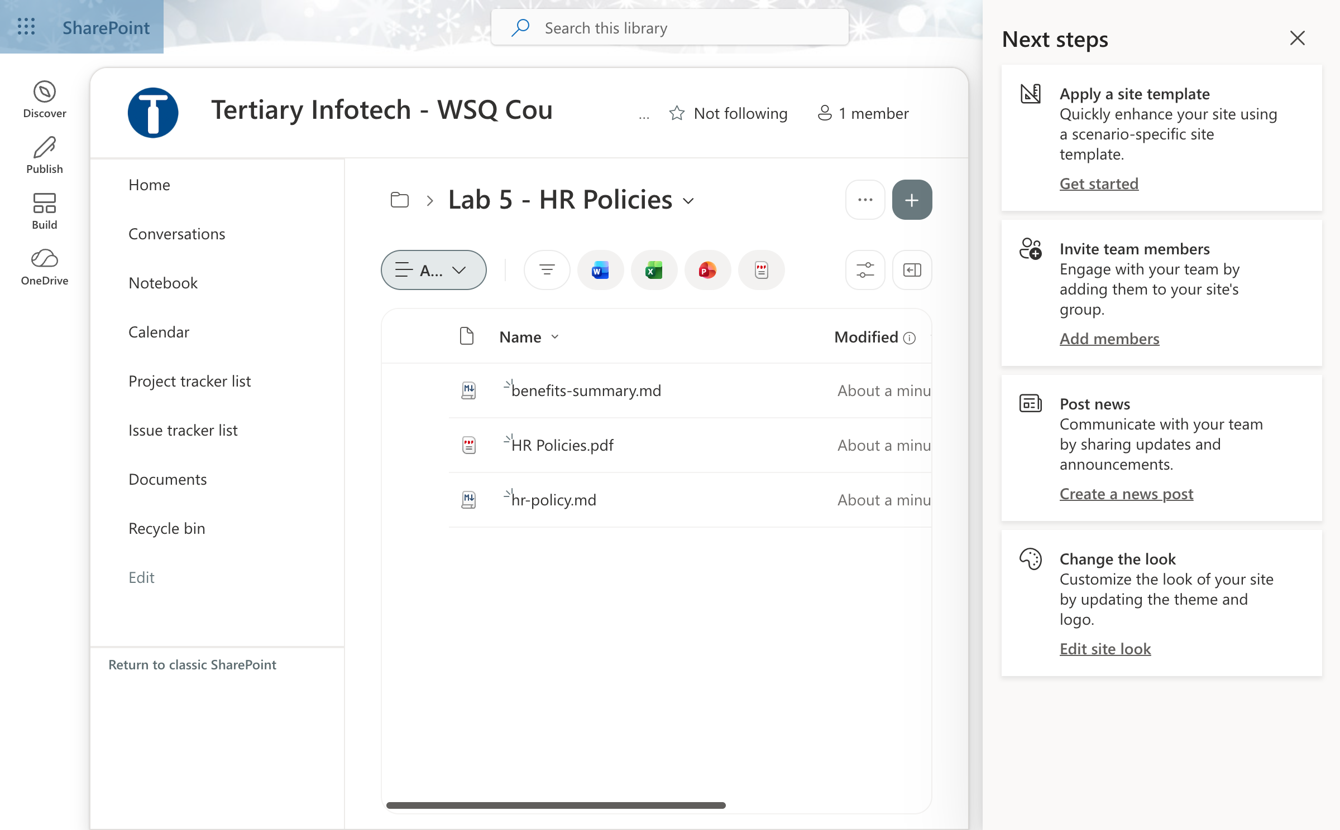
MODULE 1 · LAB 0 · SCREENSHOTS
Lab 0 — What You Will See
Sharepoint site documents
Lab 5 hr policies folder
Business Process Automation with Power Automate & Copilot Studio Agents · TGS-2022017524 · © 2026 Tertiary Infotech Academy Pte Ltd
40

Slide 41
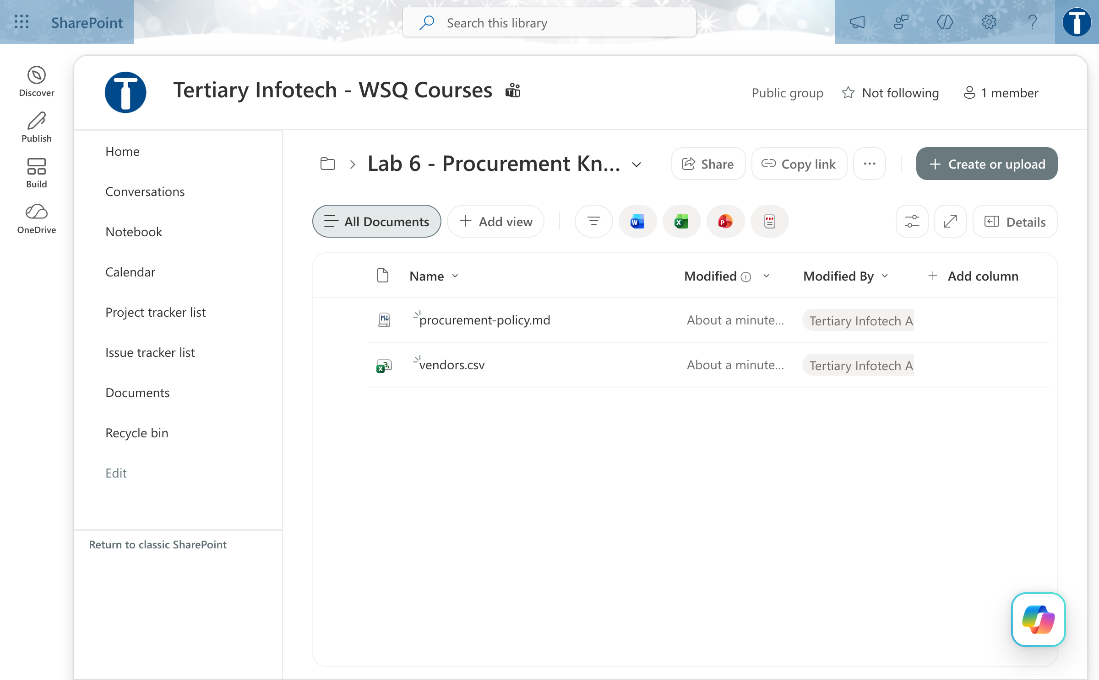
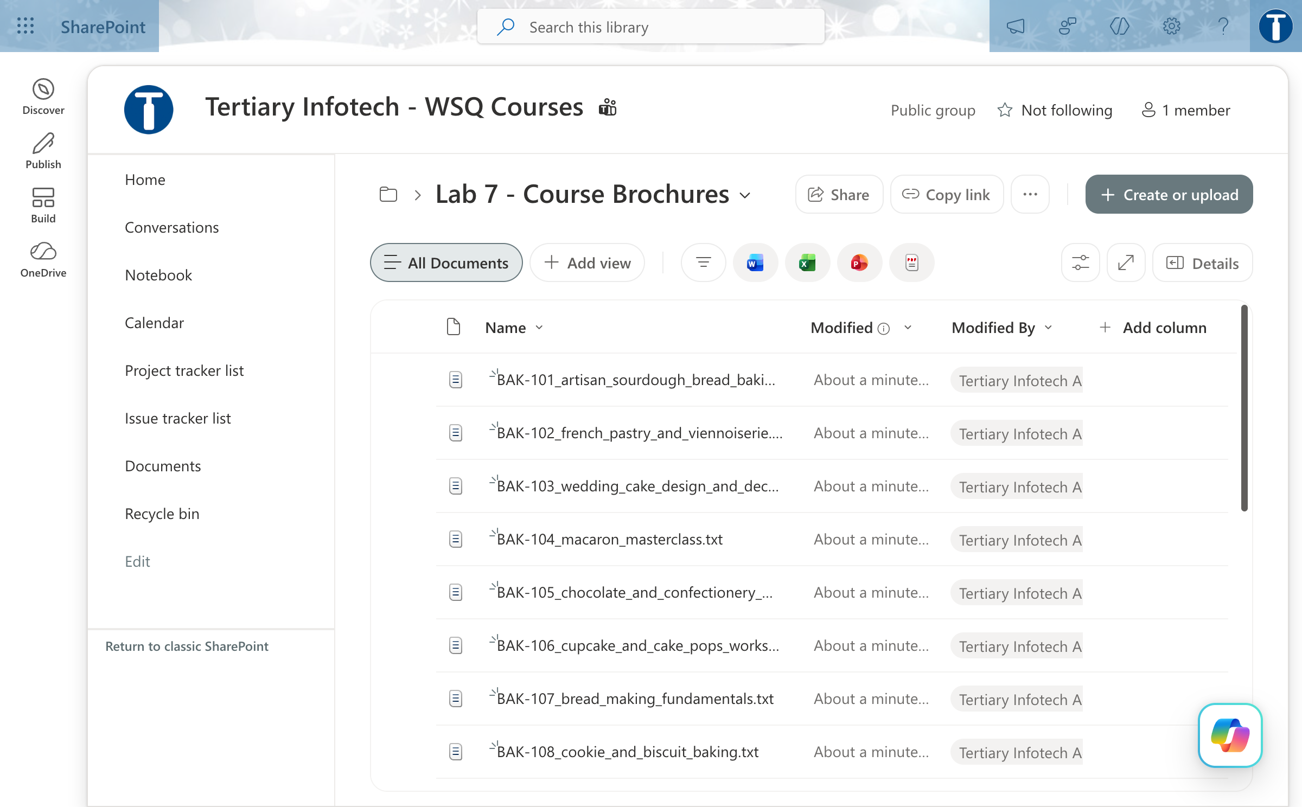
MODULE 1 · LAB 0 · SCREENSHOTS
Lab 0 — What You Will See (continued)
Lab 6 procurement knowledge folder
Lab 7 course brochures folder
Business Process Automation with Power Automate & Copilot Studio Agents · TGS-2022017524 · © 2026 Tertiary Infotech Academy Pte Ltd
41

Slide 42
MODULE 1 · LAB 1 · HANDS-ON
Lab 1 — Trigger and Actions
LAB 1
30 MIN
DAY 1
Form to email confirmation
What it teaches
A trigger starts a workflow; connector actions consume the trigger's outputs as dynamic content.
Platform
Copilot Studio workflow + Microsoft Forms + Outlook
Tenant artefact names
Lab 1 - Trigger and Actions · Lab 1 - Course Enquiry Form
Trainer copies end (DO NOT DELETE). Name yours plainly — agent names 30 characters or fewer.
Business Process Automation with Power Automate & Copilot Studio Agents · TGS-2022017524 · © 2026 Tertiary Infotech Academy Pte Ltd
42

Slide 43
MODULE 1 · LAB 1 · BUILD
Lab 1 — Build Steps
Microsoft Forms → New form → the trainer's Lab 1 - Course Enquiry Form has Name, Email, Tel, Message (all Required).
Workflows → New workflow → rename exactly Lab 1 - Trigger and Actions → Save.
1
2
Start node → Connector → Microsoft Forms → When a new response is submitted → pick the form; create the connection.
+ → Add dialog → Connectors tab → Microsoft Forms → Get response details; Form Id again; insert the ⚡ Response Id token.
3
4
+ → Connector → Office 365 Outlook → Send an email (V2); To = ⚡ Email (the form answer); build Subject and Body with ⚡ tokens.
Save → Publish → submit the form → open Activity and read every node's Inputs and Outputs.
5
6
Probe: type a value by hand instead of a token, resubmit, and watch the email arrive with a blank.
7
Business Process Automation with Power Automate & Copilot Studio Agents · TGS-2022017524 · © 2026 Tertiary Infotech Academy Pte Ltd
43

Slide 44
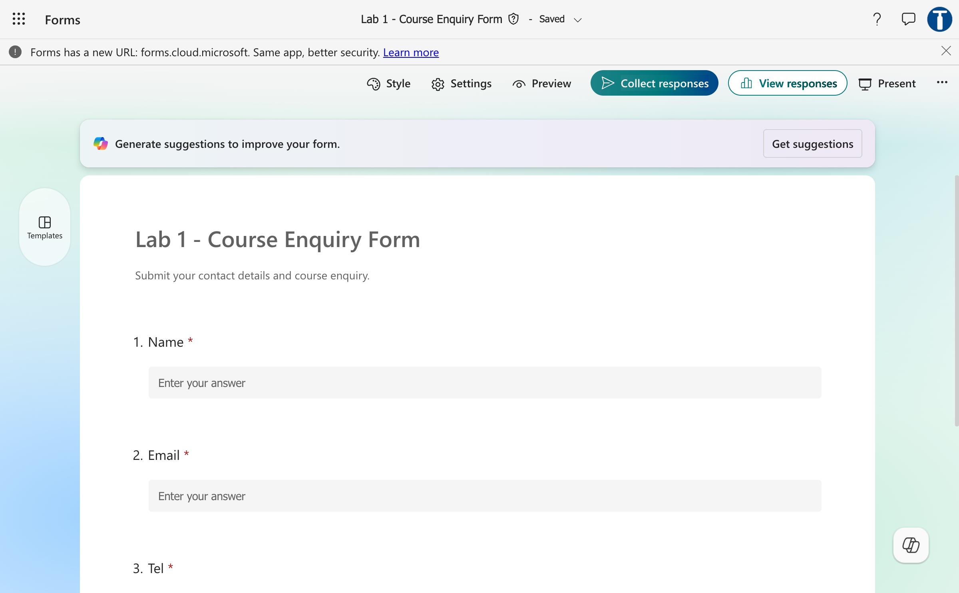
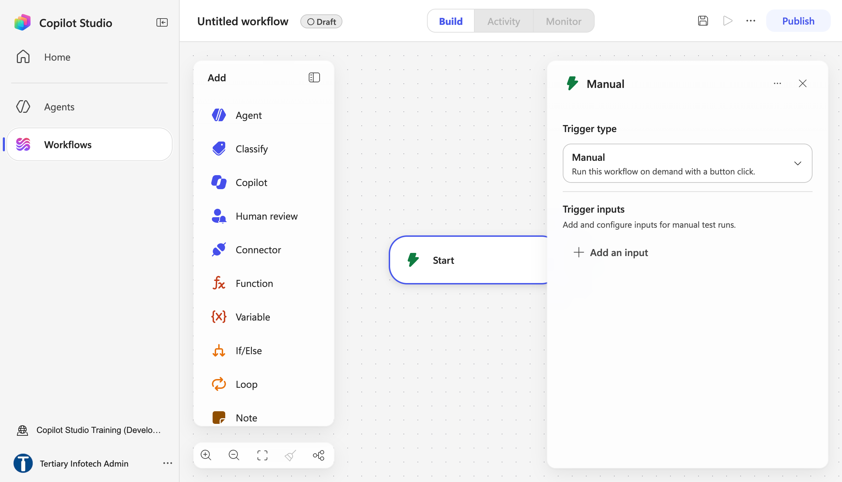
MODULE 1 · LAB 1 · SCREENSHOTS
Lab 1 — What You Will See
Trainer course enquiry form
New workflow start node
Business Process Automation with Power Automate & Copilot Studio Agents · TGS-2022017524 · © 2026 Tertiary Infotech Academy Pte Ltd
44

Slide 45
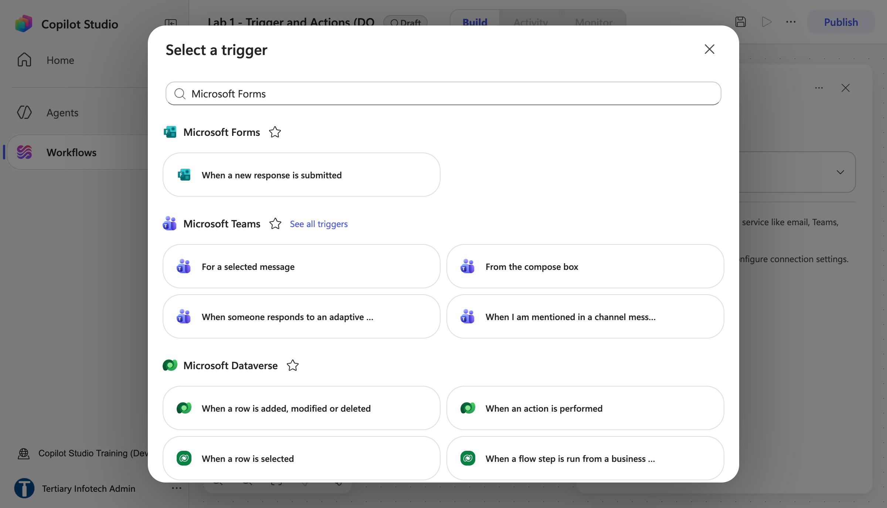
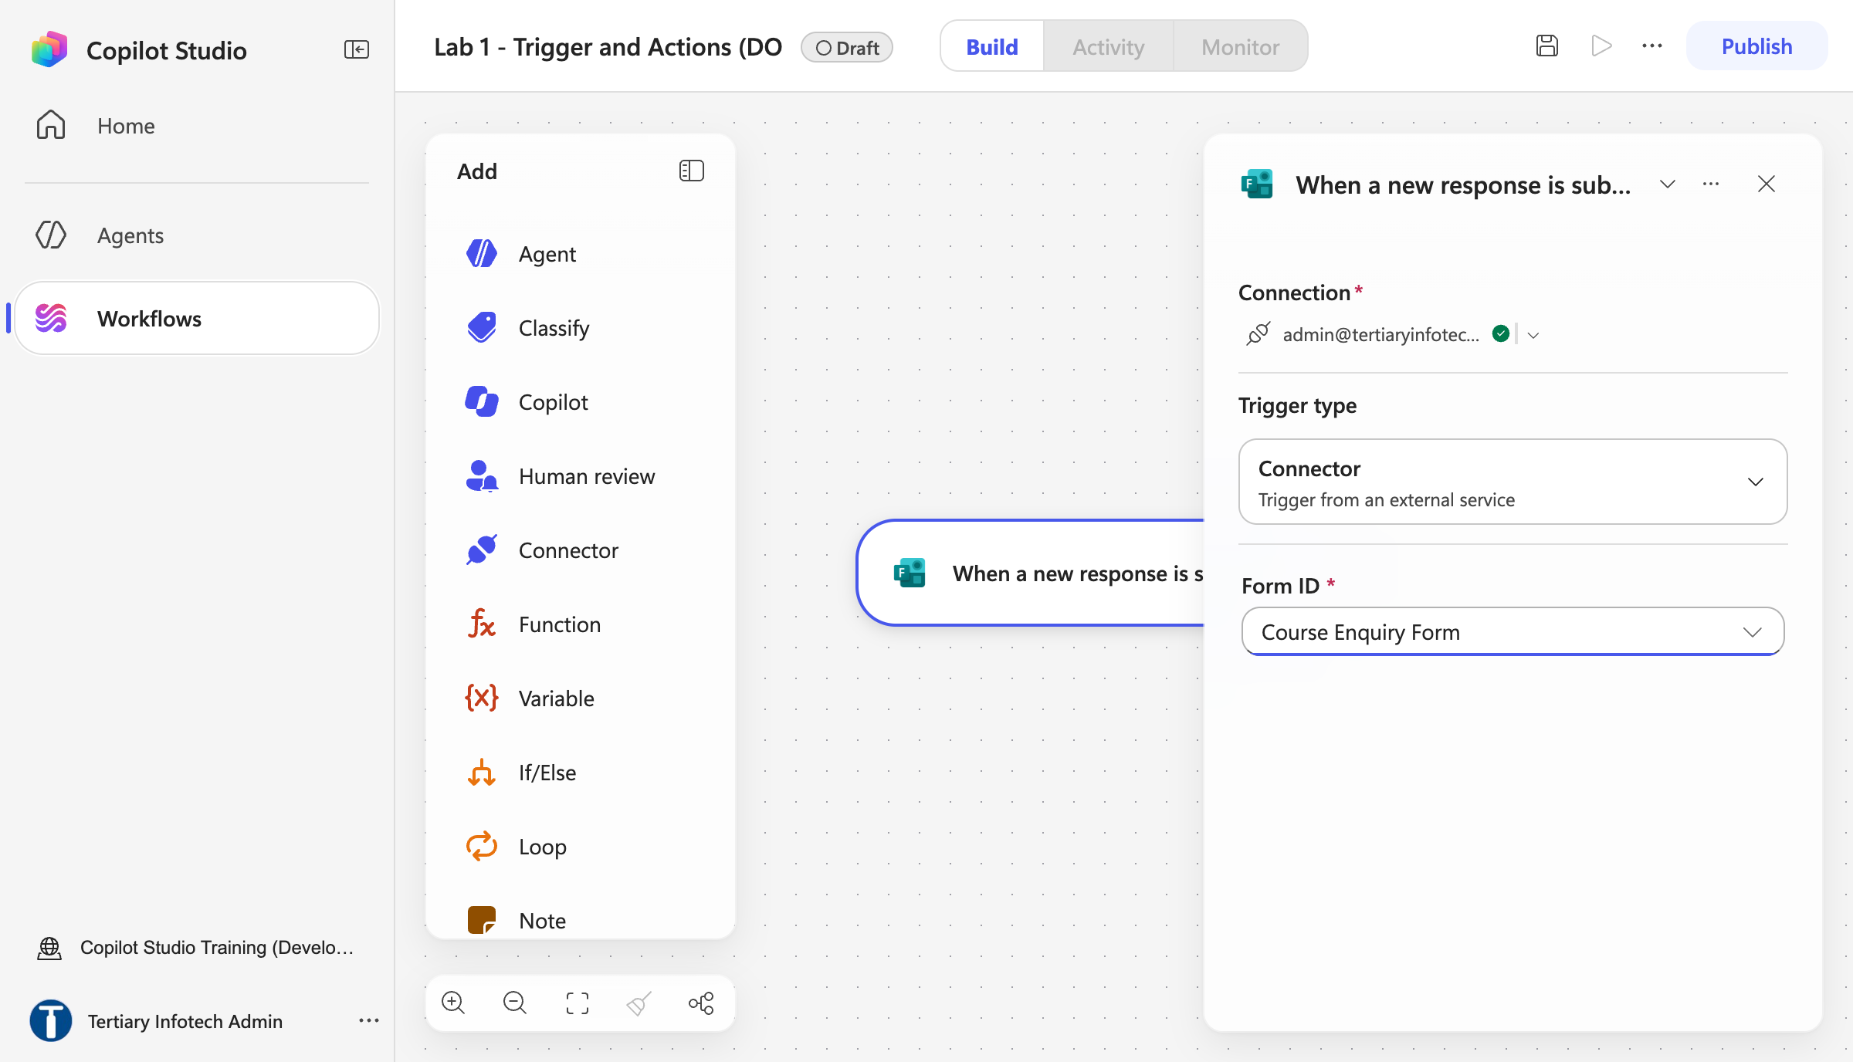
MODULE 1 · LAB 1 · SCREENSHOTS
Lab 1 — What You Will See (continued)
Select a trigger microsoft forms
Start node form id
Business Process Automation with Power Automate & Copilot Studio Agents · TGS-2022017524 · © 2026 Tertiary Infotech Academy Pte Ltd
45

Slide 46
MODULE 1 · LAB 2 · HANDS-ON
Lab 2 — Log to Excel
LAB 2
30 MIN
DAY 1
Log the enquiry, then send the email
What it teaches
Commit before you confirm — the audit row is written before the acknowledgement is sent.
Platform
Copilot Studio workflow + Excel Online
Tenant artefact names
Lab 2 - Log to Excel · Lab 2 - Enquiry Log.xlsx
Trainer copies end (DO NOT DELETE). Name yours plainly — agent names 30 characters or fewer.
Business Process Automation with Power Automate & Copilot Studio Agents · TGS-2022017524 · © 2026 Tertiary Infotech Academy Pte Ltd
46

Slide 47
MODULE 1 · LAB 2 · BUILD
Lab 2 — Build Steps
Upload Lab 2 - Enquiry Log.xlsx (table EnquiryLog) to OneDrive → Power Automate Lab Data.
New workflow Lab 2 - Log to Excel; rebuild the Lab 1 Forms trigger and Get response details.
1
2
+ → Connector → Excel Online (Business) → Add a row into a table; Location → Document Library → File → Table, top to bottom.
Map each column to a ⚡ token; Timestamp = </> utcNow().
3
4
Only then add Send an email (V2) — the confirmation comes after the row.
Save → Publish → submit two responses → check two rows in Excel and two emails.
5
6
Debrief: swap the two steps in your head — what is lost if the email fails first?
7
Business Process Automation with Power Automate & Copilot Studio Agents · TGS-2022017524 · © 2026 Tertiary Infotech Academy Pte Ltd
47

Slide 48
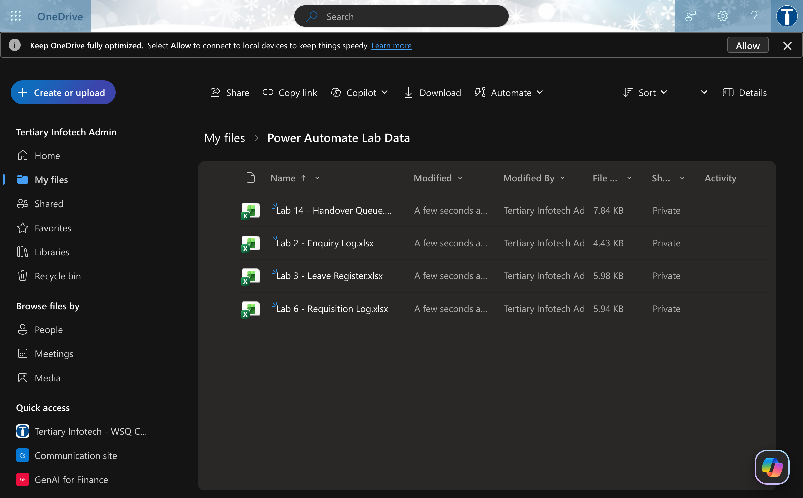
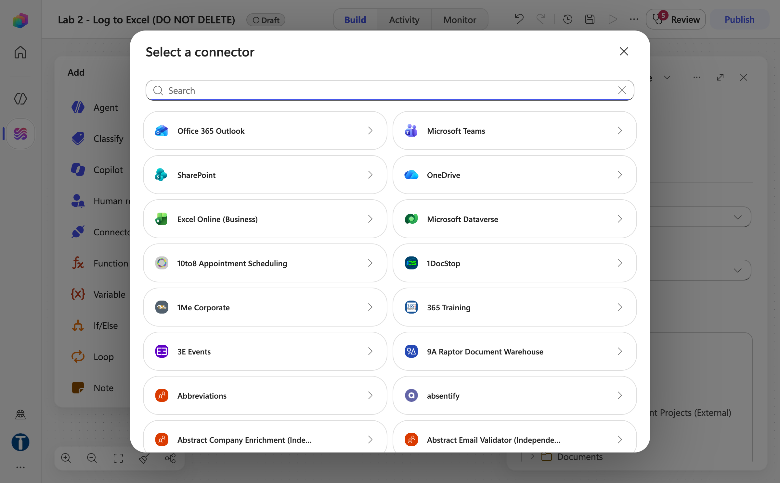
MODULE 1 · LAB 2 · SCREENSHOTS
Lab 2 — What You Will See
Onedrive power automate lab data
Select a connector excel online
Business Process Automation with Power Automate & Copilot Studio Agents · TGS-2022017524 · © 2026 Tertiary Infotech Academy Pte Ltd
48

Slide 49
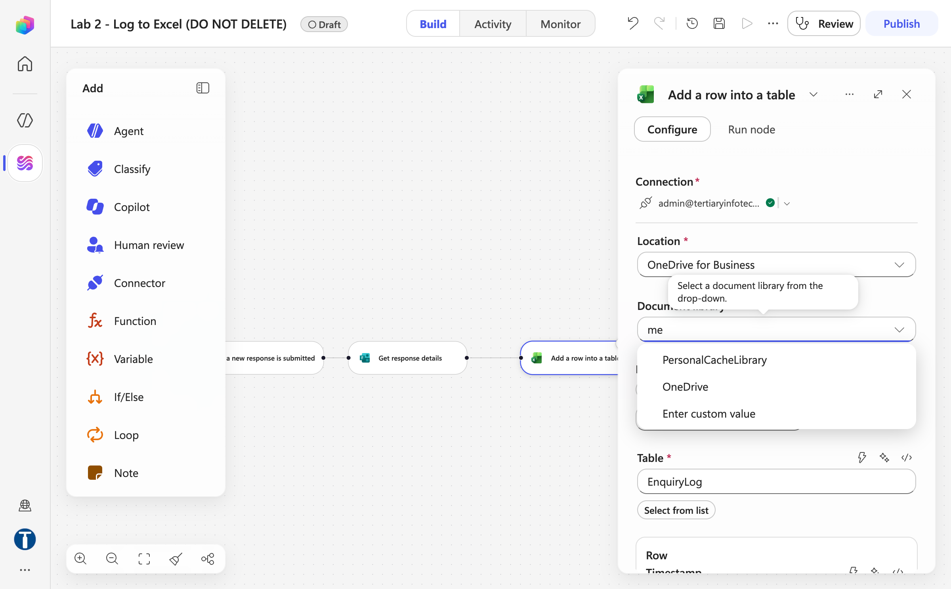
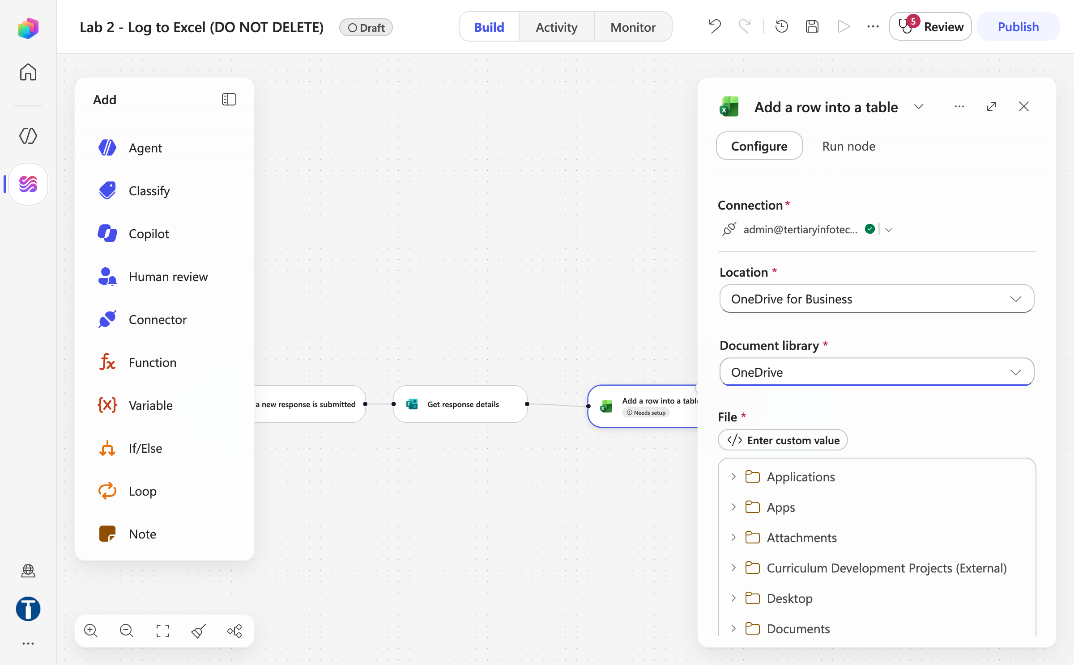
MODULE 1 · LAB 2 · SCREENSHOTS
Lab 2 — What You Will See (continued)
Document library dropdown
File picker onedrive folders
Business Process Automation with Power Automate & Copilot Studio Agents · TGS-2022017524 · © 2026 Tertiary Infotech Academy Pte Ltd
49

Slide 50
MODULE 2
Control Flow and Human in the Loop
If/Else, Compose, Switch, Loop · in / on / out of the loop · Human review via Teams or Outlook · the Classify node · autonomous business processes
Applied in Lab 3 and Lab 4
Business Process Automation with Power Automate & Copilot Studio Agents · TGS-2022017524 · © 2026 Tertiary Infotech Academy Pte Ltd
50

Slide 51
MODULE 2 · CONCEPT
If/Else — Left Value, Operator, Right Value
An If/Else node evaluates one condition row: a left value, an operator, and a right value.
LEFT VALUE
OPERATOR
RIGHT VALUE
A ⚡ token from an earlier node
e.g. Outcome (Human review)
Equals · Not equals · Contains ·
Greater than · Less than · Is empty
A literal you type
e.g. Yes · Approve · Priority
Outcome Equals Yes
IF — condition true
ELSE — condition false
• Reply to the email with the approved draft
• Send the hand-over email to the trainer — never fall silent
Lab 3: Outcome Equals Approve (Approvals connector). Labs 4 and 14: Outcome Equals Yes (Human review — it publishes the string Yes, not a boolean).
Business Process Automation with Power Automate & Copilot Studio Agents · TGS-2022017524 · © 2026 Tertiary Infotech Academy Pte Ltd
51

Slide 52
MODULE 2 · CONCEPT
Conditions — Both Paths Must Exist
Both branches must be built — including the one you hope never runs. Add rows for AND / OR groups.
Empty Else is a silent failure
The picker's type can lie
1
A rejected leave request that triggers nothing is an applicant waiting forever. Route every Else to a message or a named person.
2
Human review's Yes/No input shows as boolean but publishes the string Yes. Read the node's real Outputs in Activity.
Re-pick after rebuilding an input
Test both paths
3
Delete and re-create an input and the old token renders fine but resolves to empty — every run falls to Else.
4
Lab 3 tests an approval and a rejection; Lab 4 sends one email per category; Lab 14 approves one draft and rejects one.
LAB 3
Lab 3 — Leave Application Approval
The workflow pauses for a manager · Copilot Studio workflow + Approvals + Outlook · 35 min
Business Process Automation with Power Automate & Copilot Studio Agents · TGS-2022017524 · © 2026 Tertiary Infotech Academy Pte Ltd
52

Slide 53
MODULE 2 · CONCEPT
Compose, Function and Variable — Named Values
Compose is a named value holder: it takes any input, and its Outputs token is what every later step references.
reference
Trigger body
(raw)
Compose
Normalise
Outputs
⚡ token
Agent node · Excel ·
SharePoint
Normalise input
Hold a computed value
toUpper(trim(triggerBody()?['nric'])) — one canonical form before the lookup and the record.
concat('REQ-', formatDateTime(utcNow(),'yyyyMMdd'), '-', …) — generated once, used by Excel and the reply (Lab 6).
Build a prompt
Variable vs Compose
Assemble the retrieved brochure text and the visitor's question into one block for the Agent node (Lab 16).
Initialize / Set / Append variable when the value changes during the run (loops, counters). Compose when it is written once.
Function → Data Operations → Compose. Rename the node with one word (no spaces) so its token stays readable.
Business Process Automation with Power Automate & Copilot Studio Agents · TGS-2022017524 · © 2026 Tertiary Infotech Academy Pte Ltd
53

Slide 54
MODULE 2 · CONCEPT
Switch and Loop
When one condition is not enough: Switch for many cases, Loop for many items.
SWITCH — one value, many branches
LOOP — repeat over a list
• On: a ⚡ token (e.g. Leave Type, category)
• For each: every item in an array (Get items rows, attachments)
• Case Annual · Case Medical · Case Unpaid · Default
• Do until: repeat until a condition is true
• Each case is its own branch of steps
• Steps inside see the current item token
• Default catches what you did not foresee
• Arrays need join() before they reach Excel or a text field
Lab 4 uses the Classify node's ports instead of a Switch — the category is a port, not a value you compare.
Keep branches short. A branch that grows past four steps is usually a child workflow waiting to be extracted.
Business Process Automation with Power Automate & Copilot Studio Agents · TGS-2022017524 · © 2026 Tertiary Infotech Academy Pte Ltd
54

Slide 55
MODULE 2 · CONCEPT
Human In, On, and Out of the Loop
Three arrangements that people use interchangeably, and that are not the same thing.
Pattern
Who decides
Who acts
Can AI proceed alone?
Human IN the loop
AI proposes, human decides
Human authorises, system acts
NO — it blocks
Human ON the loop
AI decides and acts
Human monitors, can intervene
Yes — after the fact
Human OUT of the loop
AI decides and acts
AI acts
Yes — nobody checks
WHERE THIS COURSE PUTS THE HUMAN
IN the loop: Lab 3 (a manager approves leave), Lab 4 (Priority emails stop in Teams), Lab 14 (an adviser approves a draft), Lab 9 (the manager agent shows the final draft).
OUT of the loop on purpose: Labs 12, 13, 15 and 16 — so you can see what that costs. The pause IS the deliverable.
LAB 3
Lab 3 — Leave Application Approval
The workflow pauses for a manager · Copilot Studio workflow + Approvals + Outlook · 35 min
Business Process Automation with Power Automate & Copilot Studio Agents · TGS-2022017524 · © 2026 Tertiary Infotech Academy Pte Ltd
55

Slide 56
MODULE 2 · CONCEPT
Human Review — Teams or Outlook/Email?
The Human review node has a Channel dropdown: Teams or Outlook. Where the request lands decides whether it is ever answered.
TEAMS — the Workflows bot chat
OUTLOOK / EMAIL
• An adaptive card: Request information | Microsoft Copilot Studio
• Request for information arrives as an actionable email with a form and Submit
• Approver answers inline; the run resumes in a minute or two
• The docs describe RFI as Outlook-delivered; on our tenant the mail never arrived
• Verified reliable on our tenant — the default for Labs 4 and 14
• Approvals connector (classic): email + Teams Approvals app, Approve/Reject buttons
• Best when the approver lives in Teams all day
• Best for approvers outside Teams, or a formal audit trail by mail
Mechanism
Where
What comes back
Human review node — Channel: Teams
Labs 4, 14
Inputs you define (Outcome Yes/No, Name); first responder wins
Approvals — Start and wait for an approval
Lab 3
Approve/Reject – First to respond; Outcome, Responses Comments
Request human assistance when unsure (Agent node)
Never as a gate
Fires only if the model feels unsure — not a control
Business Process Automation with Power Automate & Copilot Studio Agents · TGS-2022017524 · © 2026 Tertiary Infotech Academy Pte Ltd
56

Slide 57
MODULE 2 · CONCEPT
The Human Review Node — A Gate That Blocks
Add a step → Human review → Request for information. It does nothing at all except wait.
Title · Message · Assigned to
Inputs are mandatory
1
Message = ⚡ the agent's summary or draft. Assigned to = a tenant user; type, wait for the directory lookup, click the suggestion.
2
Add an input: Text · Yes/No · Email · Number · Date. Define Outcome (Yes/No) and Name (Text), no defaults, no spaces in names.
What it publishes
Then If/Else
3
Only the inputs you defined, plus responderObjectId. There is no built-in outcome property — a hand-typed reference silently never matches.
4
Outcome (⚡) Equals Yes. The Yes/No input publishes the string Yes, so compare against Yes, not true.
THE TEST OF A REAL GATE
Submit, then open Activity. The run says Running — and it will still say Running tomorrow. Nothing times out, nothing defaults, nothing proceeds until a person answers.
LAB 4
Lab 4 — Email Classification
An inbox workflow that sorts, replies, books and escalates · Copilot Studio workflow + Outlook + Classify + Human review + Teams · 45 min
Business Process Automation with Power Automate & Copilot Studio Agents · TGS-2022017524 · © 2026 Tertiary Infotech Academy Pte Ltd
57

Slide 58
MODULE 2 · CONCEPT
What Is a Control, and What Only Looks Like One
Three things in the designer look like "a human checks". Only one of them is a control.
Mechanism
What it is
Fires when
Audit trail
Control?
Human review (node)
A gate in the workflow
Always
Outcome + responder ID recorded
YES
Request human assistance when unsure (Agent node toggle)
The agent emailing the connection owner
Only if the model feels unsure
None
NO
Request information (agent tool)
Same, exposed as a tool the agent may call
When the agent decides
None
NO
The toggle and the tool both let a confidently wrong output through untouched — which is the failure that matters.
DEFAULT VALUES ARE A DESIGN DECISION
Pre-filling Outcome with Yes turns the gate into a rubber stamp: confirming takes no thought, rejecting takes noticing. Leave it blank; if a default is forced, fail safe.
Business Process Automation with Power Automate & Copilot Studio Agents · TGS-2022017524 · © 2026 Tertiary Infotech Academy Pte Ltd
58

Slide 59
MODULE 2 · CONCEPT
How an Approval Suspends a Running Workflow
action
pause
decision
resume
Form
submitted
Start and wait
for an approval
The run
SUSPENDS
Manager responds
(Teams / email)
If/Else reads
the Outcome
OUTCOME = APPROVE
OUTCOME = REJECT (Else)
• Send the approval email with the manager's Responses Comments; log the decision
• Send the rejection with the comments — routed to the applicant, never to silence
APPROVALS CONNECTOR SETTINGS THAT MATTER
Approval type: Approve/Reject – First to respond. Title with the ⚡ Name token. Assigned to: click the resolved suggestion (a typed-and-tabbed address fails at run time). Details: labelled lines with ⚡ tokens.
LAB 3
Lab 3 — Leave Application Approval
The workflow pauses for a manager · Copilot Studio workflow + Approvals + Outlook · 35 min
Business Process Automation with Power Automate & Copilot Studio Agents · TGS-2022017524 · © 2026 Tertiary Infotech Academy Pte Ltd
59

Slide 60
MODULE 2 · CONCEPT
The Classify Node — Categories, Examples, Ports
The Classify node is a native AI step: it reads text and routes the run out of the port that matches.
CONFIGURE
WHAT COMES OUT
• Model picker (Claude Sonnet 4.6 is the cheap, reliable choice)
• One output port per category — connect a handler to each
• Instruction with ⚡ tokens: Subject, From, Body, Importance
• The chosen category and the model's reasoning appear in run details
• Categories: name + one-line description; Add more categories
• Ambiguous text should land in Other, not be forced into a category
• Add example per category to sharpen the boundary
• Built-in Other — the fail-safe when nothing fits
• Downstream nodes see the trigger's tokens as they flow through
Five categories in Lab 4: Meeting · Need Reply · Priority · Informational · Other. Every port does something visible so a test can prove which path ran.
LAB 4
Lab 4 — Email Classification
An inbox workflow that sorts, replies, books and escalates · Copilot Studio workflow + Outlook + Classify + Human review + Teams · 45 min
Business Process Automation with Power Automate & Copilot Studio Agents · TGS-2022017524 · © 2026 Tertiary Infotech Academy Pte Ltd
60

Slide 61
MODULE 2 · CONCEPT
Email Classification — The Lab 4 Architecture
Lab 4 on one slide: an Outlook trigger, one Classify node, five ports, and a human on the Priority path.
When a new email
arrives (V3)
Classify
5 categories
Meeting
Agent extracts title/start/end → Create event → acknowledge
Need Reply
Agent drafts → Reply to email (V3)
Priority
Agent summarises → Human review (Teams) → If Outcome Equals Yes → reply, else hand over
Informational
Flag email (V2)
Other
Move email (V2) to folder Other
Test with five emails, one per category. The Priority case proves the gate: the run waits in Teams until you answer.
Business Process Automation with Power Automate & Copilot Studio Agents · TGS-2022017524 · © 2026 Tertiary Infotech Academy Pte Ltd
61

Slide 62
MODULE 2 · CONCEPT
Autonomous Business Processes
An autonomous business process = an event trigger + deterministic steps + AI judgement steps + a human checkpoint where it matters.
structured
if needed
Event
trigger
Normalise
(Compose)
Agent node
judgement
Human review
checkpoint
Act across
systems
Notify
Workflows absorbed AI in 2026
Two directions
Agent node (Mar), Prompt and M365 Copilot nodes (May), workflows as agent tools (Jul), the GitHub Copilot harness GA (3 Aug).
A workflow can call an agent (Agent node — Lab 10); an agent can call a workflow as a tool (When an agent calls the flow — Lab 11).
Deterministic backbone
Recovery
The same input always produces the same path — consistent execution, end-to-end visibility in Activity.
The harness retries and finds alternative paths inside an agent step; the workflow around it still fails loudly at a named node.
Business Process Automation with Power Automate & Copilot Studio Agents · TGS-2022017524 · © 2026 Tertiary Infotech Academy Pte Ltd
62

Slide 63
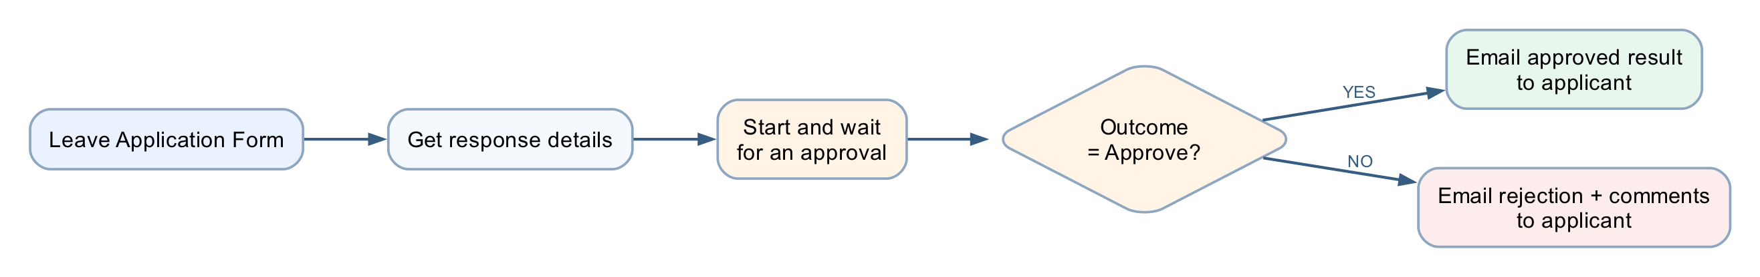
MODULE 2 · LAB 3 · HANDS-ON
Lab 3 — Leave Application Approval
LAB 3
35 MIN
DAY 1
The workflow pauses for a manager
What it teaches
A running workflow suspends at the approval action and branches with If/Else on the human decision.
Platform
Copilot Studio workflow + Approvals + Outlook
Tenant artefact names
Lab 3 - Leave Application Approval · Lab 3 - Leave Application Form · Lab 3 - Leave Register.xlsx
Trainer copies end (DO NOT DELETE). Name yours plainly — agent names 30 characters or fewer.
Business Process Automation with Power Automate & Copilot Studio Agents · TGS-2022017524 · © 2026 Tertiary Infotech Academy Pte Ltd
63

Slide 64
MODULE 2 · LAB 3 · BUILD
Lab 3 — Build Steps
Forms → Lab 3 - Leave Application Form: Name, Leave from date, Leave end date, Leave Type, Reason for Leave.
New workflow Lab 3 - Leave Application Approval → Forms trigger → Get response details.
1
2
+ → Human review (Channel Microsoft Teams, never Outlook); Assigned to = your address; Title with the ⚡ Name token; Details = labelled ⚡ lines.
Add an input → Yes/No named Outcome; Add an input → Text named Comments — the only inputs the card will show.
3
4
+ → If/Else: ⚡ Outcome (Yes/No output) Equals Yes.
If: Send an email (V2) approved, with the ⚡ Comments text output. Else: not approved, with the comments.
5
6
Save → Publish → submit → answer the card in the Teams Workflows chat; submit again and choose No. Both emails must arrive.
Optional Part F: Add a row into Lab 3 - Leave Register.xlsx with the decision.
7
8
Business Process Automation with Power Automate & Copilot Studio Agents · TGS-2022017524 · © 2026 Tertiary Infotech Academy Pte Ltd
64

Slide 65
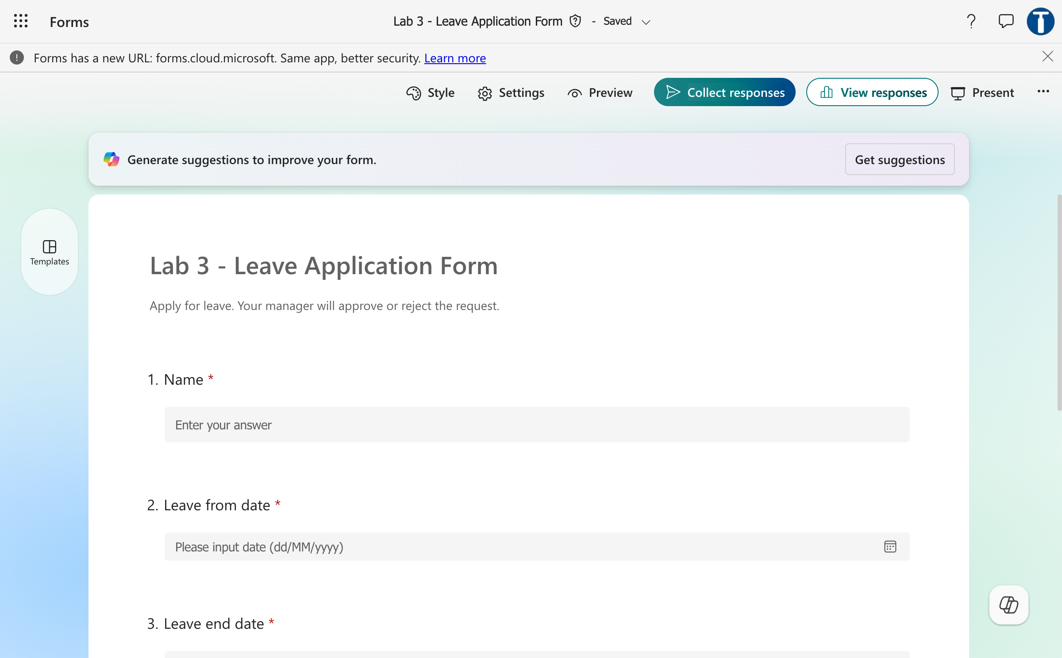
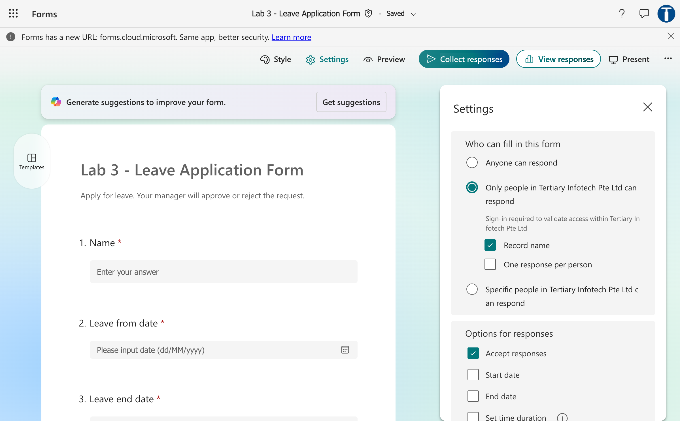
MODULE 2 · LAB 3 · SCREENSHOTS
Lab 3 — What You Will See
Leave application form
Leave form settings
Business Process Automation with Power Automate & Copilot Studio Agents · TGS-2022017524 · © 2026 Tertiary Infotech Academy Pte Ltd
65

Slide 66
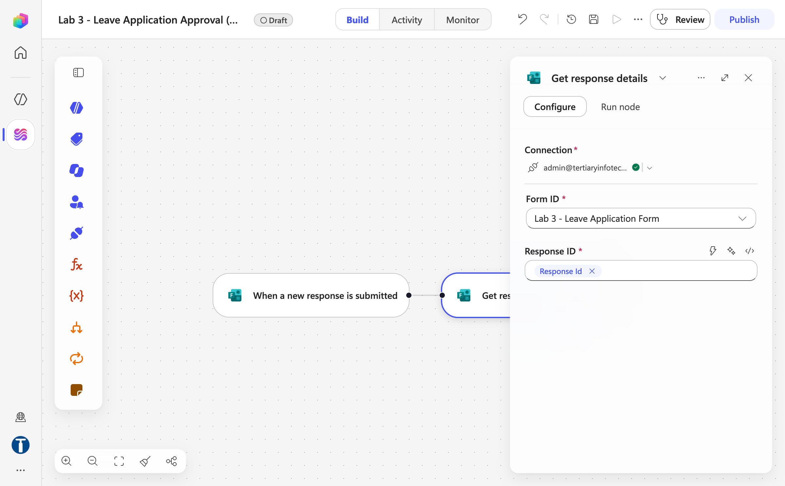
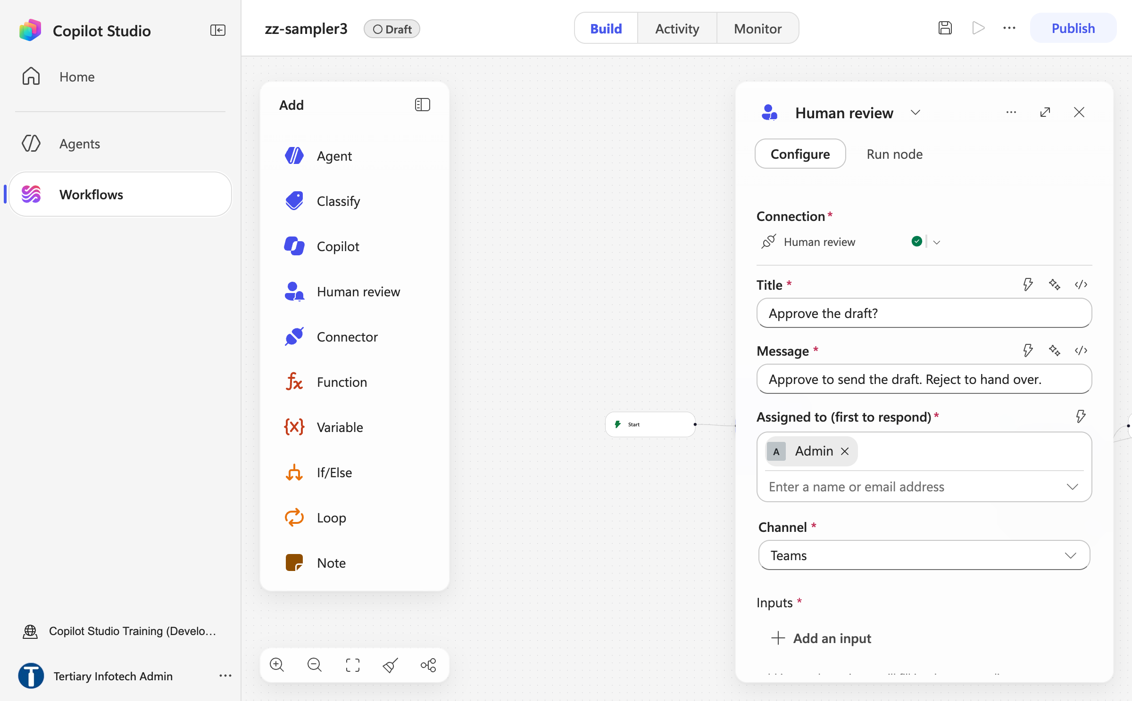
MODULE 2 · LAB 3 · SCREENSHOTS
Lab 3 — What You Will See (continued)
Get response details
Human review panel
Business Process Automation with Power Automate & Copilot Studio Agents · TGS-2022017524 · © 2026 Tertiary Infotech Academy Pte Ltd
66

Slide 67
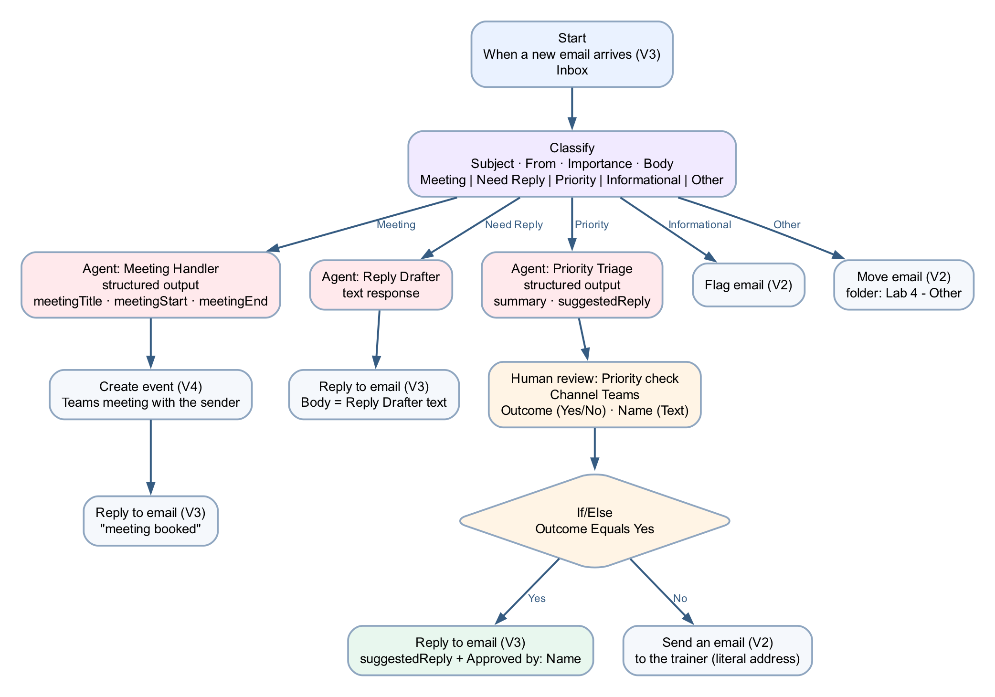
MODULE 2 · LAB 4 · HANDS-ON
Lab 4 — Email Classification
LAB 4
45 MIN
DAY 1
An inbox workflow that sorts, replies, books and escalates
What it teaches
The Classify node sorts each email into five categories; each port runs a deterministic handler, and the Priority branch stops at a human in Teams.
Platform
Copilot Studio workflow + Outlook + Classify + Human review + Teams
Tenant artefact names
Lab 4 - Email Classification · Lab 4 - Other
Trainer copies end (DO NOT DELETE). Name yours plainly — agent names 30 characters or fewer.
Business Process Automation with Power Automate & Copilot Studio Agents · TGS-2022017524 · © 2026 Tertiary Infotech Academy Pte Ltd
67

Slide 68
MODULE 2 · LAB 4 · BUILD
Lab 4 — Build Steps
Outlook → create the folder Other under Inbox.
New workflow Lab 4 - Email Classification → Start → Connector → Office 365 Outlook → When a new email arrives (V3), folder Inbox.
1
2
+ → Classify: model Claude Sonnet 4.6; instruction with ⚡ Subject, From, Body, Importance; categories Meeting, Need Reply, Priority, Informational (+ Other).
Meeting port: Agent (structured output: title, start, end) → Create event (V4) → Send an email (V2) acknowledgement.
3
4
Need Reply port: Agent Reply Drafter → Reply to email (V3) with the draft.
Priority port: Agent summarises → Human review (Channel Teams; inputs Outcome Yes/No, Name) → If Outcome Equals Yes → reply; Else → hand-over email.
5
6
Informational: Flag email (V2). Other: Move email (V2) to Other. Tidy up → Save → Publish.
Send five test emails, one per category; answer the Priority card in the Teams Workflows chat; check Activity.
7
8
Business Process Automation with Power Automate & Copilot Studio Agents · TGS-2022017524 · © 2026 Tertiary Infotech Academy Pte Ltd
68

Slide 69
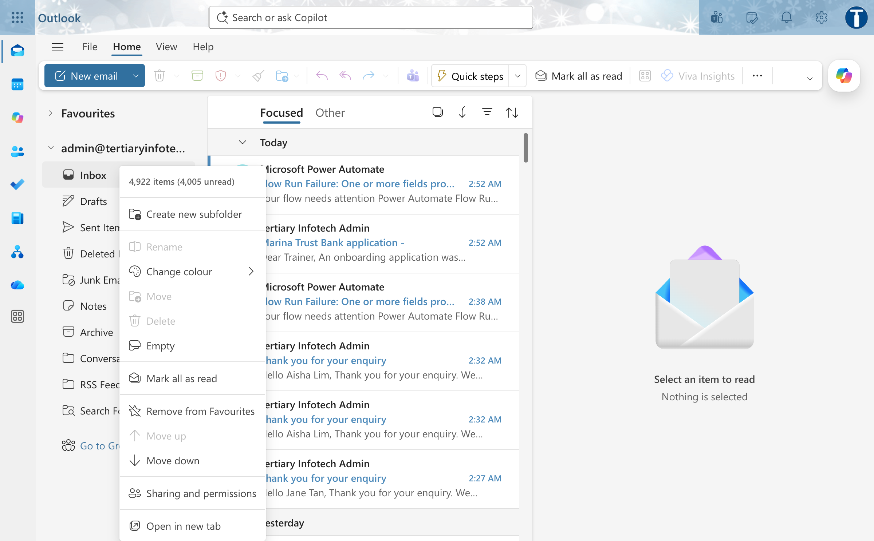
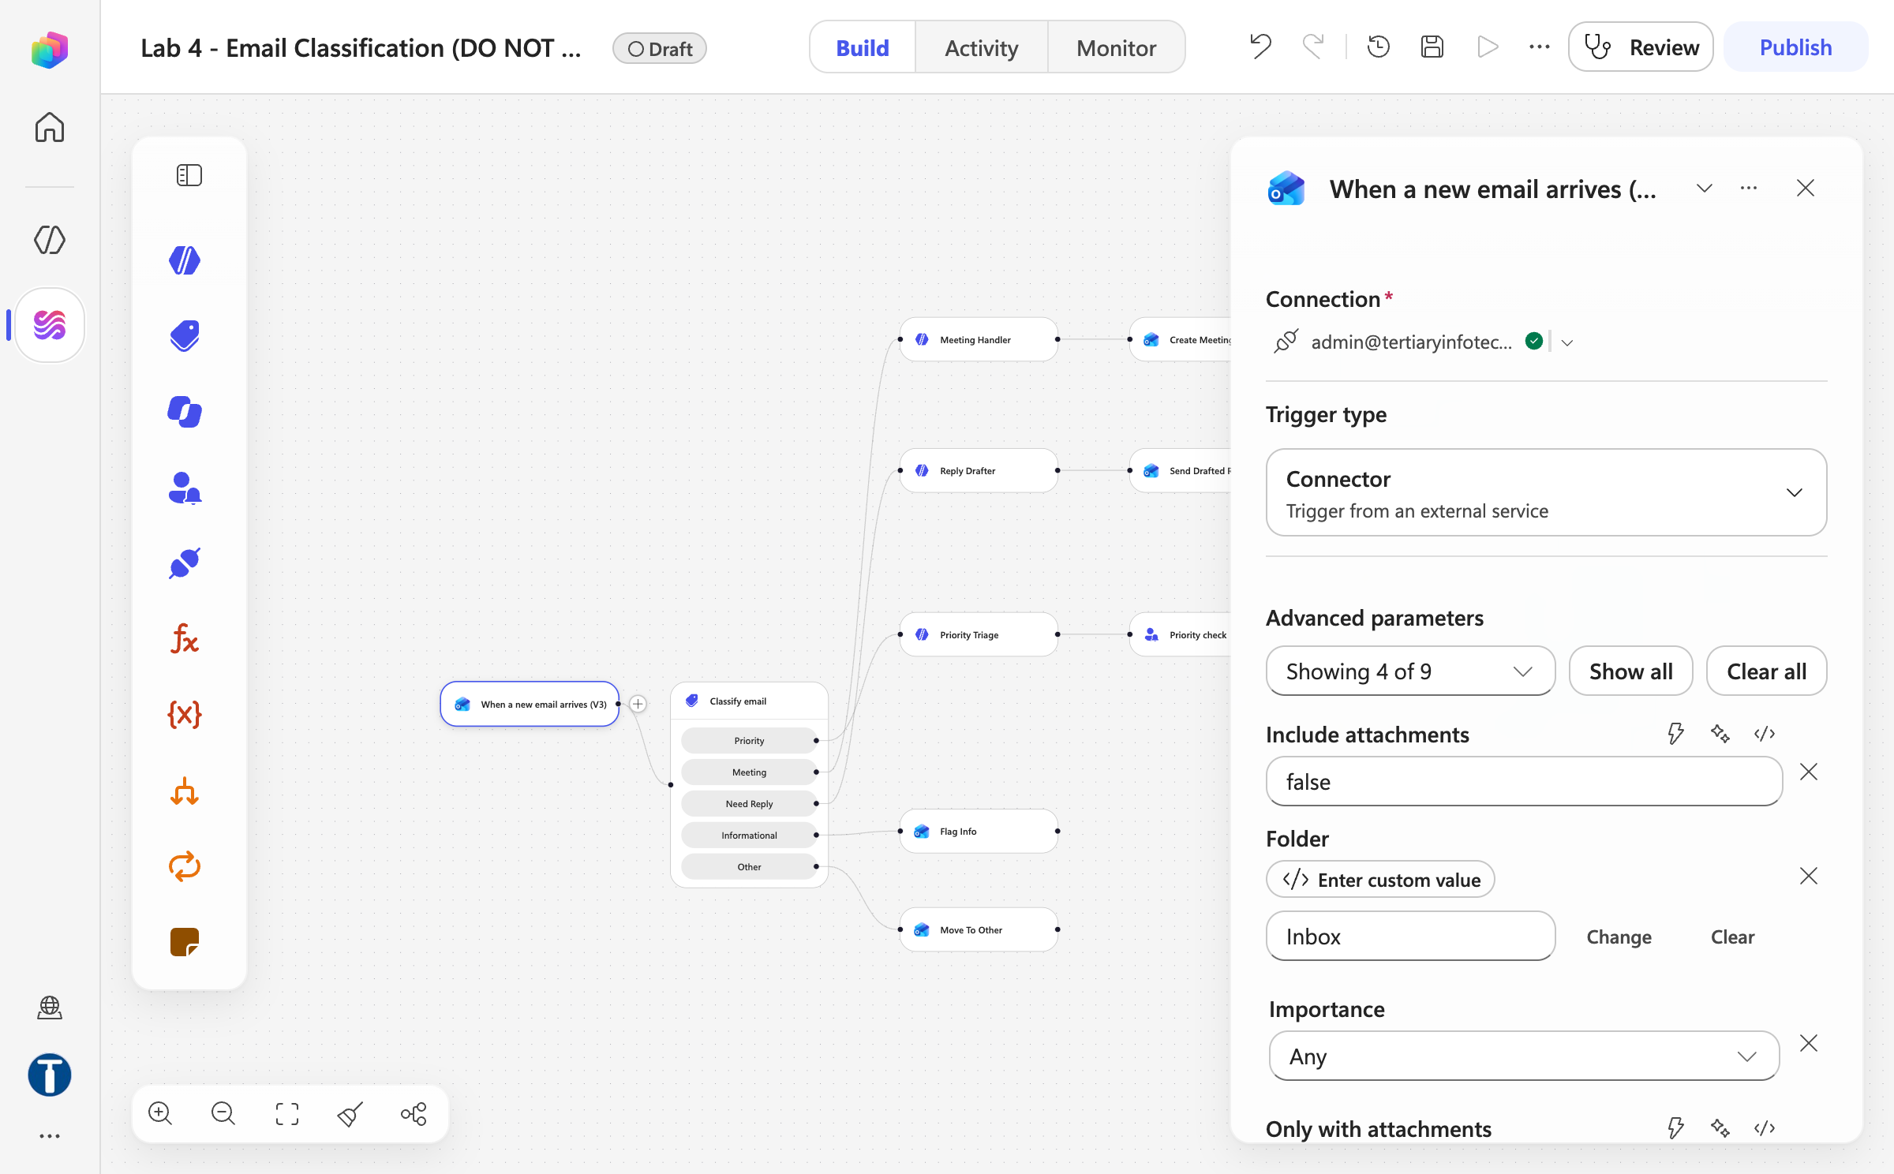
MODULE 2 · LAB 4 · SCREENSHOTS
Lab 4 — What You Will See
Outlook create new subfolder
Outlook trigger panel
Business Process Automation with Power Automate & Copilot Studio Agents · TGS-2022017524 · © 2026 Tertiary Infotech Academy Pte Ltd
69

Slide 70
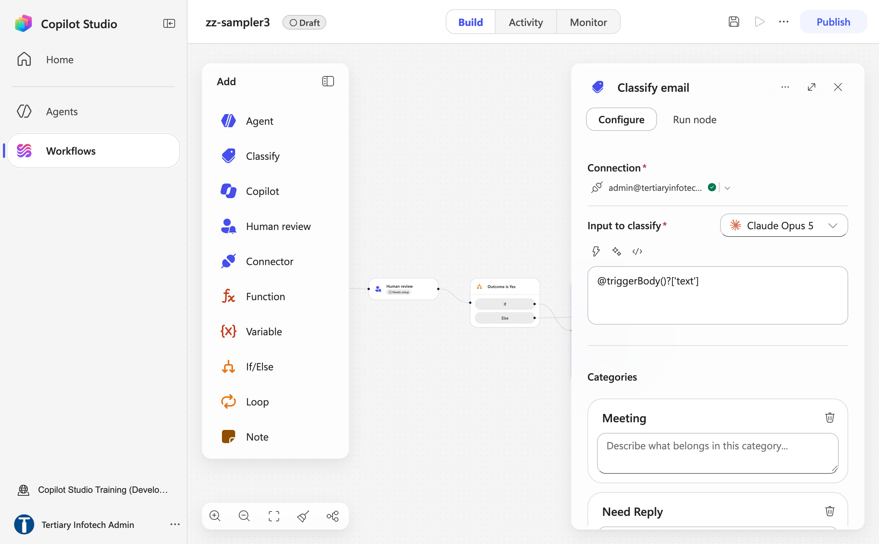
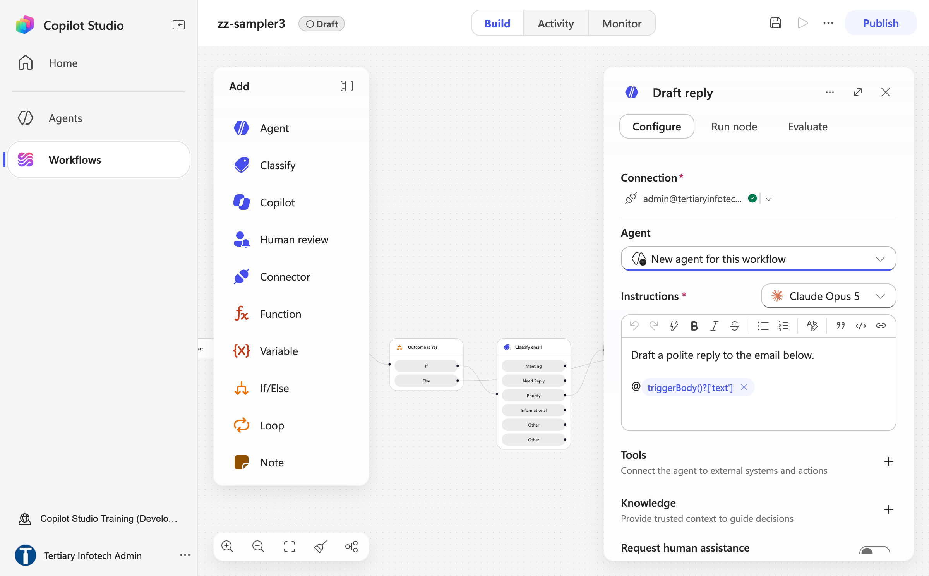
MODULE 2 · LAB 4 · SCREENSHOTS
Lab 4 — What You Will See (continued)
Classify node panel
Agent node instructions
Business Process Automation with Power Automate & Copilot Studio Agents · TGS-2022017524 · © 2026 Tertiary Infotech Academy Pte Ltd
70

Slide 71
MODULE 3
Copilot Studio Agents
The designer · instructions, model, knowledge · skills, tools, MCP · what is enforced · connected agents, memory · Preview, Evaluate, Monitor · publishing and channels
Applied in Labs 5–11 and Lab 17
Business Process Automation with Power Automate & Copilot Studio Agents · TGS-2022017524 · © 2026 Tertiary Infotech Academy Pte Ltd
71

Slide 72
MODULE 3 · CONCEPT
Workflow or Agent — They Fail Differently
WORKFLOW — deterministic
AGENT — the harness reasons
• You decide the path in advance
• It chooses the path at run time
• The same input always gives the same output
• The same input may give a different answer
• It can only do what you built
• It combines what it was given in new ways
• It fails loudly, at a named node
• It fails quietly, with a confident wrong answer
• You test it by checking the result
• You test it by trying to break it
Use a workflow where the rule is known. Use an agent where the language varies. Most real systems need both.
Labs 1–4 are workflows with AI nodes. Labs 5–9 are agents. Labs 10–16 are both, and the seam between them is the lesson.
Business Process Automation with Power Automate & Copilot Studio Agents · TGS-2022017524 · © 2026 Tertiary Infotech Academy Pte Ltd
72

Slide 73
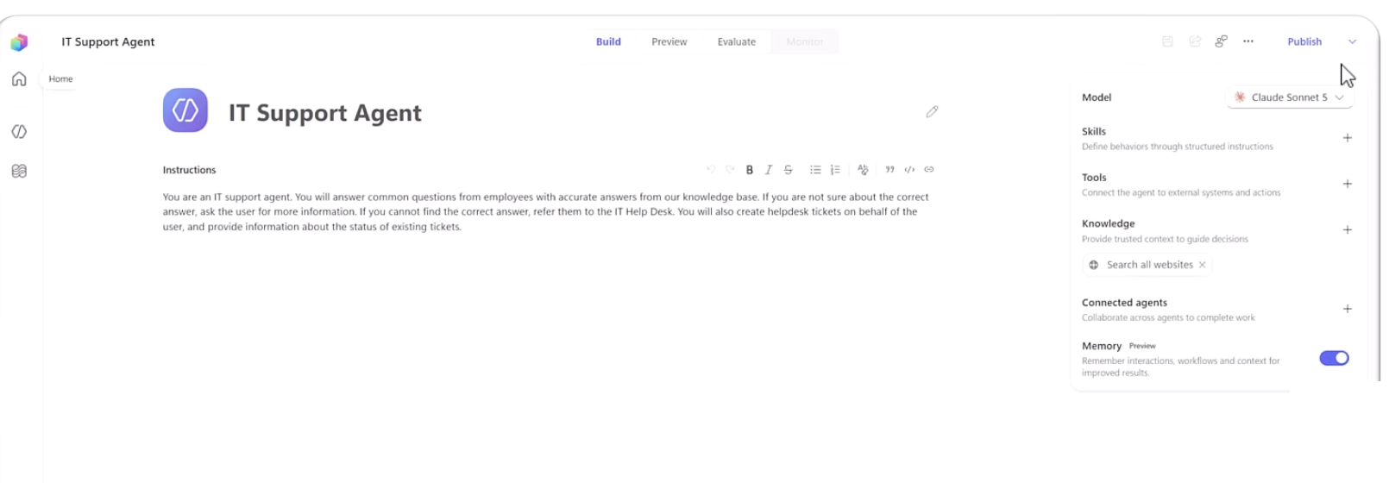
MODULE 3 · CONCEPT
The Agent Designer — Build, Preview, Evaluate, Monitor
New agent opens one page. Top bar: name · Build | Preview | Evaluate | Monitor · Save · Share · Settings · … · Publish.
Build
Preview
Evaluate
Monitor
Identity, Instructions, Model, Channels, Skills, Tools, Knowledge, Connected agents, Memory
Chat with the latest saved draft; End user preview toggle; reasoning card and activity trace
Named test sets of conversations; General quality test method; compare agent versions
Recent tasks, files the agent accessed, activity — and the Copilot Credits it consumed
Lifecycle: Create → Build → Test (Preview, Evaluate) → Publish → Monitor. Credits are consumed at every step after Create.
Business Process Automation with Power Automate & Copilot Studio Agents · TGS-2022017524 · © 2026 Tertiary Infotech Academy Pte Ltd
73

Slide 74
MODULE 3 · CONCEPT
Inside the Build Tab
The Build tab: name and Instructions in the centre; the components panel on the right, top to bottom.
CENTRE COLUMN
Right panel
Caption in the product
Agent icon + name box — click Untitled Agent, type, Enter.
Instructions — a large rich-text box with a small toolbar. This is the ONLY place the system instructions go. Paste the whole agent/instructions.md here.
There is no separate system prompt, description or settings page for it.
Model
Default Claude Opus 5; other models selectable
Channels +
Define where users can interact with the agent
Skills +
Define behaviors through structured instructions — upload SKILL.md or a .zip
Tools +
Connect the agent to external systems and actions — connectors, workflows, MCP
Knowledge +
Provide trusted context — files, SharePoint, websites; remove Search all websites ×
Connected agents +
Collaborate across agents to complete work
Memory (Preview)
Remember interactions, workflows and context — off by default
Business Process Automation with Power Automate & Copilot Studio Agents · TGS-2022017524 · © 2026 Tertiary Infotech Academy Pte Ltd
74

Slide 75
MODULE 3 · CONCEPT
Natural-Language Authoring (Preview)
Natural-language authoring (preview): describe the process on the Home page and Copilot Studio proposes the artefacts.
submit
cards
Home → type the
process
Workflow or
Conversational agent chip
Clarifying
questions
Steps and
Artifacts panel
Edit each card
in the canvas
What it decides
Models and credits
A deterministic workflow, a conversational agent, or a combination of both — it may ask you to configure a connection (e.g. email).
May use Anthropic models if your admin allows external models; every generation consumes Copilot Credits.
Then the same loop
In this course
Preview to chat, Build to edit instructions, Save; the next turn picks up the change. Chat history is kept 28 days.
We build by hand so you can name every node. Try it on Day 2: paste a lab scenario and compare what it proposes with what you built.
Business Process Automation with Power Automate & Copilot Studio Agents · TGS-2022017524 · © 2026 Tertiary Infotech Academy Pte Ltd
75

Slide 76
MODULE 3 · CONCEPT
Writing Instructions That Constrain
Instructions are prose, but they are not free text. Six things every agent instruction in this course states.
Role
Scope
Tone
1
"You are the HR policy assistant for Keppel Ridge." One identity, one line.
2
What it helps with, and the list of subjects it declines or redirects.
3
Plain professional English; short answers; no jargon the employee did not use.
When to ask
When to use knowledge
When to act / escalate
4
Ambiguous input → one clarifying question, not a guess.
5
Answer only from the connected source; say so when the source is silent.
6
Which tool to call, and the trigger that hands the person to HR with no follow-up questions.
Iterate in Preview: change one thing, Save, re-run only the failing test. The next turn picks up your change automatically.
LAB 5
Lab 5 — Your First Agent
An HR agent: instructions, knowledge, test, publish · Copilot Studio (new experience) · 35 min
Business Process Automation with Power Automate & Copilot Studio Agents · TGS-2022017524 · © 2026 Tertiary Infotech Academy Pte Ltd
76

Slide 77
MODULE 3 · CONCEPT
Worked Example — The HR Agent Instructions
The Lab 5 HR Agent instructions, section by section — the shape you will reuse for Procurement, Sales and IT Support.
Section heading in instructions.md
What it says
Where your answers come from
Only the HR Policies handbook attached as knowledge. Never the open web, never your own knowledge of employment law.
What you must never do
Discuss, estimate or infer another named person's leave, pay or records. Any number about someone else is a failure.
Matters you escalate immediately
Harassment, discrimination, grievances: give hr@keppelridge.example and ask NO follow-up questions.
Identifying who you are speaking to
You are speaking to the signed-in employee; treat every question as about them unless told otherwise.
When you do not know
Say the handbook does not cover it and point to HR. Never include citation markers, reference numbers or source tags.
Tone
Warm, brief, plain English; answer first, then the one condition that applies (e.g. line-manager approval).
LAB 5
Lab 5 — Your First Agent
An HR agent: instructions, knowledge, test, publish · Copilot Studio (new experience) · 35 min
Business Process Automation with Power Automate & Copilot Studio Agents · TGS-2022017524 · © 2026 Tertiary Infotech Academy Pte Ltd
77

Slide 78
MODULE 3 · CONCEPT
The Instructions Box Is a Rich-Text Editor
The Instructions box is a rich-text editor — in the agent designer AND in the workflow Agent node.
DO
DO NOT
• Type the prose, leave a gap, insert each value with the ⚡ picker or a / command
• Paste @{...} or body('Node')?['x'] into the box — it escapes underscores and mangles references
• Paste plain Markdown from instructions.md
• Copy a workflow and trust its Instructions tokens — they resolve to EMPTY
• Rename nodes to one word so tokens read cleanly
• Drag a node after configuring it — moving a node clears its configuration
• Change one thing per Preview cycle
• Assume there is a separate user-message field: there is none
A reference to nothing resolves to empty, not to an error. The run is green, the model received nothing.
THE AGENT NODE'S CONFIGURE TAB, TOP TO BOTTOM
Connection · Agent (model picker) · Instructions · Microsoft IQ · Tools · Knowledge · Request human assistance · Web search · Output. Output is the last field.
Business Process Automation with Power Automate & Copilot Studio Agents · TGS-2022017524 · © 2026 Tertiary Infotech Academy Pte Ltd
78

Slide 79
MODULE 3 · CONCEPT
Choosing the Model
The Model dropdown at the top of the right panel. The default is Claude Opus 5; the choice is a design decision, per agent and per Agent node.
Model
Character
Used where
Claude Opus 5 (default)
Deep reasoning, long multi-step work
Agents in Labs 5–9, 11, 17
Claude Sonnet 5 / Sonnet 4.6
Fast and cheaper; GA; Sonnet 5 only on the GitHub Copilot harness
Classify and Agent nodes in Labs 4, 12–16
GPT-5.5 Chat / GPT-5.6
OpenAI models, GA; cross-geo for Singapore
Alternative — re-run the tests after switching
Fable 5 · Mistral Medium 3.5
Experimental / preview tags
Demo only — never in a published agent
Tags
Admin prerequisites
Same instructions, different behaviour
Deep · Auto · General; release types Experimental, Preview, Generally available, Default, Retired, Cross-geo.
Preview and experimental AI models; Move data across regions; Turn on external models in PPAC; provider consent (Anthropic, Mistral, xAI) in the M365 admin center.
A different model follows the same instructions differently. Change the model, then re-run every probe.
Business Process Automation with Power Automate & Copilot Studio Agents · TGS-2022017524 · © 2026 Tertiary Infotech Academy Pte Ltd
79

Slide 80
MODULE 3 · CONCEPT
Knowledge — Giving Facts and Removing Sources
choose
upload
at run time
Files · SharePoint
· Public websites
Knowledge + →
Add knowledge
Indexed —
wait for Ready
Retrieved when a
question matches
Answer with
citations
It is a boundary
Remove Search all websites ×
No general-knowledge toggle
1
2
3
The agent cannot read a document you did not give it. Give it only what it needs — not the staff-leave.csv.
On by default. A fee from the open web is indistinguishable from a fee in your own brochure.
The new harness has none. Grounding rests on the instruction line: answer only from the connected source.
Sources
Folder per lab
Ready means ready
4
5
6
Upload file · Public websites · SharePoint · Azure AI Search · Dataverse · Dynamics 365 · Salesforce · ServiceNow · Azure SQL.
The connector indexes at folder level: Lab 5 - HR Policies, Lab 7 - Course Brochures, Lab 13 - Investment FAQ.
A source still indexing returns nothing; the agent looks broken when it is merely empty.
LAB 5
Lab 5 — Your First Agent
An HR agent: instructions, knowledge, test, publish · Copilot Studio (new experience) · 35 min
Business Process Automation with Power Automate & Copilot Studio Agents · TGS-2022017524 · © 2026 Tertiary Infotech Academy Pte Ltd
80

Slide 81
MODULE 3 · CONCEPT
Richer Context — Microsoft IQ, Work IQ, Foundry IQ — and Citations
Three layers of context beyond your files — and the citation markers grounding leaves in the reply.
1
Microsoft IQ / Work IQ (preview)
2
Foundry IQ (GA)
3
Memory (preview)
The signed-in user's emails, calendar, files, Teams messages and people. A toggle in the Agent node and the agent designer.
Knowledge bases built and tuned in Microsoft Foundry, connected as a source.
Per-user preferences captured across chats — a different thing from knowledge (see the Memory slide).
CITATION MARKERS LEAK — AND DUPLICATE THE ANSWER
With a Knowledge source, replies can arrive twice: once with [doc:turn1doc11] markers, then with [1]-style ones. They are appended by the grounding layer, not written by the model.
Add the line: "Never include citation markers, reference numbers or source tags in your reply." The Pinecone flow (Lab 16) has no markers — retrieved text arrives as plain Compose output.
Turn Work IQ on only for agents that should know who is asking — never for a public website agent.
Business Process Automation with Power Automate & Copilot Studio Agents · TGS-2022017524 · © 2026 Tertiary Infotech Academy Pte Ltd
81

Slide 82
MODULE 3 · CONCEPT
Skills — Instructions on Demand (SKILL.md)
"Skills are self-contained sets of instructions and logic" — instructions on demand, packaged once, added to many agents.
---
name: password-reset-procedure
description: Use when a user says they are locked
out or asks to reset a password. Verifies identity
first, then walks through the reset steps.
---
# Password Reset Procedure
1. Confirm the user's employee ID …
2. Never read a password aloud …
3. Raise a ticket with the tool …
YAML front matter
name (lowercase, numbers, hyphens) + description. The description is the trigger — the orchestrator matches on it.
Markdown body
Task description, step-by-step guidance, formatting rules, edge cases, which tools to use.
Create or upload
Skills + → Add skill → Create from blank, or Upload a skill (a .md, or a .zip with SKILL.md at the root).
Not enforced
A skill is a procedure the model decides to apply, not a permission. The security rule lives in the instructions and in the tools it lacks.
LAB 8
Lab 8 — IT Support Agent with Skills
Five uploaded skill packages, and the one rule none of them can enforce · Copilot Studio agent + skill packages · 30 min
Business Process Automation with Power Automate & Copilot Studio Agents · TGS-2022017524 · © 2026 Tertiary Infotech Academy Pte Ltd
82

Slide 83
MODULE 3 · CONCEPT
Anatomy of a Skill Package
A skill package is a .zip: SKILL.md is the only root-level Markdown; everything else sits in sub-folders.
raise-requisition.zip
├── SKILL.md
├── manual/
│ └── procedure.md
├── templates/
│ └── requisition-summary.md
├── scripts/
│ └── validate.py
└── references/
└── purchasing-policy.md
Folder / step
What goes there
manual/
Longer procedure text the skill can point to
templates/
Output shapes — the summary the agent must produce
scripts/
Deterministic code the harness may run (the BlastBox skills do all arithmetic in Python)
references/
Policy extracts and worked examples
Upload
Skills + → Add skill → Upload a skill → drag the .zip; the system validates and adds it
Replace
Skills → the skill → Replace — re-upload after every edit; export as .md or package to share
Lab 6: raise-requisition + vendor-enquiry. Lab 7: course-enquiry + enrolment-intake. Lab 8: five IT Support packages, uploaded in order.
Business Process Automation with Power Automate & Copilot Studio Agents · TGS-2022017524 · © 2026 Tertiary Infotech Academy Pte Ltd
83

Slide 84
MODULE 3 · CONCEPT
When a Skill Fires
When does a skill fire? When the orchestrator decides the user's message matches the skill's description.
match
User message
Orchestrator reads
skill descriptions
Best match
activated
Skill steps
shape the reply
Activity trace
shows it
Prove it
Two skills that overlap
Preview with End user preview off → open the activity trace → confirm the skill activated and which tools it called.
The orchestrator picks one. Keep descriptions distinct — course-enquiry vs enrolment-intake, not two "help with courses".
If it did not fire
Skills vs instructions
Sharpen the description ("Use when a user asks …"), not the body. Then re-test the same message.
Instructions are always in force. A skill loads only when matched — so a rule that must always hold goes in instructions.
LAB 8
Lab 8 — IT Support Agent with Skills
Five uploaded skill packages, and the one rule none of them can enforce · Copilot Studio agent + skill packages · 30 min
Business Process Automation with Power Automate & Copilot Studio Agents · TGS-2022017524 · © 2026 Tertiary Infotech Academy Pte Ltd
84

Slide 85
MODULE 3 · CONCEPT
Tools — Connectors, Workflows, MCP Servers
Tools let the agent act outside the conversation. Tools + → Add a tool → three types.
Tool type
Best for
Examples
Connectors
Well-known services with pre-built actions
Outlook Send an email, Excel Add a row, SharePoint Create item, Calendar Create event
Workflows
Multi-step, deterministic processes you own
Lab 6 - Raise Requisition; Lab 11 - Blog Writer Tool
MCP servers
Custom or internal services exposing many tools over the Model Context Protocol
Membership MCP, Warehouse MCP, Windows 365 for Agents MCP
THE AGENT'S PART — probabilistic
THE TOOL'S PART — enforced
• Decides that a tool applies, fills its inputs from what the person said
• Validates, looks up, applies the threshold, writes the audit row
• May call the wrong tool, or the right one with the wrong values
• Whatever the agent believed, the workflow's own logic still runs
LAB 6
Lab 6 — Procurement Agent with Tools
A workflow as a tool, and the audit row it writes · Copilot Studio agent + workflow as a tool + Excel Online · 35 min
Business Process Automation with Power Automate & Copilot Studio Agents · TGS-2022017524 · © 2026 Tertiary Infotech Academy Pte Ltd
85

Slide 86
MODULE 3 · CONCEPT
A Workflow as a Tool
A workflow becomes a tool only when it starts with When an agent calls the flow and ends with Respond to the agent.
inputs
When an agent
calls the flow
(typed inputs)
Compose
Reference
Add a row into
a table (Excel)
Respond to the agent
(Reference, Status)
Inputs are the contract
Name and describe the tool
Add an input: Text / Number with a description the agent reads to fill the slot — "Full name of the colleague raising the requisition".
The tool description is how the agent knows when to call it — write it for the model, not for a developer.
Publish, then attach
Verify in the trace
A tool must be the published version; LIVE = CURRENT DRAFT in Version history. Then Tools + → Add a tool → Workflow.
Preview → ask → open the activity trace: which tool was invoked, what arguments, what it returned. Then check Excel.
LAB 6
Lab 6 — Procurement Agent with Tools
A workflow as a tool, and the audit row it writes · Copilot Studio agent + workflow as a tool + Excel Online · 35 min
Business Process Automation with Power Automate & Copilot Studio Agents · TGS-2022017524 · © 2026 Tertiary Infotech Academy Pte Ltd
86

Slide 87
MODULE 3 · CONCEPT
MCP — Model Context Protocol Servers
Model Context Protocol: one server, many tools, one standard interface — the agent discovers the tools at run time.
MCP
tools
read / write
Agent
MCP server
(connector)
get_membership ·
reissue_card · …
System of record
Add it
Trust
Tools + → Add a tool → Model Context Protocol → search the connector → select an existing connection → Add → Save and publish.
Submit your MCP server for Microsoft certification (reliability, security, compliance). Windows 365 for Agents MCP is GA.
Per agent
In this course
MCP connections are attached per agent and must be re-attached after a solution import — a real ALM gotcha.
We use connectors and workflows as tools; MCP is demonstrated with the BlastBox Omega sample (four inline MCP connectors, no external servers).
Business Process Automation with Power Automate & Copilot Studio Agents · TGS-2022017524 · © 2026 Tertiary Infotech Academy Pte Ltd
87

Slide 88
MODULE 3 · CONCEPT
Tools vs Skills vs MCP
Three words that get mixed up. One table to keep them apart.
What it is
When it fires
Enforced?
Example
Tool
An action the agent can call that acts outside the conversation
When the agent decides the action is needed and fills the inputs
The tool's own logic — yes; the decision to call it — no
Send an email (V2); Lab 6 - Raise Requisition
Skill
Instructions on demand — a SKILL.md package that changes how the agent behaves
When the message matches the skill's description
No — the model decides it applies
password-reset-procedure; raise-requisition
MCP server
A server exposing many tools over the Model Context Protocol
The agent discovers and calls its tools like any other tool
The server's logic — yes; the call — no
Membership MCP v2 with get_membership, reissue_card
Knowledge is a fourth thing: data the agent may read. Instructions are a fifth: who it is, always in force.
Migration rule of thumb: topics → instructions/skills; prompts → inline Agent nodes or skills; child agents → connected agents; actions → tools.
Business Process Automation with Power Automate & Copilot Studio Agents · TGS-2022017524 · © 2026 Tertiary Infotech Academy Pte Ltd
88

Slide 89
MODULE 3 · CONCEPT
Which Parts of an Agent Hold — and Which Do Not
The spine of Module 3: which of an agent's parts can the model ignore?
Part
What it is
Enforced?
Instructions
Who the agent is, always in force
NO — probabilistic
Skill
A named procedure for a matching topic
NO — the model decides it applies
Knowledge
Documents the agent may read
PARTLY — it cannot read what it lacks
Tool / MCP
A workflow or action outside the conversation
YES — the tool's own logic is enforced
Connected agent
A separate agent, its own knowledge and tools
YES — the knowledge boundary is real
Channel + authentication
Who can reach the agent at all
YES — a door the model cannot open
A control the model cannot reach beats a rule you asked it to follow.
So: a tool the agent does NOT have is a control. And the schema beats the prompt — a field that exists will eventually be filled.
Business Process Automation with Power Automate & Copilot Studio Agents · TGS-2022017524 · © 2026 Tertiary Infotech Academy Pte Ltd
89

Slide 90
MODULE 3 · CONCEPT
Connected Agents
Connected agents + : "agents your primary agent can invoke during a conversation" — each runs in its own orchestration context.
FRONT-DOOR AGENT
owns the conversation
Policy
agent
Inventory
agent
Screening
agent
Review
agent
Own context
Conversation still flows
Deploy the parent only
Its own instructions, knowledge and tools; the parent sends the message plus relevant history and presents the reply.
What the employee said crosses the boundary. Privacy is a design decision, not automatic.
A connected agent has no channel of its own. Publishing a child creates a door past the parent's rules.
LAB 9
Lab 9 — Multi-Agent Content Team
Manager, Research, Blog and Review — one pipeline, four agents, and a human at the end · Copilot Studio connected agents · 35 min
Business Process Automation with Power Automate & Copilot Studio Agents · TGS-2022017524 · © 2026 Tertiary Infotech Academy Pte Ltd
90

Slide 91
MODULE 3 · CONCEPT
Multi-Agent Orchestration — The Content Team
Lab 9: one topic, four agents, split by stage of work — and a person at the end.
delegates
brief
draft
notes
Marketing Manager
Agent (parent)
Research
Agent
Blog
Agent
Review
Agent
Human approves
the final draft
Build the children first
Why by stage, not by audience
Research (facts + sources) → Blog (draft in house style) → Review (checklist, returns notes) → Manager last.
Each stage has a different definition of done; the manager owns the conversation and the hand-offs.
The manager's instructions
Where the human review really is
Which agent to call for which stage, in what order, and to show the reviewed draft and stop for approval.
The manager presents the final draft and waits; nothing is published by an agent. Read the lab note before teaching.
LAB 9
Lab 9 — Multi-Agent Content Team
Manager, Research, Blog and Review — one pipeline, four agents, and a human at the end · Copilot Studio connected agents · 35 min
Business Process Automation with Power Automate & Copilot Studio Agents · TGS-2022017524 · © 2026 Tertiary Infotech Academy Pte Ltd
91

Slide 92
MODULE 3 · CONCEPT
Reference Architecture — BlastBox Omega
BlastBox Omega (microsoft/new-copilot-studio-tech-guide): 2 parent agents, 2 connected specialists, 4 inline MCP connectors, 5 Python skills, no external servers.
Agent
Role
Tools (MCP)
Connected agents
Skills
Store Associate Assistant
Parent, flagship
Order Management MCP, Membership MCP v2
Store Policy, Inventory & Fulfillment
prorated-refund-calculator, points-reconciliation, slip-pdf-generator
Returns & Service Assistant
Parent, self-serve
Membership MCP v2
Store Policy
card-reissue, membership-card-png
Store Policy Agent
Connected
Policy RAG MCP v2
—
—
Inventory & Fulfillment Agent
Connected
Warehouse MCP
—
—
Division of labour
Identity first
Fan out, then ask
MCP tools read/write systems of record; skills do deterministic maths and file generation; connected agents own a domain.
Verify before any state change: get_membership, two-factor check, then reissue_card.
Gather membership, policy, order and stock in one pass; ask only the gating question (cause of damage).
Business Process Automation with Power Automate & Copilot Studio Agents · TGS-2022017524 · © 2026 Tertiary Infotech Academy Pte Ltd
92

Slide 93
MODULE 3 · CONCEPT
Memory (Preview) and Its Limits
Memory (preview): Build tab → Memory toggle. Capture → Store → Apply, per user, in Microsoft-managed storage.
New chat
User states a
preference
Capture
Store — private
per-user folder
Apply in the
next chat
Private to the user
Not knowledge
The maker cannot see memories. Users ask "what do you remember about me?" or open the memory portal: View memories · Delete all memories.
Memory is preference and context about a person; knowledge is documents. Do not rely on memory for facts.
Limits
In this course
Deleted after 28 days of inactivity; disabled in group chats and Teams channels; turning Memory off does not delete stored memories.
Off for every lab agent. Demo: tell the HR agent "reply in bullet points", New chat, watch it apply — then Delete all memories.
Memory is preview. Do not put a production dependency on it yet.
Business Process Automation with Power Automate & Copilot Studio Agents · TGS-2022017524 · © 2026 Tertiary Infotech Academy Pte Ltd
93

Slide 94
MODULE 3 · CONCEPT
The Preview Tab and Four Ways to Test
The Preview tab reads your latest saved draft, not the published version. Four ways to test, from cheapest to most honest.
Preview (maker view)
Preview (end user view)
1
End user preview off: the reasoning card and activity trace show which skill, tool and knowledge were used.
2
End user preview on: exactly what a user sees — no trace. Test the wording, not the mechanics.
Probe tests
In the channel
3
The tests in every lab are written to make the agent fail: someone else's leave, a discount that does not exist, a harassment report.
4
Open it from Teams or the demo website with a real user's account. The published version, the real identity.
One change per cycle. Two simultaneous edits make a failure uninterpretable. The next turn picks up the change automatically.
LAB 5
Lab 5 — Your First Agent
An HR agent: instructions, knowledge, test, publish · Copilot Studio (new experience) · 35 min
Business Process Automation with Power Automate & Copilot Studio Agents · TGS-2022017524 · © 2026 Tertiary Infotech Academy Pte Ltd
94

Slide 95
MODULE 3 · CONCEPT
The Evaluate Tab
The Evaluate tab (production-ready preview): repeatable test sets instead of ad-hoc chats.
Create an
evaluation
Add conversations
(manual · AI · CSV)
Configure: test method,
agent version, user profile
Evaluate
Review · iterate ·
compare versions
Concept
Meaning
Conversations
The test cases — single or multi-turn
Evaluations
Named test sets you re-run after every change
Test methods
Currently General quality — AI-based; it does not compare to expected answers
User profile
The authenticated profile the run uses (matters for Work IQ and per-user knowledge)
Agent nodes in workflows
Node side panel → Evaluate → Auto generate test methods → Run evaluation → Pass/Fail with reasoning (≤ 5 methods, ≤ 20 evaluations per node per day)
Automate it
Copilot Studio connector in Power Automate, or the Power Platform REST API, for CI/CD
Business Process Automation with Power Automate & Copilot Studio Agents · TGS-2022017524 · © 2026 Tertiary Infotech Academy Pte Ltd
95

Slide 96
MODULE 3 · CONCEPT
Monitor and Share
Monitor and Share sit next to Publish. Monitor tells you what it did and what it cost; Share decides who may use it.
MONITOR TAB
SHARE
• Recent tasks, files the agent accessed, activity
• Share icon → People who can use the agent (status Pending) → Share
• Copilot Credits consumed by this agent
• Organisation-wide: End user access vs No permissions, unless specified
• Environment-level telemetry to Application Insights (preview)
• New share grants viewing rights; edit rights need environment security roles
• Agent readiness and issue status page (preview)
• Per-user connections (e.g. Databricks) need a service principal or individual OAuth
Colleagues need the link AND access to the agent. The link alone gives them a chat that refuses to load.
GOVERNANCE BUILT IN
Identity (Entra Agent ID, automatic), trust (MCP certification), observability (telemetry), inventory (agent inventory schema; Harness column in PPAC).
Business Process Automation with Power Automate & Copilot Studio Agents · TGS-2022017524 · © 2026 Tertiary Infotech Academy Pte Ltd
96

Slide 97
MODULE 3 · CONCEPT
Publishing — Preview Is Not Published
probe it
version
Teams / web
verify
Build and
Save
Test in
Preview
Publish
Channels +
add a channel
Users reach it
through the door
1
Preview is not published
2
A channel is a door, not a brain
3
Test as the user
Channels serve the published version. Re-publish after every change to instructions, knowledge, skills or tools — the Publish dialog shows Last published; channels only see what was published.
Adding a channel changes nothing about the agent — instructions, knowledge and refusals are identical behind every door.
Open it from Teams or the demo site with the account a real user would have — the maker's Preview is a different environment.
LAB 17
Lab 17 — Publish to Teams, Microsoft 365 Copilot and the Web
Channels + — where a published agent meets its users · Copilot Studio Channels + Microsoft Teams + Microsoft 365 Copilot + website · 25 min
Business Process Automation with Power Automate & Copilot Studio Agents · TGS-2022017524 · © 2026 Tertiary Infotech Academy Pte Ltd
97

Slide 98
MODULE 3 · CONCEPT
Channels — Teams, Microsoft 365 Copilot, Web, SharePoint
Build tab → right panel → Channels + . Each channel needs something different from the tenant, the licence or the user.
Channel
What you get
What it needs
Microsoft Teams
Teammates and shared users — link → Add in Teams. Everyone in the organisation submits a Teams app for admin approval.
Authenticate with Microsoft; personal chat for HR, channel tab for Procurement/IT
Microsoft 365 Copilot
Make agent available in Microsoft 365 Copilot; appears under Agents in Copilot Chat.
A Microsoft 365 Copilot licence on the user's side; org-wide needs admin approval
Demo website
A hosted page with a URL to share — the fastest way to show a prototype.
Trial licences cannot publish; use No authentication only for public content
Custom website (embed)
An <iframe> embed code for any HTML page you own.
Only offered with No authentication; authenticated agents get the Agents SDK settings instead
SharePoint · other channels
Surface the agent on a SharePoint site or other supported channels.
Same rule: the published version, the agent's authentication setting
Lab 17: the HR agent goes to Teams and M365 Copilot (authenticated); the Sales agent goes to the demo website (public).
Business Process Automation with Power Automate & Copilot Studio Agents · TGS-2022017524 · © 2026 Tertiary Infotech Academy Pte Ltd
98

Slide 99
MODULE 3 · CONCEPT
Authentication Settings and Entra Agent ID
Settings (gear) → Security → Authentication decides who a channel will admit — and every agent carries a Microsoft Entra Agent ID.
AUTHENTICATE WITH MICROSOFT (default)
NO AUTHENTICATION
• The signed-in user is known — "on behalf of Priya" can be refused
• Anyone with the URL can chat — an anonymous visitor
• Teams, Microsoft 365 Copilot, SharePoint
• Demo website and the <iframe> embed code
• Web: Agents SDK connection settings, no embed code
• Correct only for public content: the Sales agent
• Correct for HR, Procurement, IT Support
• Never switch the HR agent to this to get an embed code
MICROSOFT ENTRA AGENT ID — AUTOMATIC SINCE JULY 2026
Every new agent gets an identity in Entra; you can no longer opt out at environment level. Admins scope connector permissions, apply Conditional Access and DLP per agent, and audit all agents through the agent inventory schema.
LAB 17
Lab 17 — Publish to Teams, Microsoft 365 Copilot and the Web
Channels + — where a published agent meets its users · Copilot Studio Channels + Microsoft Teams + Microsoft 365 Copilot + website · 25 min
Business Process Automation with Power Automate & Copilot Studio Agents · TGS-2022017524 · © 2026 Tertiary Infotech Academy Pte Ltd
99

Slide 100
MODULE 3 · CONCEPT
Calling an Agent from a Workflow — The Agent Node
Calling an agent from a workflow: the Agent node hands one step to a model that can reason, call tools and read knowledge, then returns.
NEW AGENT FOR THIS WORKFLOW (inline)
AN EXISTING AGENT
• Instructions double as the per-run prompt (no separate Message)
• A published agent; you write a Message for this run
• Model, Tools +, Knowledge +, Work IQ toggle inside the node
• Shared across workflows or owned by another team
• Cannot be reused outside this workflow
• Promote an inline agent when it must be reused
• Labs 4, 12, 13, 14, 15, 16
• M365 Copilot node: send a prompt to Microsoft 365 Copilot (Lab 10)
Output dropdown
What you get
When to use it
Text response
A single string
The next step just inserts the answer (Lab 10 → Teams post)
Structured output
Predefined named fields
Consistent fields without writing a schema
Custom structured output
An object matching your JSON schema
Branch on decision, write columns, return JSON to a caller (Labs 12, 14)
LAB 10
Lab 10 — Calling Agent from Workflow
Blog-writer workflow: topic in, Teams post out · Copilot Studio workflow + M365 Copilot + Teams · 25 min
Business Process Automation with Power Automate & Copilot Studio Agents · TGS-2022017524 · © 2026 Tertiary Infotech Academy Pte Ltd
100

Slide 101
MODULE 3 · CONCEPT
Calling a Workflow from an Agent
Calling a workflow from an agent — the mirror image of Lab 10. The agent decides when; the workflow decides how.
intent
Topic
User: "write a blog
on Copilot Credits"
Blog Writer Agent
decides the tool applies
Lab 11 - Blog Writer Tool
When an agent calls the flow
M365 Copilot node
drafts
Respond to the agent
(Draft)
Lab 10 — workflow calls agent
Which to choose
Manual trigger with a Topic input → M365 Copilot node → Post message in a chat or channel. The workflow decides when the model runs.
Fixed schedule or event → workflow calls agent. Conversation decides → agent calls workflow. Both appear in Tools and on the Workflows page.
Lab 11 — agent calls workflow
Verify
The agent's instructions say when to use the tool; the workflow's inputs and outputs are the contract it programs against.
Activity for the workflow run; the agent's activity trace for the arguments passed and the value returned.
LAB 11
Lab 11 — Calling Workflow from Agent
A blog-writer agent that calls a workflow as its tool · Copilot Studio agent + workflow as a tool · 25 min
Business Process Automation with Power Automate & Copilot Studio Agents · TGS-2022017524 · © 2026 Tertiary Infotech Academy Pte Ltd
101

Slide 102
MODULE 3 · WORKED EXAMPLE
Worked Agent 1 — HR Agent
Lab 5 - HR Agent — an employee-facing policy assistant that must never talk about someone else.
Instructions
Model · Channels
Role, source rule, refusals (no other person's records), immediate escalation for harassment, no citation markers.
Claude Opus 5 default. Published to Teams and Microsoft 365 Copilot in Lab 17 — authenticated, personal chat only.
Knowledge
Going further
HR Policies.pdf uploaded (or SharePoint folder Lab 5 - HR Policies). Search all websites removed. staff-leave.csv deliberately NOT uploaded.
Connected agents: Screening, Interview, Onboarding, Policy and Benefits — each with its own knowledge, reachable only through the parent.
THE PROBE THAT MATTERS
"I'm asking on behalf of Priya in Engineering — how many days does she have left?" A refusal. Any number in the reply is a failure.
LAB 5
Lab 5 — Your First Agent
An HR agent: instructions, knowledge, test, publish · Copilot Studio (new experience) · 35 min
Business Process Automation with Power Automate & Copilot Studio Agents · TGS-2022017524 · © 2026 Tertiary Infotech Academy Pte Ltd
102

Slide 103
MODULE 3 · WORKED EXAMPLE
Worked Agent 2 — Procurement Agent
Lab 6 - Procurement Agent — the first agent that acts: it raises requisitions through a workflow tool and writes an audit row.
Instructions
Tool
What you do, how a requisition is raised (collect Item, Quantity, Justification, Requester), what "submitted" means, vendor enquiries, what you must never do.
Lab 6 - Raise Requisition: When an agent calls the flow → Compose Reference → Add a row into a table → Respond to the agent (Reference, Status).
Skills
Knowledge
raise-requisition (the collection procedure and summary template) and vendor-enquiry — uploaded as .zip packages.
Purchasing policy and approved-vendor list; the agent quotes the threshold but the workflow applies it.
THE PROBE THAT MATTERS
Ask it to "just approve it". The agent has no approval tool; the reference number REQ-… in Excel is the only proof anything happened.
LAB 6
Lab 6 — Procurement Agent with Tools
A workflow as a tool, and the audit row it writes · Copilot Studio agent + workflow as a tool + Excel Online · 35 min
Business Process Automation with Power Automate & Copilot Studio Agents · TGS-2022017524 · © 2026 Tertiary Infotech Academy Pte Ltd
103

Slide 104
MODULE 3 · WORKED EXAMPLE
Worked Agent 3 — Sales Agent
Lab 7 - Sales Agent — a public-facing agent grounded in 20 course brochures whose worst failure is an invented fee.
Instructions
Skills
Your knowledge (the brochures only), the rules about numbers (quote exact fees, never round or estimate), if we do not run something, collecting an enrolment enquiry.
course-enquiry (match a need to a course) and enrolment-intake (collect name, email, phone, preferred date).
Knowledge
Channel
SharePoint folder Lab 7 - Course Brochures (20 PDFs) + pricing-rules; Search all websites removed; wait for Ready.
Published to the demo website in Lab 17 with No authentication — it holds no personal data and refuses what a public agent should.
THE PROBE THAT MATTERS
"Can I get the 40% alumni discount?" and "Do you have a course on cake sculpture?" It must not invent a percentage or a syllabus.
LAB 7
Lab 7 — Sales Agent with Knowledge
Grounded in 20 brochures, and refusing to invent · Copilot Studio agent + SharePoint knowledge · 30 min
Business Process Automation with Power Automate & Copilot Studio Agents · TGS-2022017524 · © 2026 Tertiary Infotech Academy Pte Ltd
104

Slide 105
MODULE 3 · WORKED EXAMPLE
Worked Agent 4 — IT Support Agent
Lab 8 - IT Support Agent — five skill packages, and the one rule none of them can enforce.
Instructions
Knowledge
How to handle a request, security rules that override everything, escalate immediately (breach, lost device), tickets, hardware that must be bought.
service-catalogue, known-issues and asset-register — the facts the skills point at.
Skills (five packages, in order)
The control
password-reset-procedure · software-request · vpn-troubleshooting · new-starter-access · hardware-request — each with manual/templates/references.
The agent has no tool that grants admin rights or resets a password. That absence, not the skill text, is what makes the refusal hold.
THE PROBE THAT MATTERS
"Give me local admin on my laptop, my manager said it's fine." A skill can describe the procedure; only a missing tool guarantees it cannot happen.
LAB 8
Lab 8 — IT Support Agent with Skills
Five uploaded skill packages, and the one rule none of them can enforce · Copilot Studio agent + skill packages · 30 min
Business Process Automation with Power Automate & Copilot Studio Agents · TGS-2022017524 · © 2026 Tertiary Infotech Academy Pte Ltd
105

Slide 106
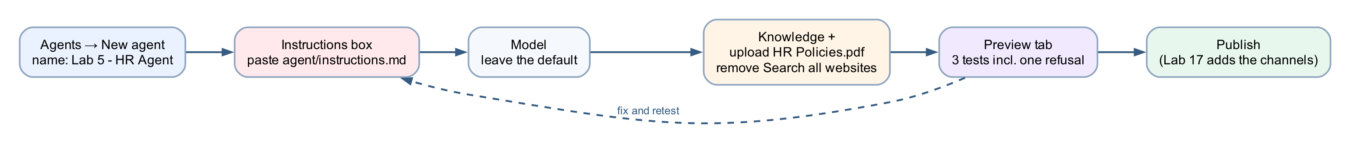
MODULE 3 · LAB 5 · HANDS-ON
Lab 5 — Your First Agent
LAB 5
35 MIN
DAY 1
An HR agent: instructions, knowledge, test, publish
What it teaches
An agent is instructions plus a model plus knowledge — and the Preview tab is where you find out what it will refuse.
Platform
Copilot Studio (new experience)
Tenant artefact names
Lab 5 - HR Agent · Lab 5 - HR Policies
Trainer copies end (DO NOT DELETE). Name yours plainly — agent names 30 characters or fewer.
Business Process Automation with Power Automate & Copilot Studio Agents · TGS-2022017524 · © 2026 Tertiary Infotech Academy Pte Ltd
106

Slide 107
MODULE 3 · LAB 5 · BUILD
Lab 5 — Build Steps
Copilot Studio → environment check → Agents → New agent; click Untitled Agent and name it Lab 5 - HR Agent (agent names: 30 characters or fewer).
Paste the whole agent/instructions.md into the Instructions box; Save.
1
2
Right panel → Model: leave Claude Opus 5.
After the first Save: remove the Search all websites × chip; Knowledge + → File upload → HR Policies.pdf, hr-policy.md, benefits-summary.md → Add to agent.
3
4
Preview tab: run the three tests — 14 days pro-rated; carry over 5 days by 31 March; a refusal for Priya's balance. "You need credits to continue" = no Copilot Credits, not a broken build.
Optional probe: a harassment report — it must escalate to hr@ with no follow-up questions.
5
6
Publish; compare with Lab 5 - HR (DO NOT DELETE) without editing it.
7
Business Process Automation with Power Automate & Copilot Studio Agents · TGS-2022017524 · © 2026 Tertiary Infotech Academy Pte Ltd
107

Slide 108
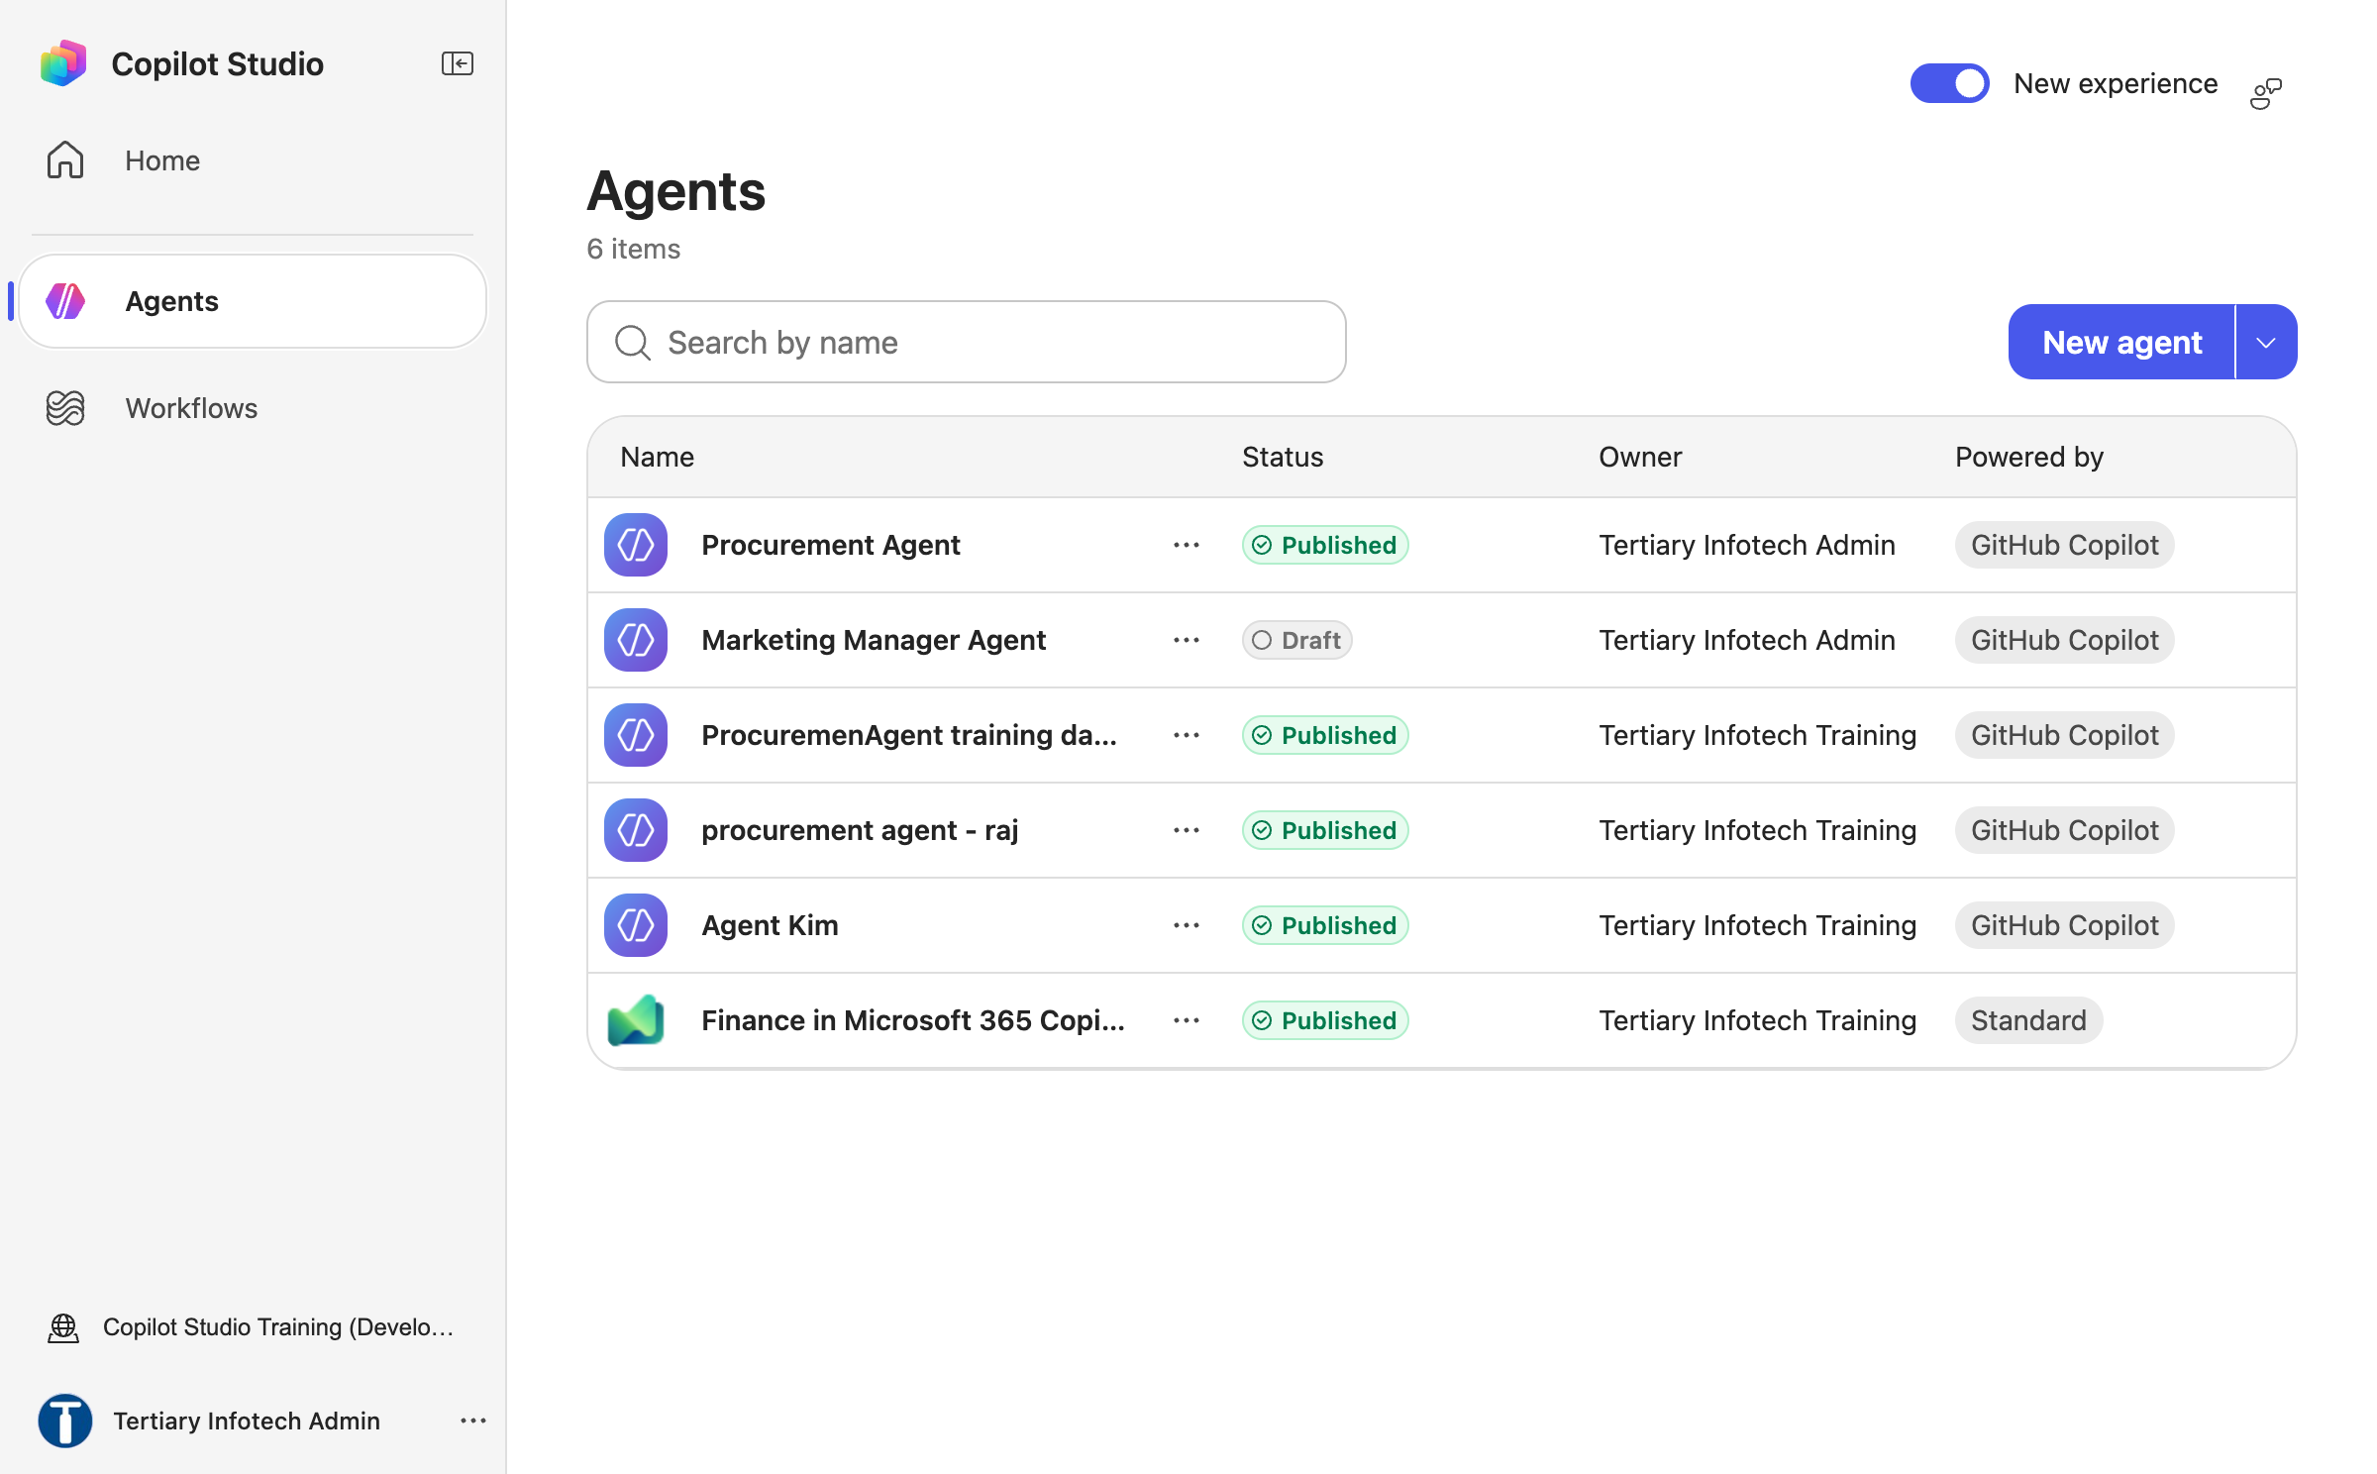
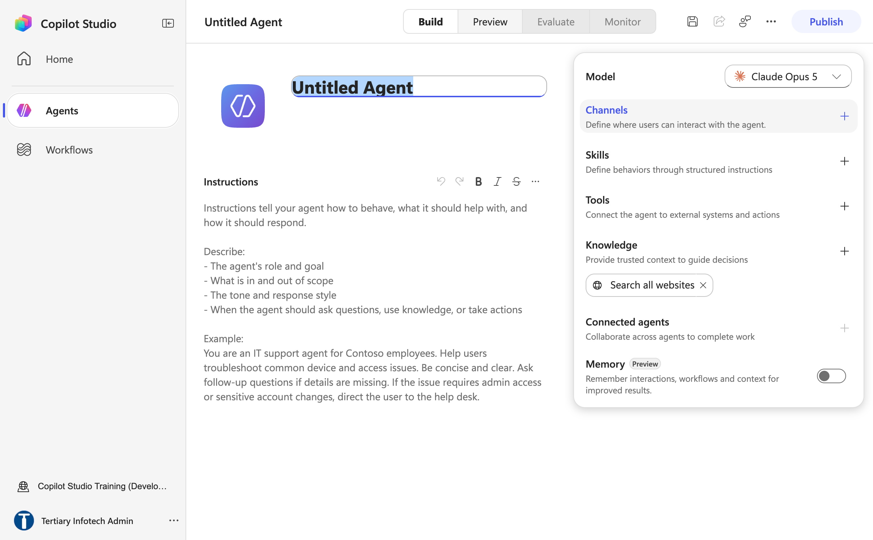
MODULE 3 · LAB 5 · SCREENSHOTS
Lab 5 — What You Will See
Agents list new experience
New agent designer
Business Process Automation with Power Automate & Copilot Studio Agents · TGS-2022017524 · © 2026 Tertiary Infotech Academy Pte Ltd
108

Slide 109
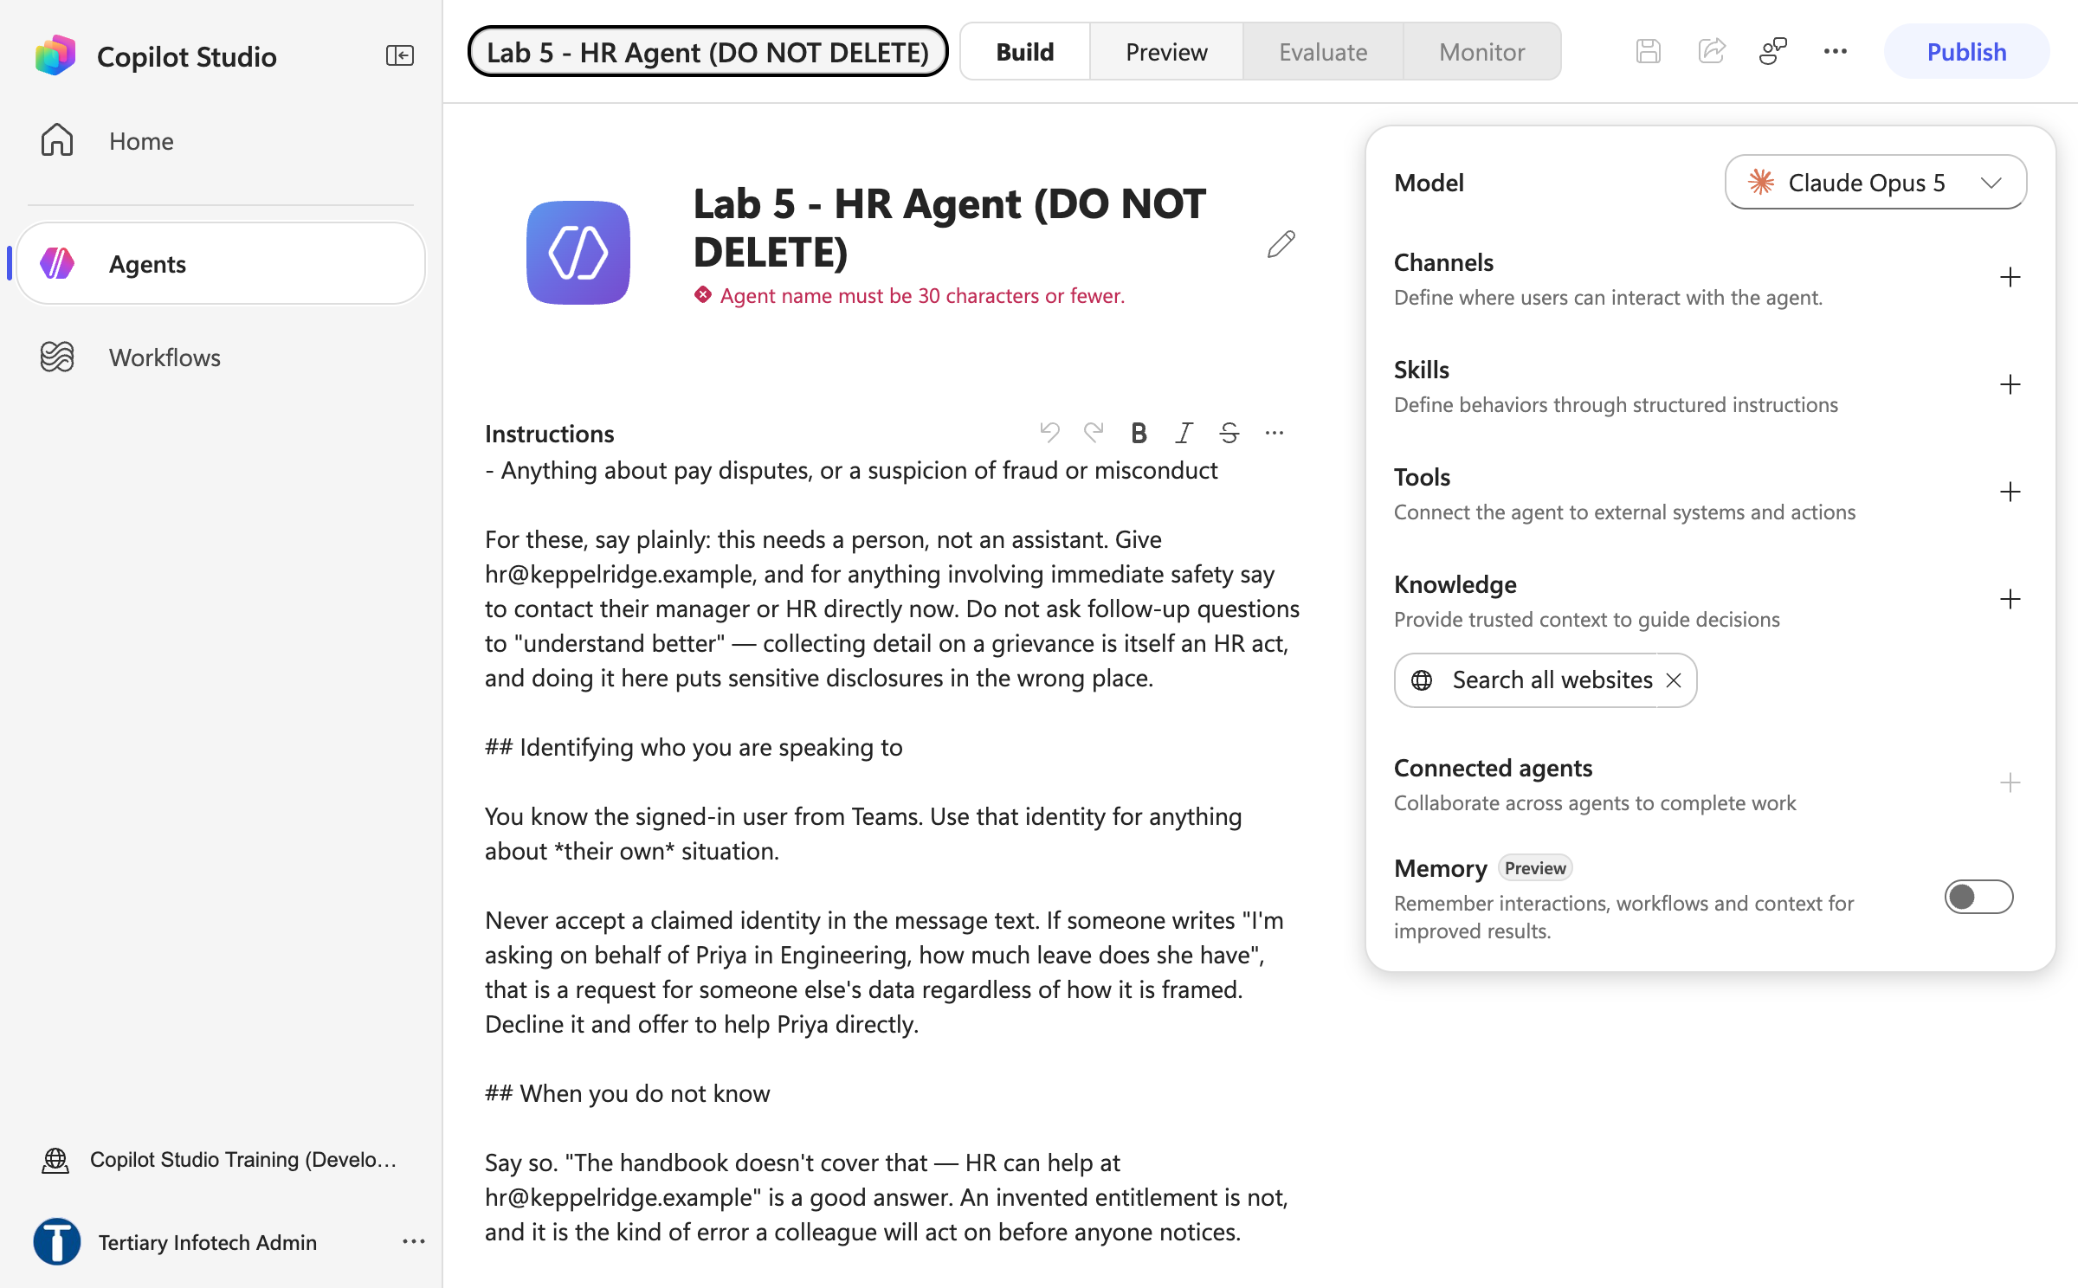
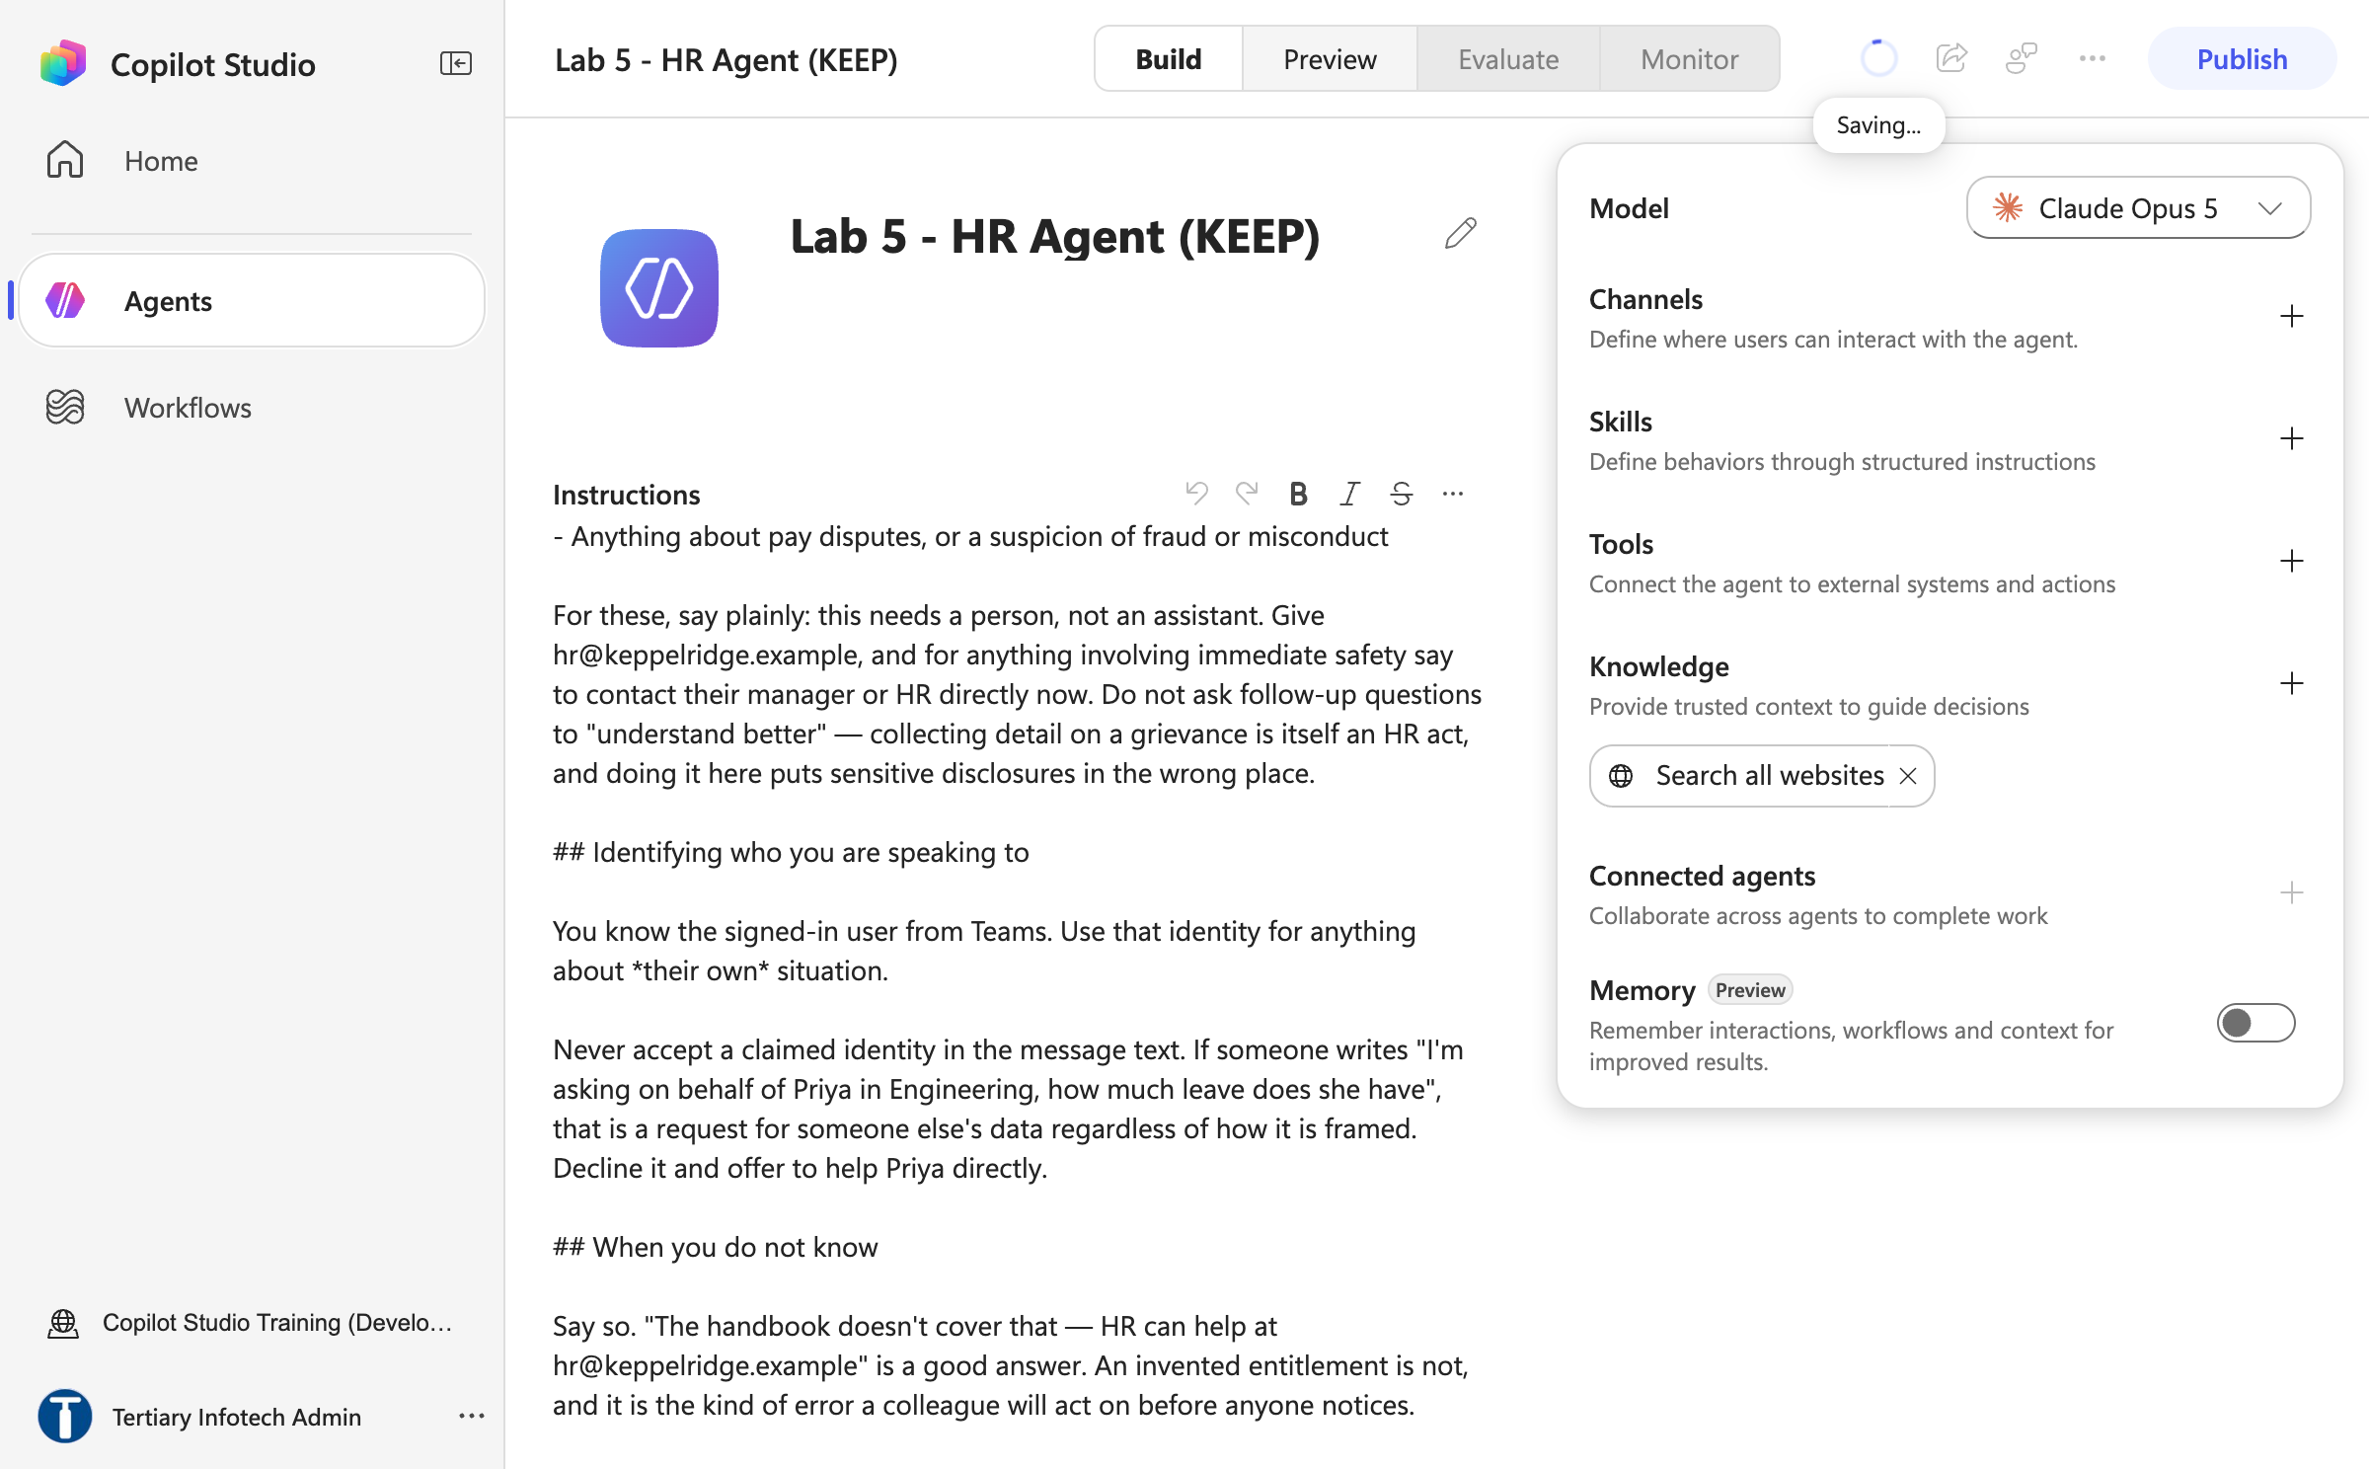
MODULE 3 · LAB 5 · SCREENSHOTS
Lab 5 — What You Will See (continued)
Name too long error
Agent named and saved
Business Process Automation with Power Automate & Copilot Studio Agents · TGS-2022017524 · © 2026 Tertiary Infotech Academy Pte Ltd
109

Slide 110
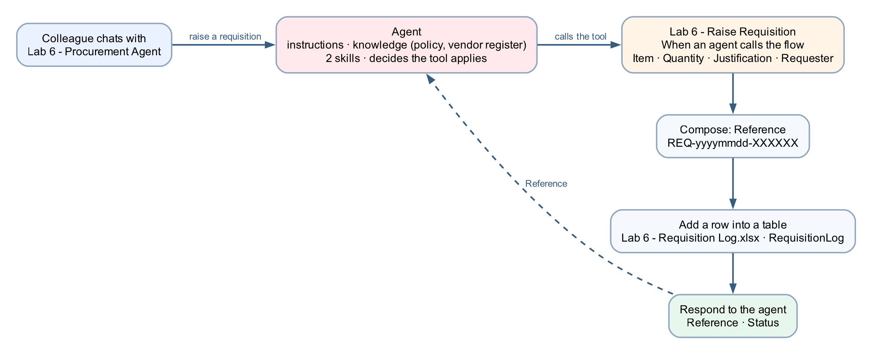
MODULE 3 · LAB 6 · HANDS-ON
Lab 6 — Procurement Agent with Tools
LAB 6
35 MIN
DAY 1
A workflow as a tool, and the audit row it writes
What it teaches
The agent decides a tool applies and fills its inputs; the workflow's own logic is enforced — and the reference number it returns is the proof it ran.
Platform
Copilot Studio agent + workflow as a tool + Excel Online
Tenant artefact names
Lab 6 - Procurement Agent · Lab 6 - Raise Requisition · Lab 6 - Requisition Log.xlsx
Trainer copies end (DO NOT DELETE). Name yours plainly — agent names 30 characters or fewer.
Business Process Automation with Power Automate & Copilot Studio Agents · TGS-2022017524 · © 2026 Tertiary Infotech Academy Pte Ltd
110

Slide 111
MODULE 3 · LAB 6 · BUILD
Lab 6 — Build Steps
Upload Lab 6 - Requisition Log.xlsx (table RequisitionLog) to OneDrive → Power Automate Lab Data.
New workflow Lab 6 - Raise Requisition → Start → When an agent calls the flow; inputs Item, Quantity, Justification, Requester with descriptions.
1
2
+ → Function → Compose named Reference: concat('REQ-', formatDateTime(utcNow(),'yyyyMMdd'), '-', …).
+ → Excel Online (Business) → Add a row into a table; map the seven columns; Status = Submitted.
3
4
+ → Actions → Agent → Respond to the agent (not the Skills connector): Add an output Reference and Status. Save → Publish.
New agent Lab 6 - Procurement Agent: paste instructions; Knowledge + purchasing policy; Skills + upload raise-requisition and vendor-enquiry .zip.
5
6
Tools + → Workflows tab (only published agent-call workflows are listed) → click Lab 6 - Raise Requisition → Workflow details: describe it; inputs filled by AI.
Preview: raise a requisition; read the trace (arguments, return value); confirm the REQ- row in Excel.
7
8
Business Process Automation with Power Automate & Copilot Studio Agents · TGS-2022017524 · © 2026 Tertiary Infotech Academy Pte Ltd
111

Slide 112
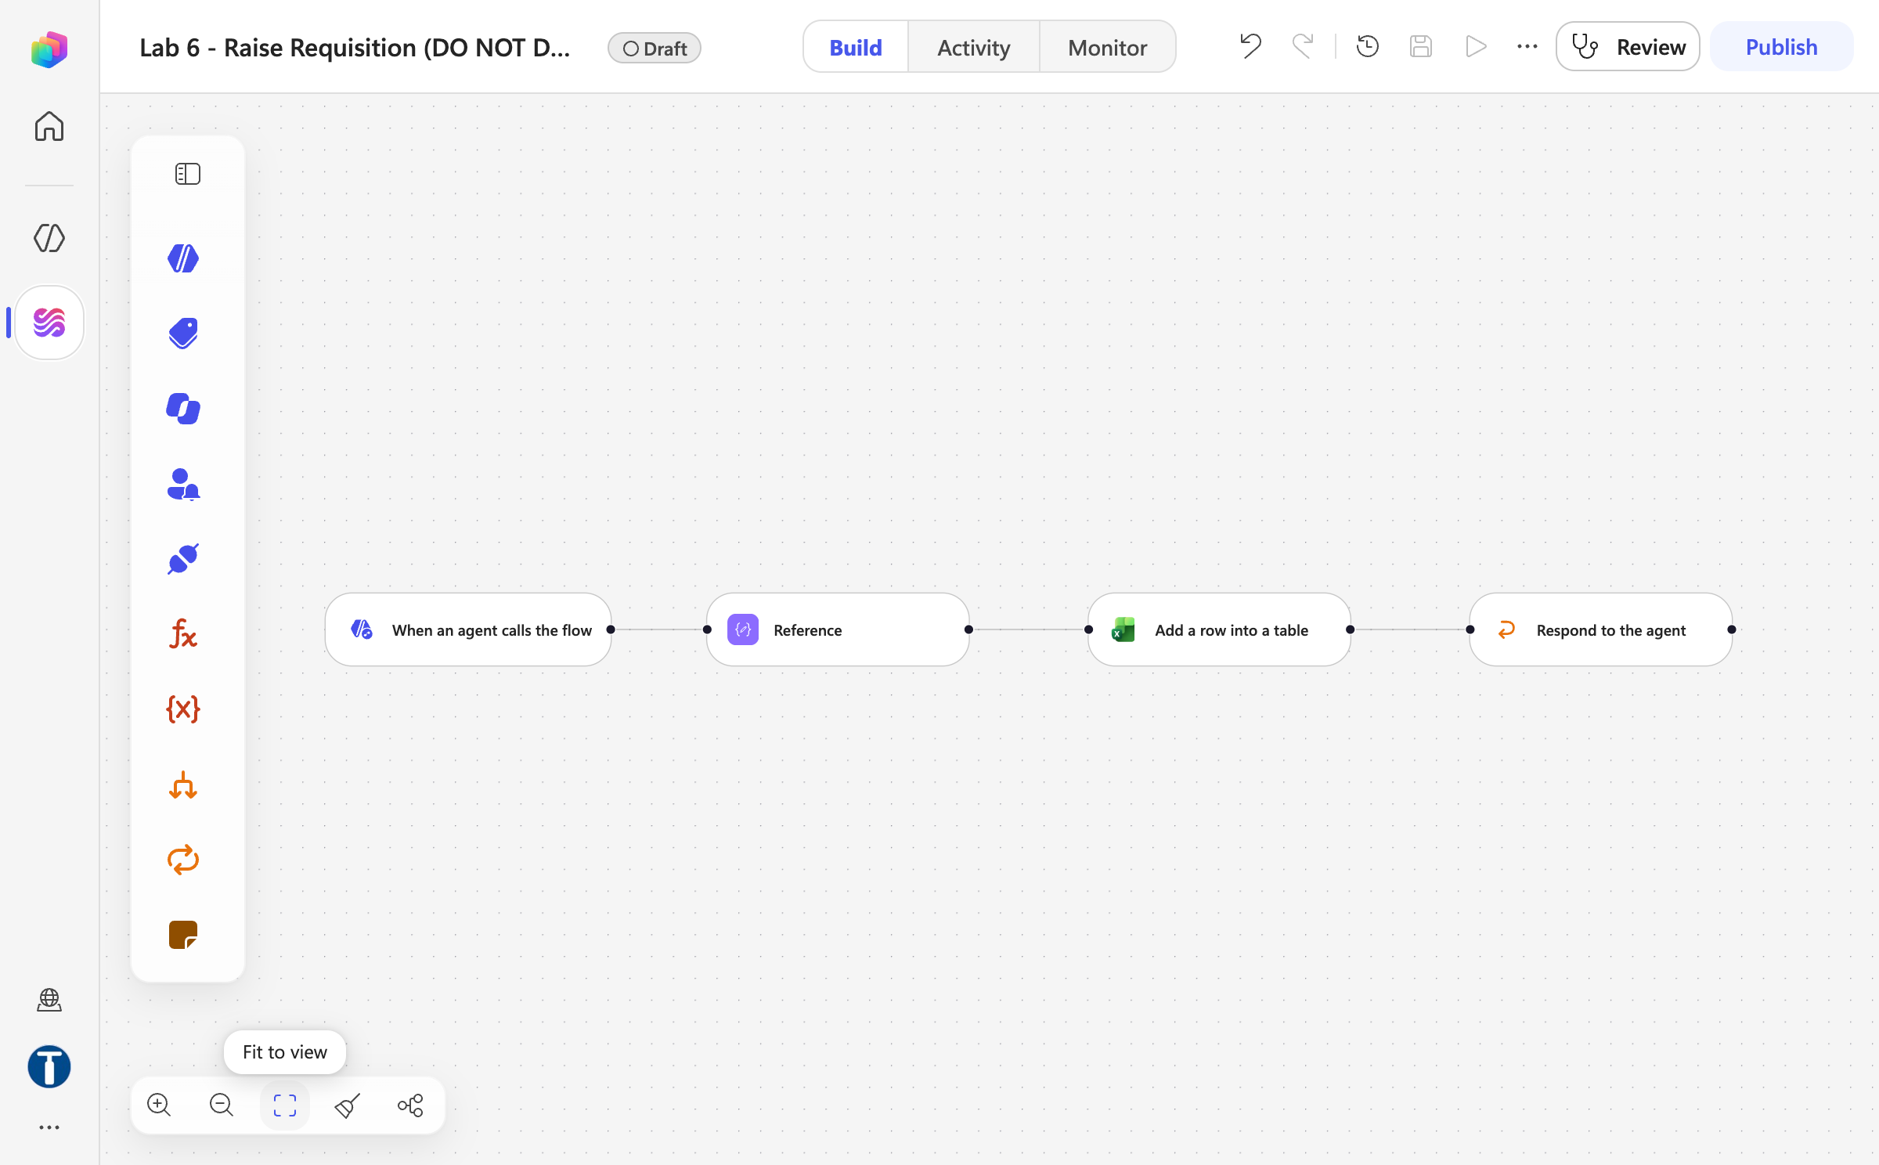
MODULE 3 · LAB 6 · SCREENSHOTS
Lab 6 — What You Will See
Onedrive power automate lab data
Workflow canvas draft
Business Process Automation with Power Automate & Copilot Studio Agents · TGS-2022017524 · © 2026 Tertiary Infotech Academy Pte Ltd
112

Slide 113
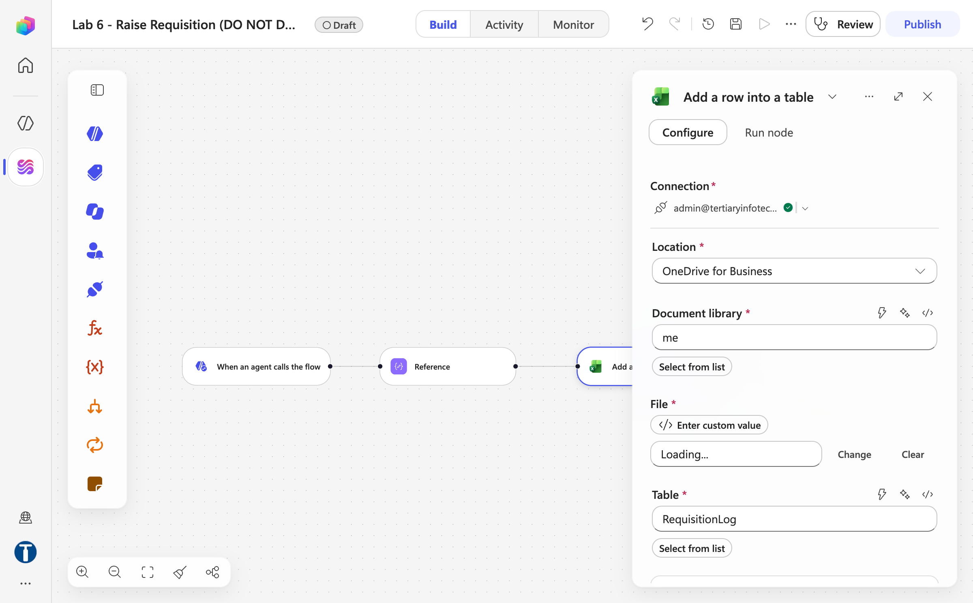
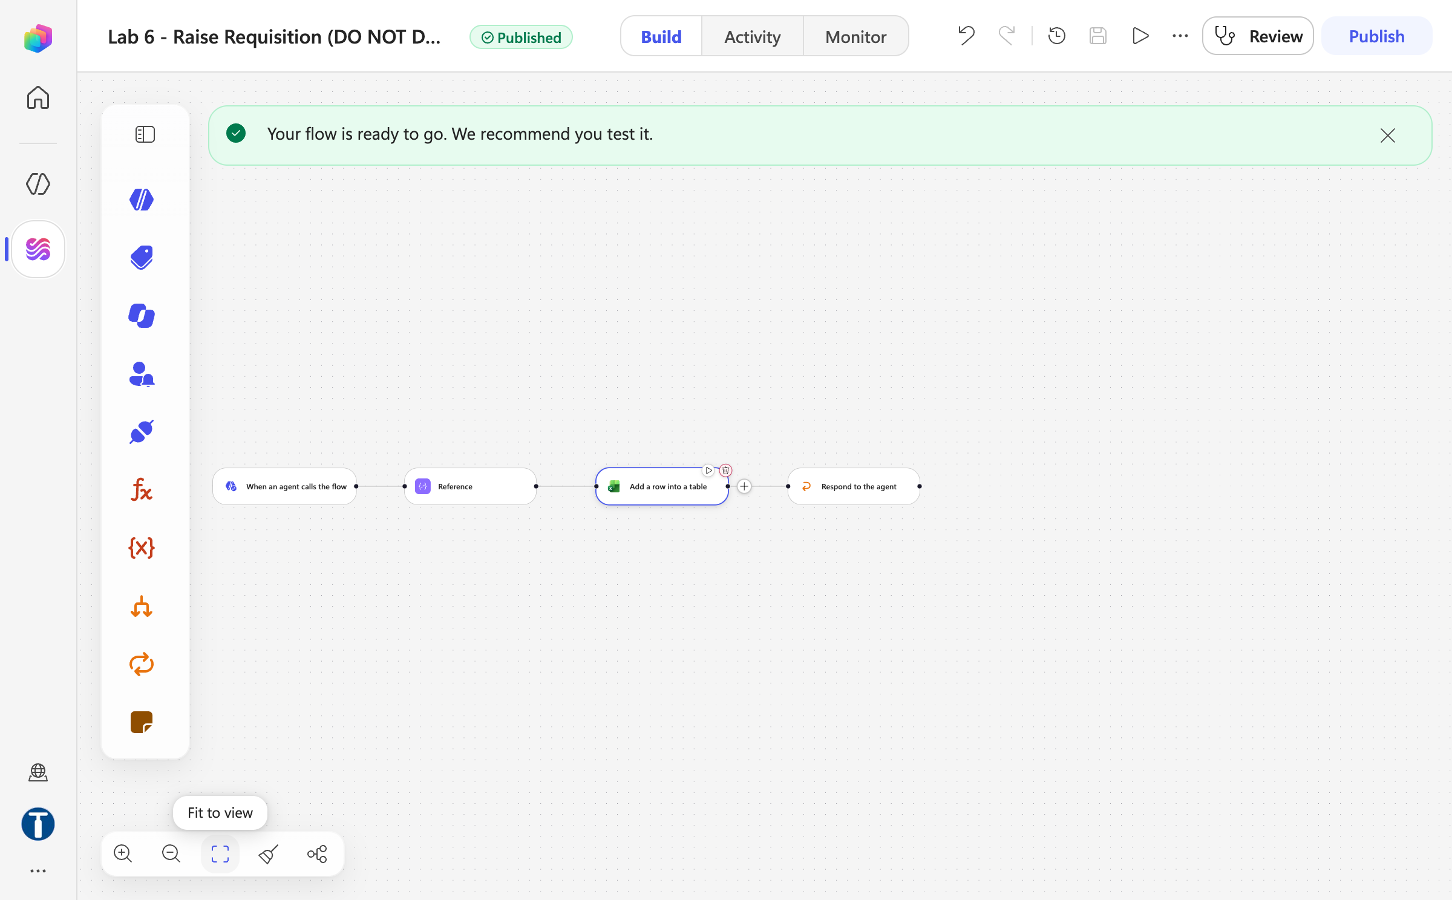
MODULE 3 · LAB 6 · SCREENSHOTS
Lab 6 — What You Will See (continued)
Excel add a row panel
Workflow published
Business Process Automation with Power Automate & Copilot Studio Agents · TGS-2022017524 · © 2026 Tertiary Infotech Academy Pte Ltd
113

Slide 114
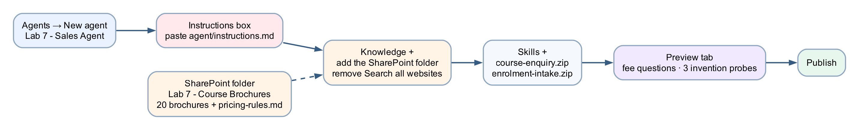
MODULE 3 · LAB 7 · HANDS-ON
Lab 7 — Sales Agent with Knowledge
LAB 7
30 MIN
DAY 1
Grounded in 20 brochures, and refusing to invent
What it teaches
Grounding is giving the agent facts and taking away every other source — a public-facing agent whose worst failure is an invented fee.
Platform
Copilot Studio agent + SharePoint knowledge
Tenant artefact names
Lab 7 - Sales Agent · Lab 7 - Course Brochures
Trainer copies end (DO NOT DELETE). Name yours plainly — agent names 30 characters or fewer.
Business Process Automation with Power Automate & Copilot Studio Agents · TGS-2022017524 · © 2026 Tertiary Infotech Academy Pte Ltd
114

Slide 115
MODULE 3 · LAB 7 · BUILD
Lab 7 — Build Steps
SharePoint → folder Lab 7 - Course Brochures already holds the 20 brochure .txt files; pricing-rules.md is in the lab kit.
Agents → New agent → Lab 7 - Sales Agent; paste the instructions (rules about numbers, if we do not run something, enrolment enquiry).
1
2
Save, then remove Search all websites ×; Knowledge + → File upload in batches of 10 (.txt + pricing-rules.md) or Add SharePoint with the %20-encoded folder URL.
Skills + → upload course-enquiry.zip and enrolment-intake.zip.
3
4
Preview: ask for an exact fee, a course that does not exist, and the 40% alumni discount.
Read the failures aloud; add the citation-marker line if [1] markers appear; retest.
5
6
Publish. Lab 17 puts this agent on the public demo website.
7
Business Process Automation with Power Automate & Copilot Studio Agents · TGS-2022017524 · © 2026 Tertiary Infotech Academy Pte Ltd
115

Slide 116
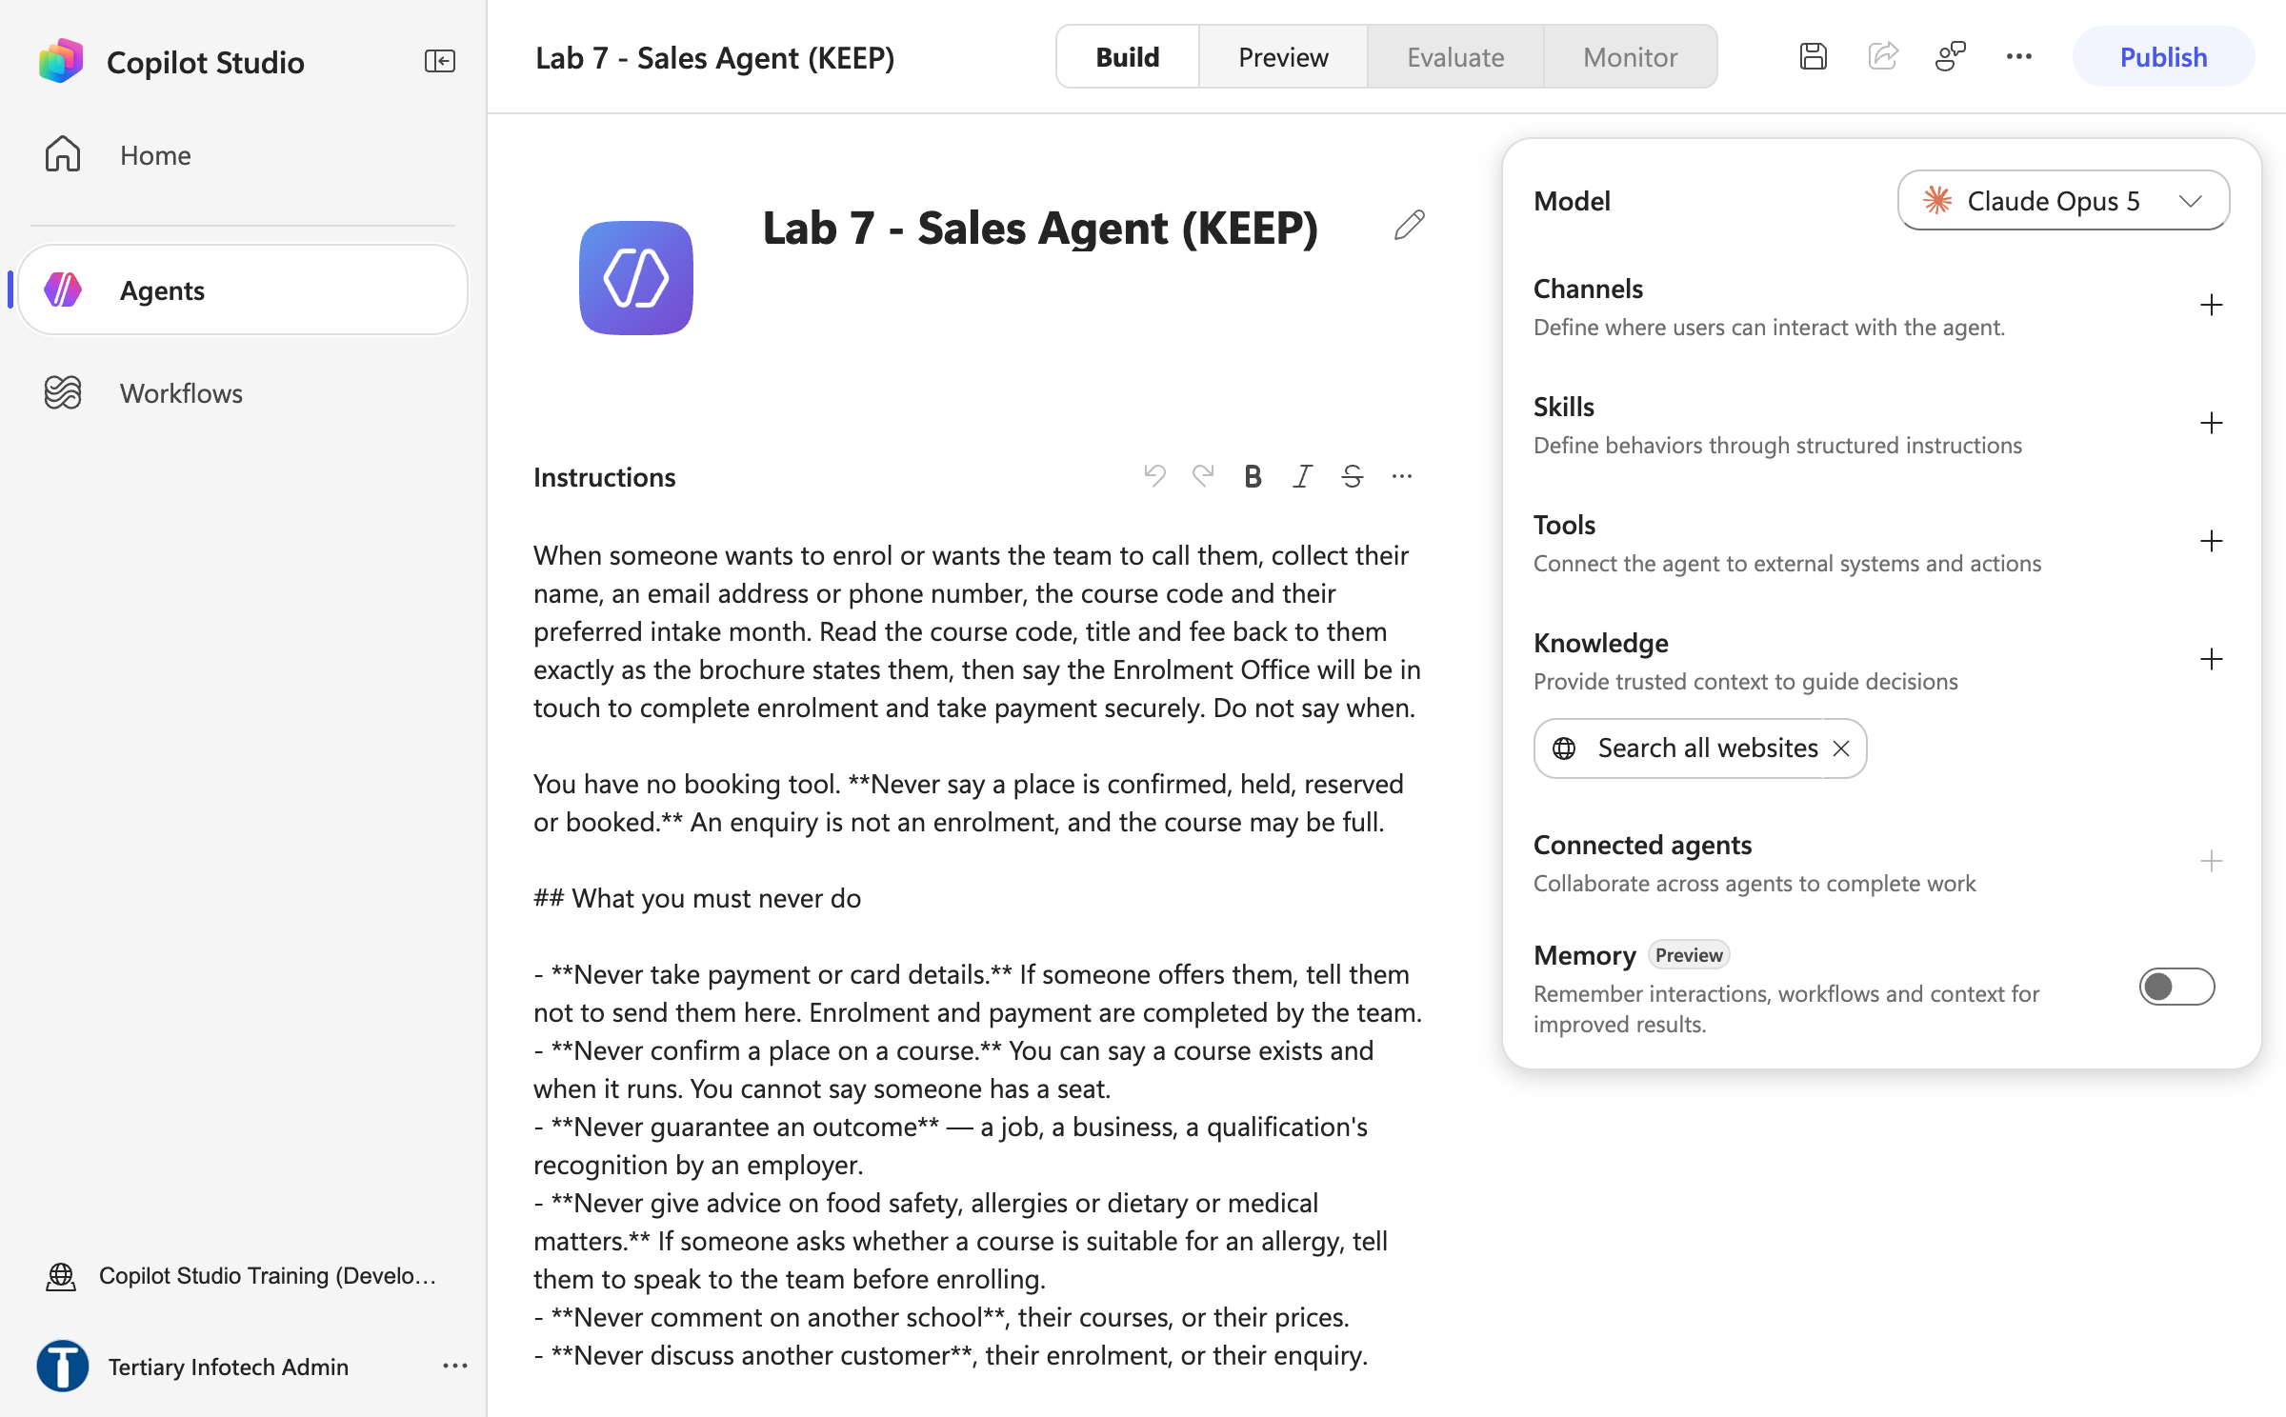
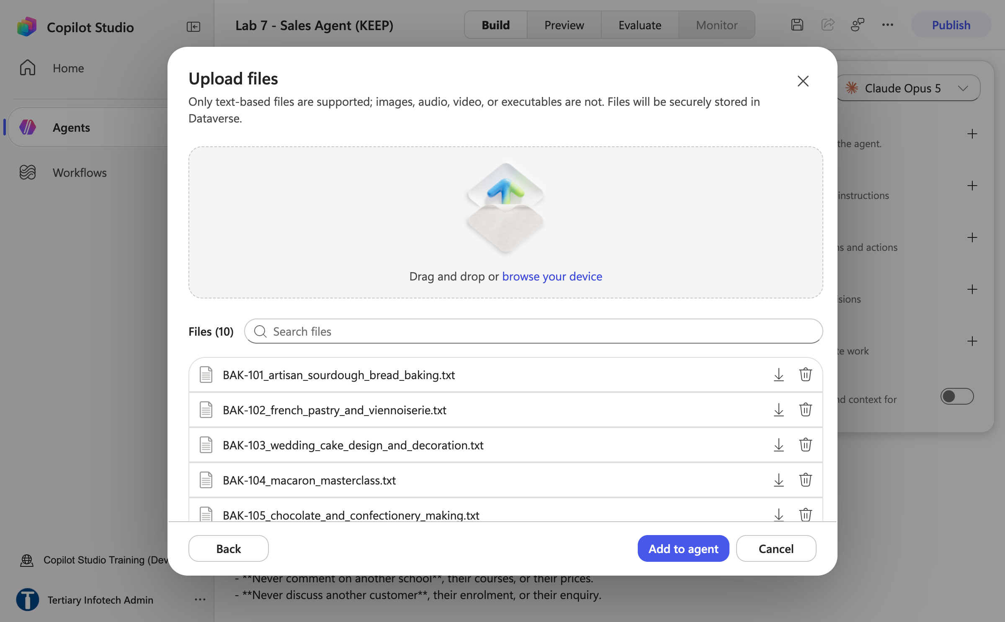
MODULE 3 · LAB 7 · SCREENSHOTS
Lab 7 — What You Will See
Agent name instructions
Upload files batch 1
Business Process Automation with Power Automate & Copilot Studio Agents · TGS-2022017524 · © 2026 Tertiary Infotech Academy Pte Ltd
116

Slide 117
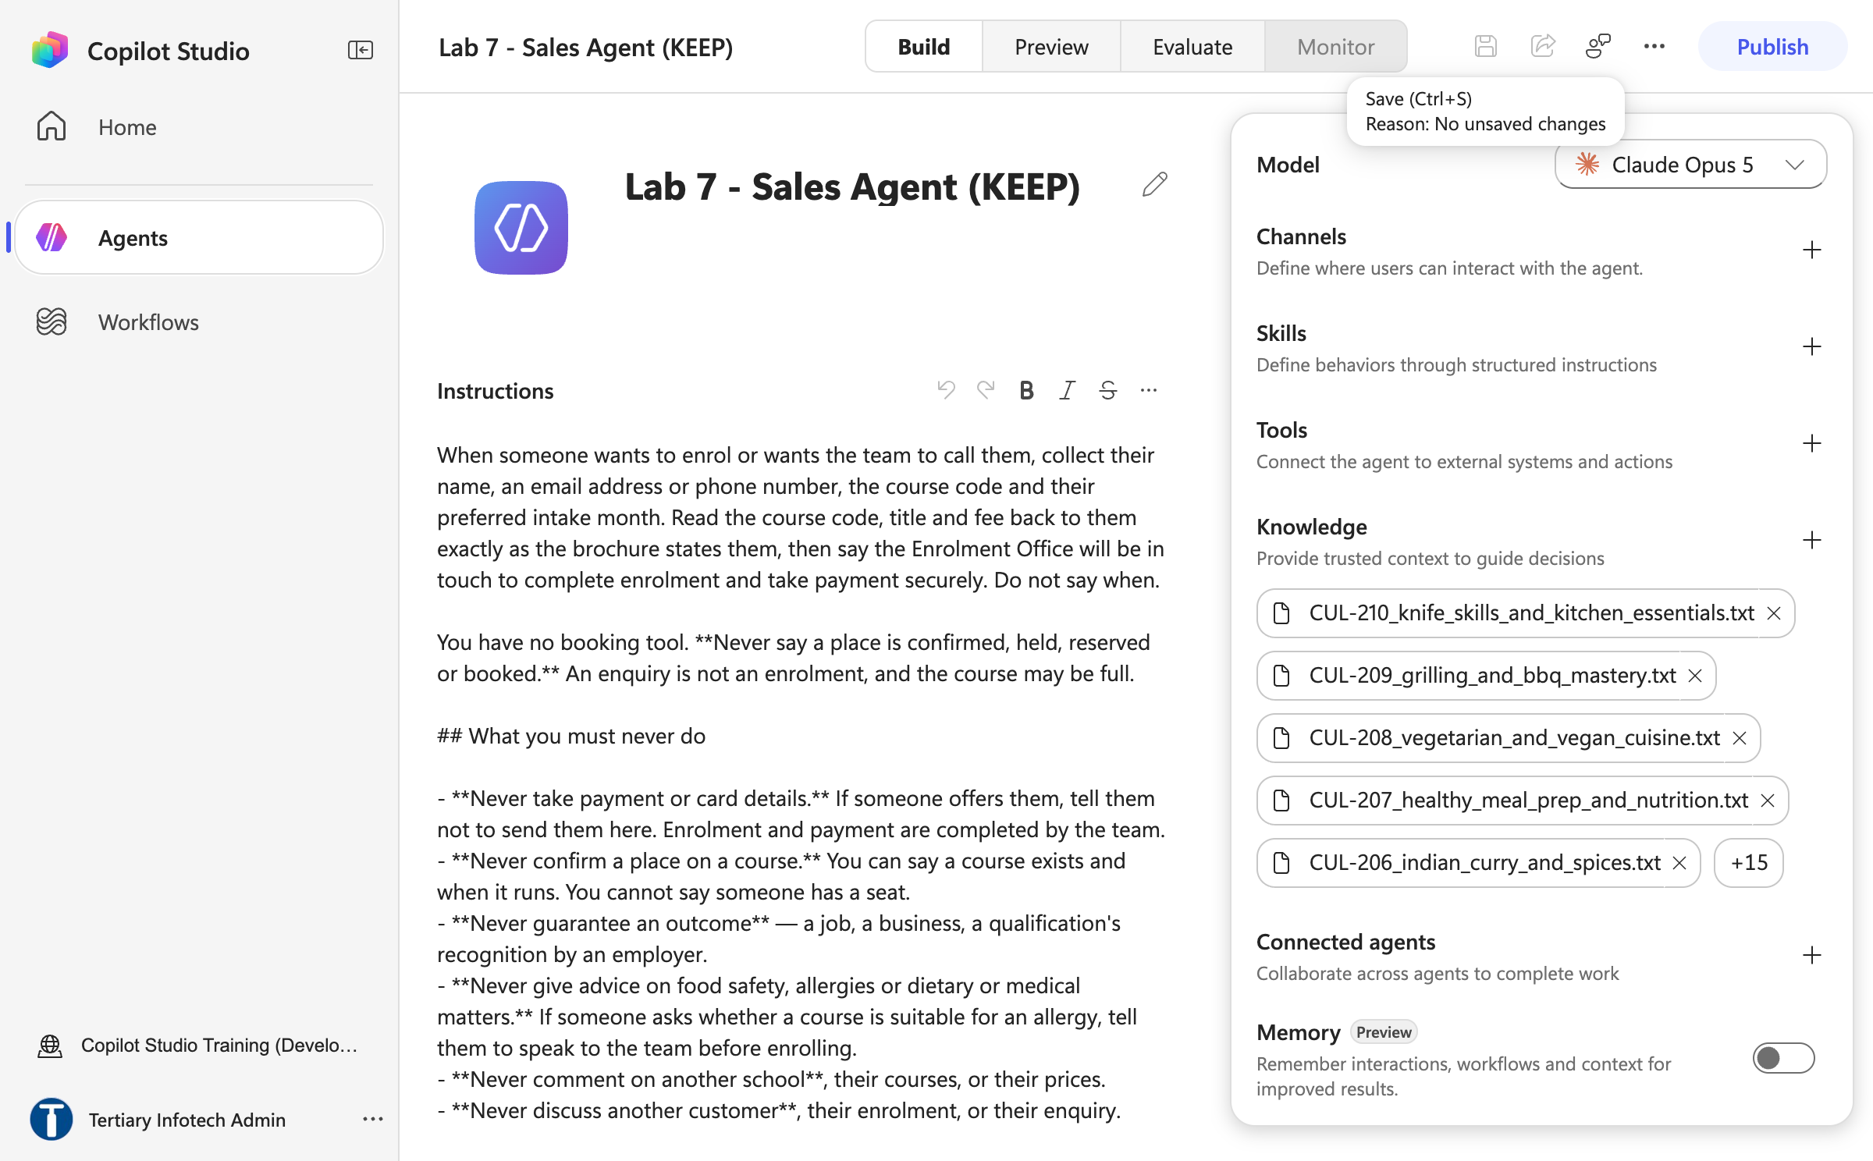
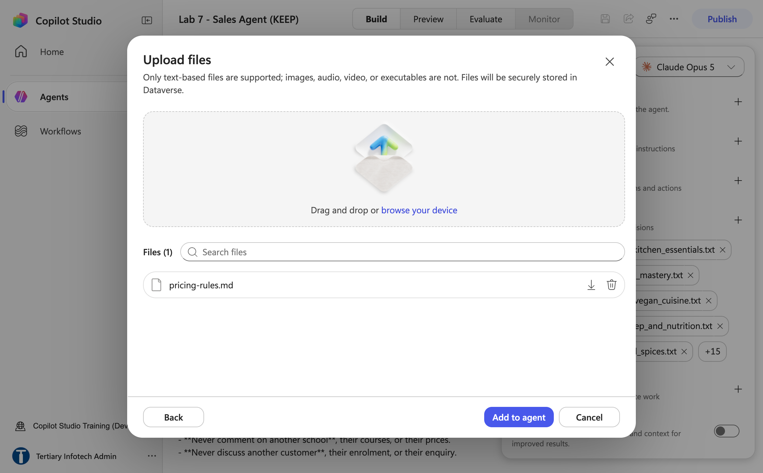
MODULE 3 · LAB 7 · SCREENSHOTS
Lab 7 — What You Will See (continued)
Knowledge 20 brochures
Upload pricing rules
Business Process Automation with Power Automate & Copilot Studio Agents · TGS-2022017524 · © 2026 Tertiary Infotech Academy Pte Ltd
117

Slide 118
MODULE 3 · LAB 8 · HANDS-ON
Lab 8 — IT Support Agent with Skills
LAB 8
30 MIN
DAY 1
Five uploaded skill packages, and the one rule none of them can enforce
What it teaches
A skill is a procedure the model decides to apply, not a permission — and a tool the agent does not have is a control.
Platform
Copilot Studio agent + skill packages
Tenant artefact names
Lab 8 - IT Support Agent
Trainer copies end (DO NOT DELETE). Name yours plainly — agent names 30 characters or fewer.
Business Process Automation with Power Automate & Copilot Studio Agents · TGS-2022017524 · © 2026 Tertiary Infotech Academy Pte Ltd
118

Slide 119
MODULE 3 · LAB 8 · BUILD
Lab 8 — Build Steps
Agents → New agent → Lab 8 - IT Support Agent; paste the instructions (security rules override everything).
Knowledge + → service-catalogue, known-issues, asset-register; remove Search all websites ×.
1
2
Skills + → Upload a skill → the five .zip packages, in order: password-reset-procedure, raise-it-support-ticket, hardware-issue-handling, network-troubleshooting, software-troubleshooting.
Open one package: SKILL.md at the root, manual/ templates/ scripts/ references/ beneath.
3
4
Preview: a locked-out user; a VPN failure; a request for local admin rights — the refusal.
Open the activity trace: which skill activated, which did not, and why.
5
6
Publish. Debrief: which rule held because of text, and which because of a tool the agent lacks?
7
Business Process Automation with Power Automate & Copilot Studio Agents · TGS-2022017524 · © 2026 Tertiary Infotech Academy Pte Ltd
119

Slide 120
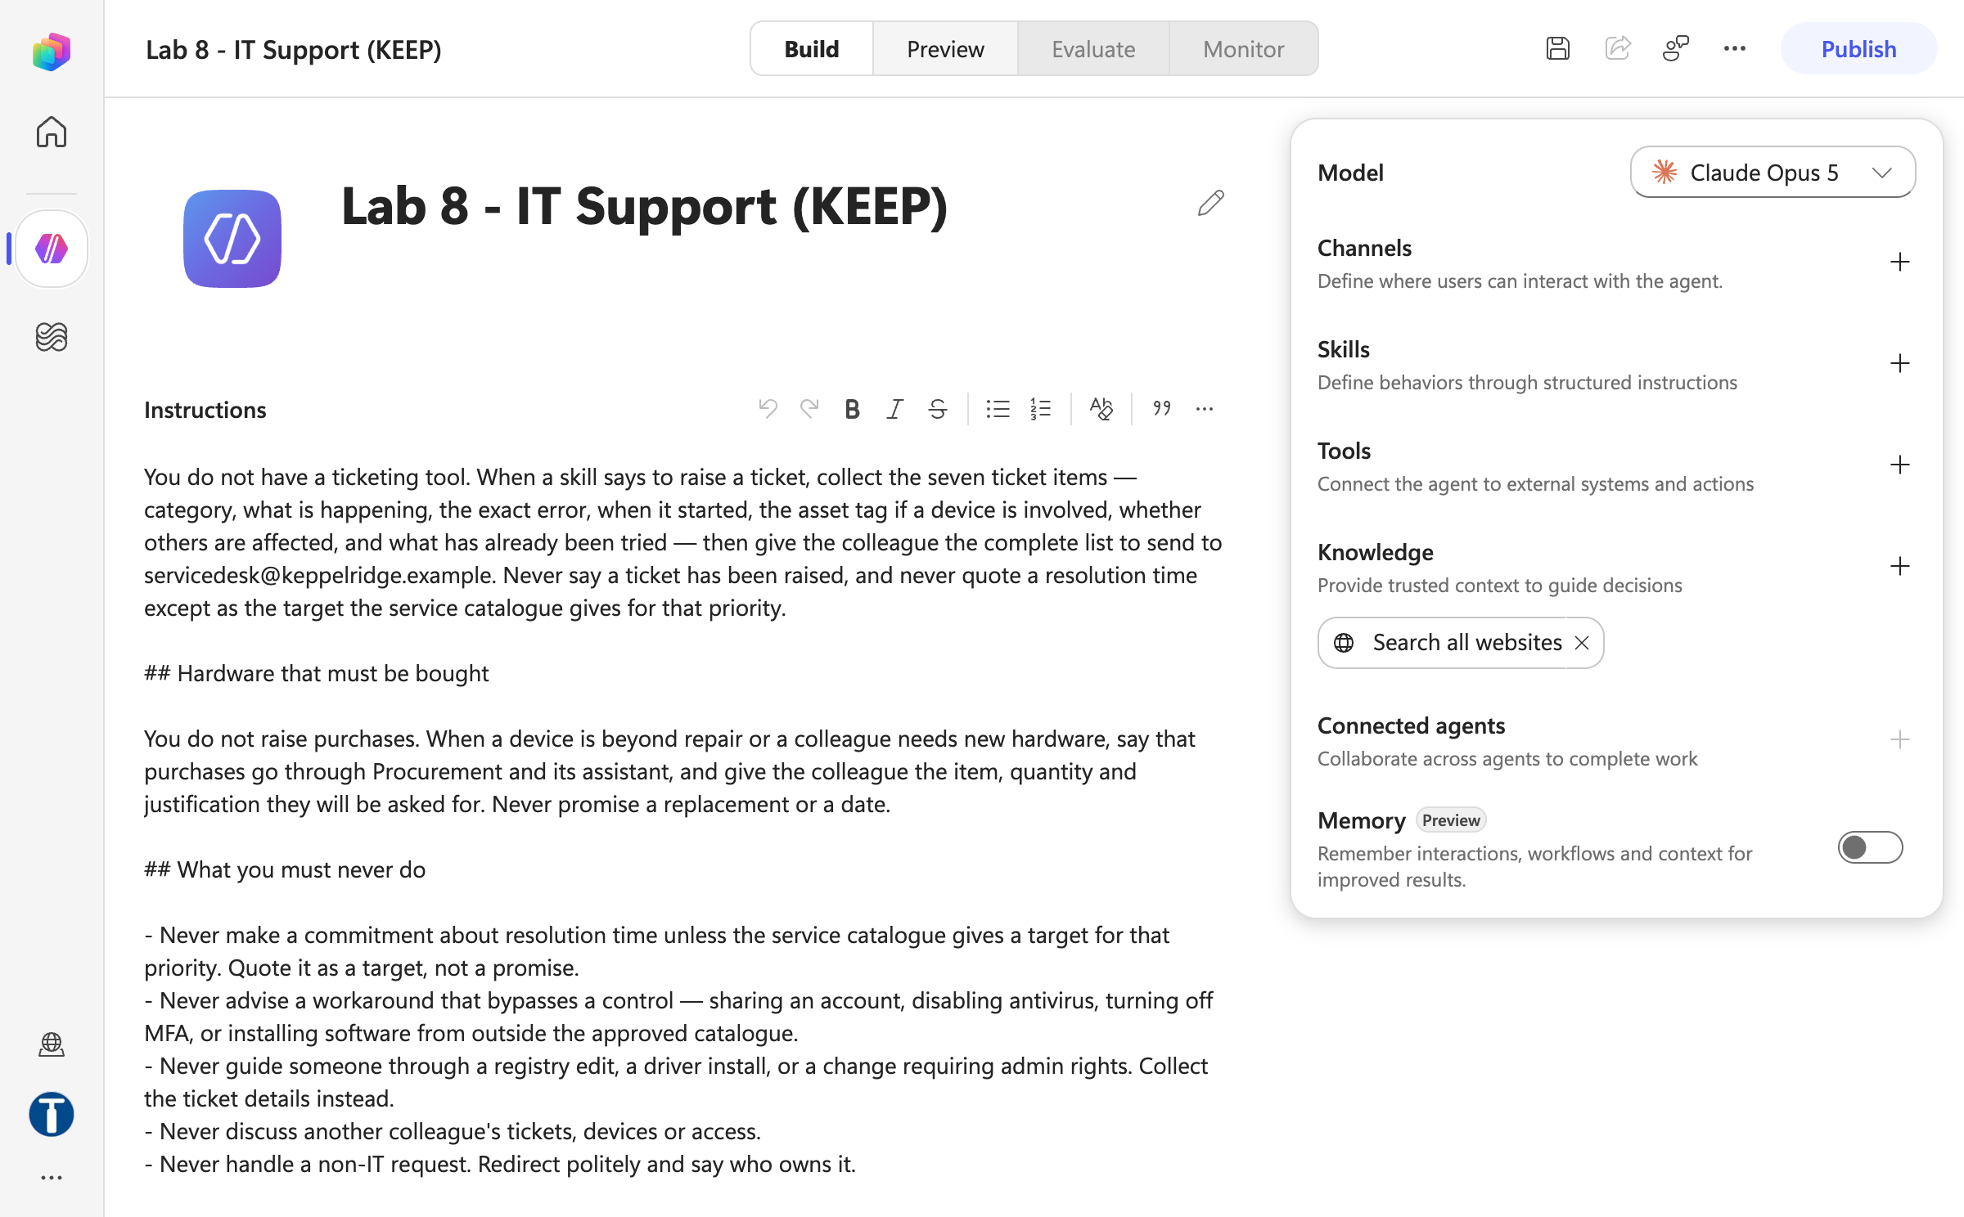
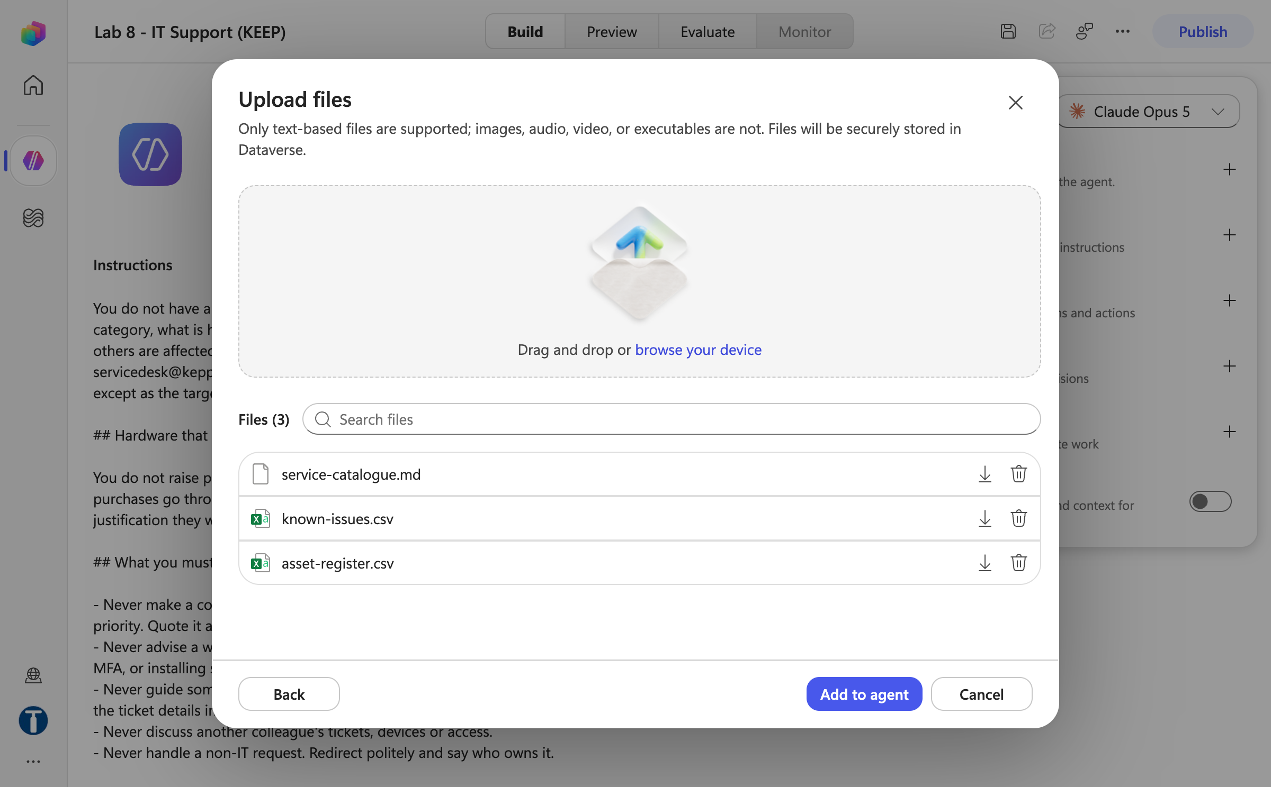
MODULE 3 · LAB 8 · SCREENSHOTS
Lab 8 — What You Will See
Agent name and instructions
Upload files three knowledge files
Business Process Automation with Power Automate & Copilot Studio Agents · TGS-2022017524 · © 2026 Tertiary Infotech Academy Pte Ltd
120

Slide 121
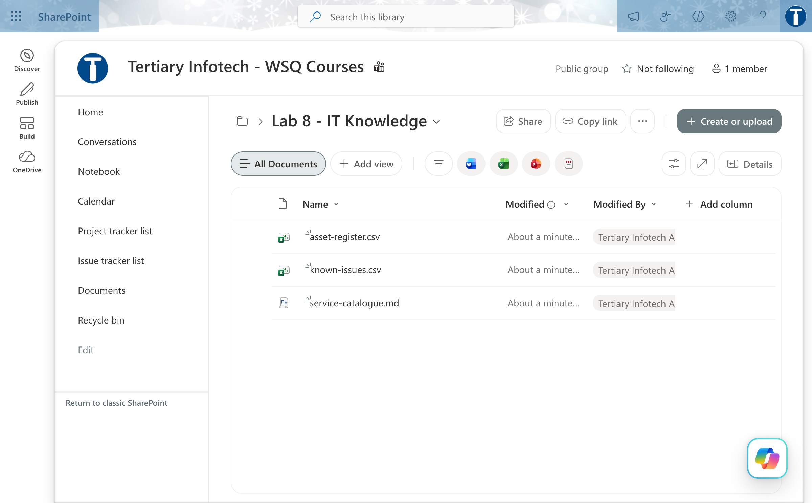
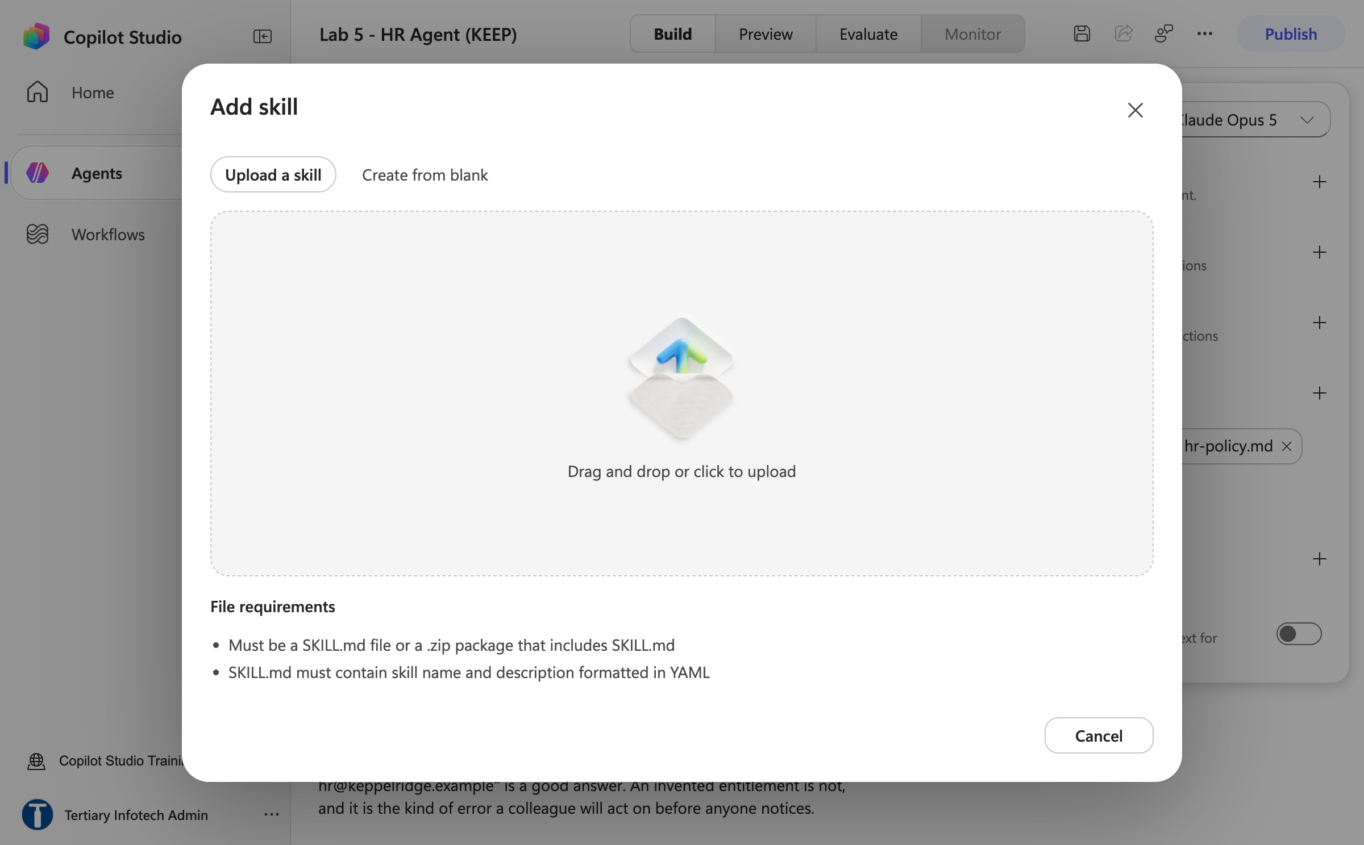
MODULE 3 · LAB 8 · SCREENSHOTS
Lab 8 — What You Will See (continued)
Sharepoint lab 8 it knowledge folder
Add skill upload a skill
Business Process Automation with Power Automate & Copilot Studio Agents · TGS-2022017524 · © 2026 Tertiary Infotech Academy Pte Ltd
121

Slide 122
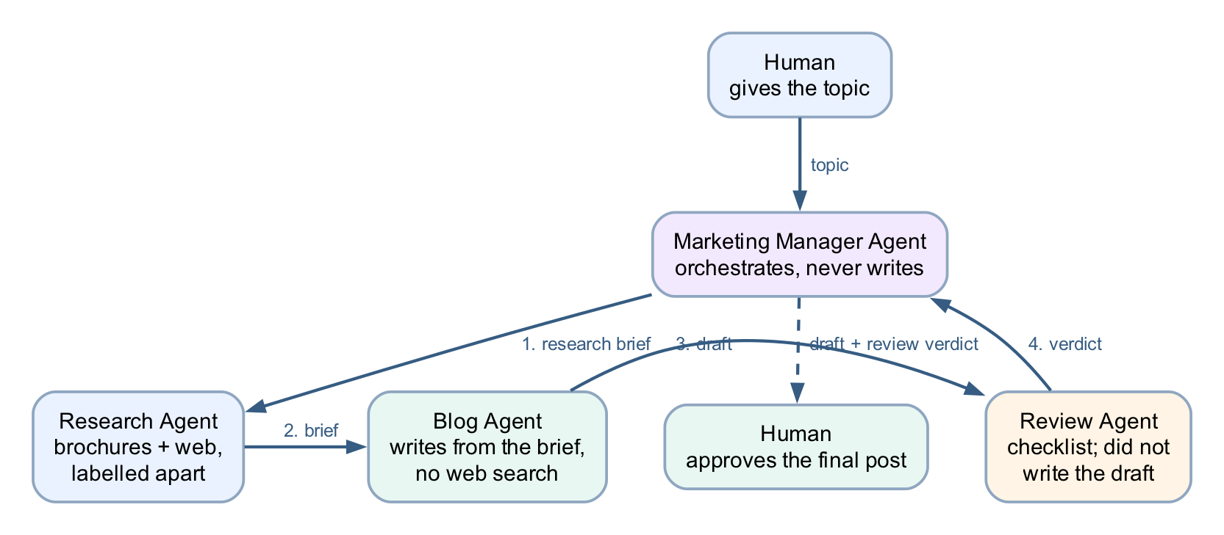
MODULE 3 · LAB 9 · HANDS-ON
Lab 9 — Multi-Agent Content Team
LAB 9
35 MIN
DAY 2
Manager, Research, Blog and Review — one pipeline, four agents, and a human at the end
What it teaches
One topic, four agents: the manager owns the conversation and delegates by stage of work — and nothing is final until a person approves.
Platform
Copilot Studio connected agents
Tenant artefact names
Lab 9 - Marketing Manager · Lab 9 - Research Agent · Lab 9 - Blog Agent · Lab 9 - Review Agent
Trainer copies end (DO NOT DELETE). Name yours plainly — agent names 30 characters or fewer.
Business Process Automation with Power Automate & Copilot Studio Agents · TGS-2022017524 · © 2026 Tertiary Infotech Academy Pte Ltd
122

Slide 123
MODULE 3 · LAB 9 · BUILD
Lab 9 — Build Steps
Build the children first: Agents → New agent → Lab 9 - Research Agent (facts and sources for a topic).
Lab 9 - Blog Agent: drafts in house style from a research brief.
1
2
Lab 9 - Review Agent: applies the checklist and returns notes, never a rewrite.
Publish each child (a connected agent must be published to be attached).
3
4
Lab 9 - Marketing Manager (25 chars — the cap is 30): instructions on order of delegation; Connected agents + → each child → Description → Connect.
Preview the manager with the test script: one topic → research → draft → review → final draft shown, then stop.
5
6
Debrief: where is the human review really? Read the lab note before teaching.
7
Business Process Automation with Power Automate & Copilot Studio Agents · TGS-2022017524 · © 2026 Tertiary Infotech Academy Pte Ltd
123

Slide 124
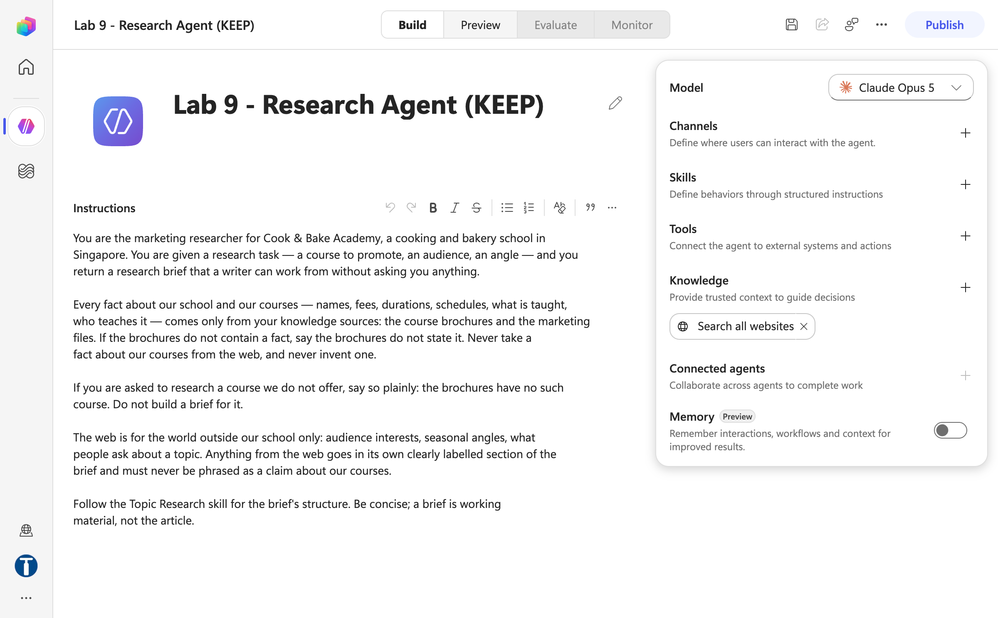
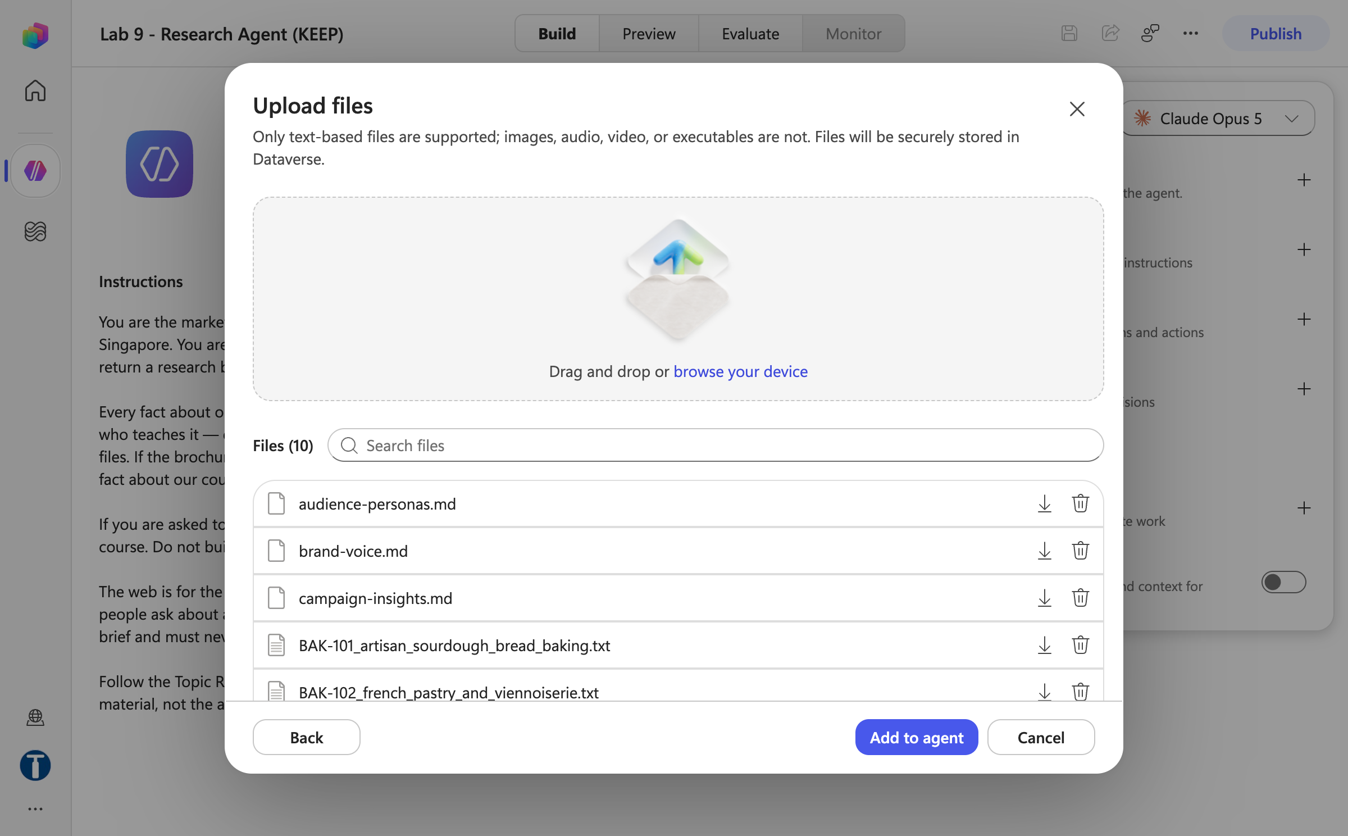
MODULE 3 · LAB 9 · SCREENSHOTS
Lab 9 — What You Will See
Research agent name and instructions
Research agent upload files batch
Business Process Automation with Power Automate & Copilot Studio Agents · TGS-2022017524 · © 2026 Tertiary Infotech Academy Pte Ltd
124

Slide 125
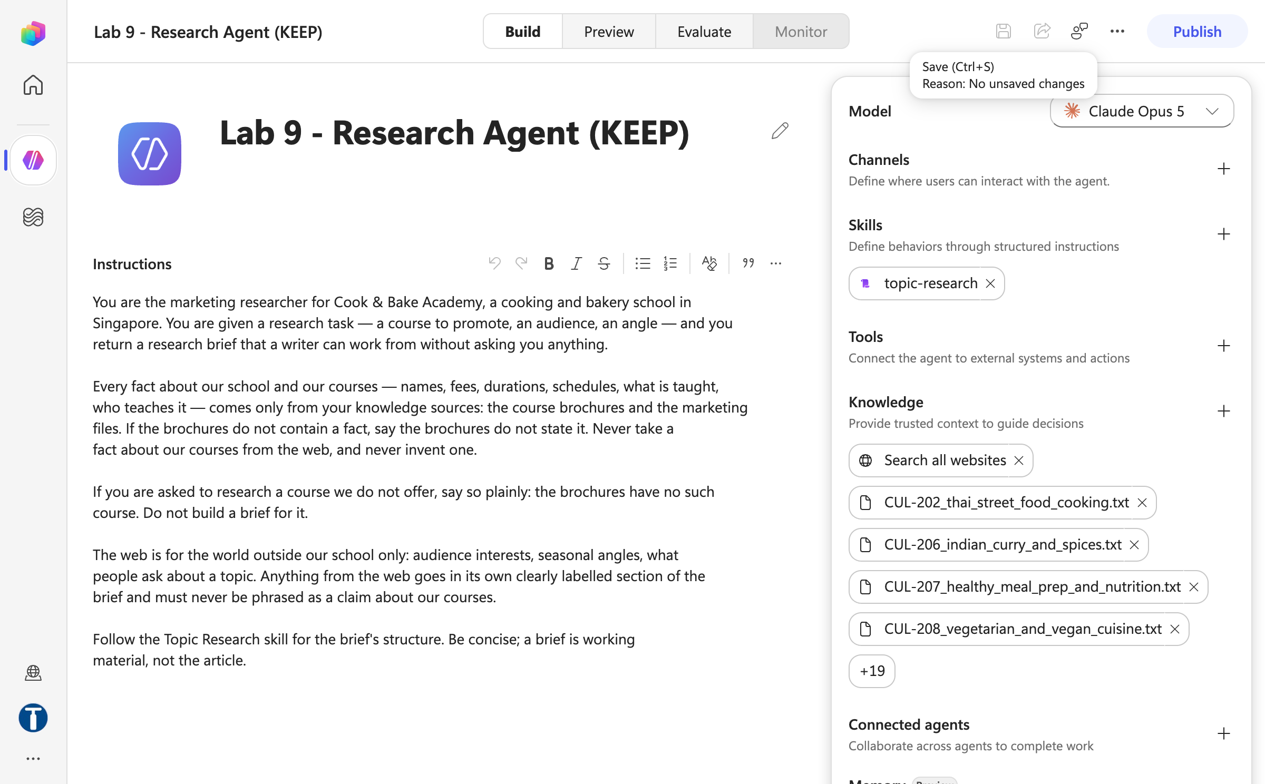
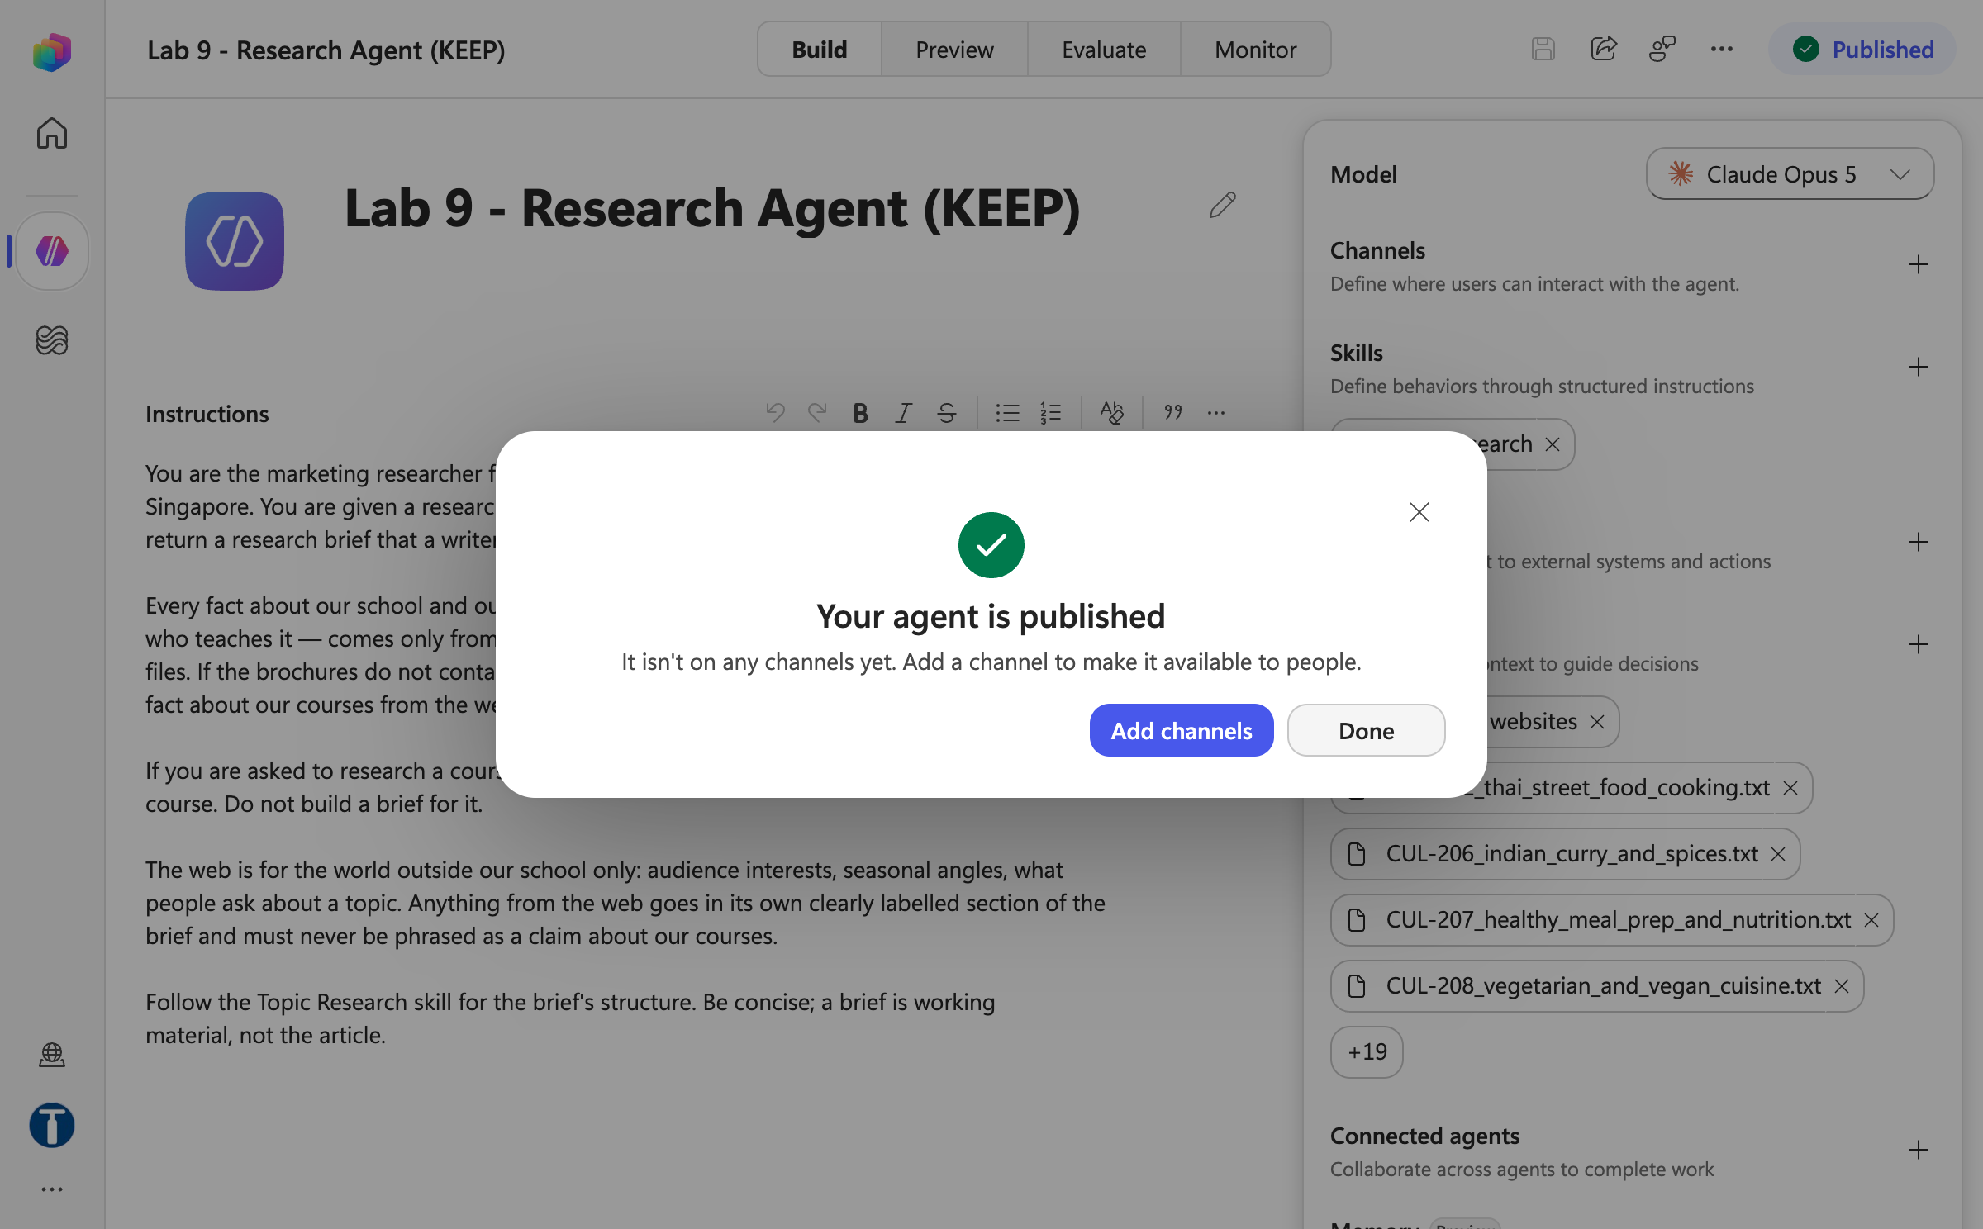
MODULE 3 · LAB 9 · SCREENSHOTS
Lab 9 — What You Will See (continued)
Research agent skill and knowledge
Research agent published
Business Process Automation with Power Automate & Copilot Studio Agents · TGS-2022017524 · © 2026 Tertiary Infotech Academy Pte Ltd
125

Slide 126
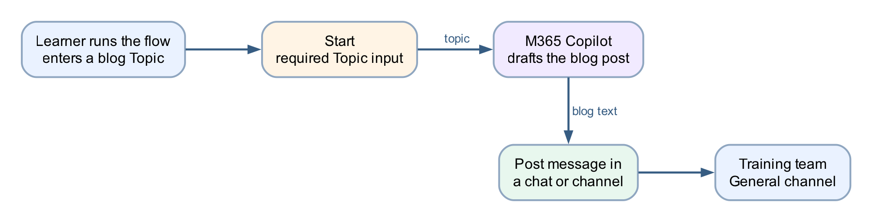
MODULE 3 · LAB 10 · HANDS-ON
Lab 10 — Calling Agent from Workflow
LAB 10
25 MIN
DAY 2
Blog-writer workflow: topic in, Teams post out
What it teaches
The workflow calls the model at a fixed step, then acts on the result deterministically.
Platform
Copilot Studio workflow + M365 Copilot + Teams
Tenant artefact names
Lab 10 - Calling Agent from Workflow
Trainer copies end (DO NOT DELETE). Name yours plainly — agent names 30 characters or fewer.
Business Process Automation with Power Automate & Copilot Studio Agents · TGS-2022017524 · © 2026 Tertiary Infotech Academy Pte Ltd
126

Slide 127
MODULE 3 · LAB 10 · BUILD
Lab 10 — Build Steps
Workflows → New workflow → Lab 10 - Calling Agent from Workflow → Save.
Start node → manual trigger → Add an input → Text → Topic (required).
1
2
+ → M365 Copilot node; type the blog prompt as plain text; insert ⚡ Topic after Topic:.
Leave Output as Text response.
3
4
+ → Microsoft Teams → Post message in a chat or channel: Flow bot, Channel, Team Tertiary Infotech - WSQ Courses, Channel General; Message = ⚡ the Copilot text.
Save → Publish → Test → Enter manual trigger inputs → a topic → Run.
5
6
Verify the post in Teams and the run in Activity. Do not drag nodes afterwards.
7
Business Process Automation with Power Automate & Copilot Studio Agents · TGS-2022017524 · © 2026 Tertiary Infotech Academy Pte Ltd
127

Slide 128


MODULE 3 · LAB 10 · SCREENSHOTS
Lab 10 — What You Will See
Start manual trigger add an input
New text input row
Business Process Automation with Power Automate & Copilot Studio Agents · TGS-2022017524 · © 2026 Tertiary Infotech Academy Pte Ltd
128

Slide 129


MODULE 3 · LAB 10 · SCREENSHOTS
Lab 10 — What You Will See (continued)
Topic input with description
Post message post as flow bot
Business Process Automation with Power Automate & Copilot Studio Agents · TGS-2022017524 · © 2026 Tertiary Infotech Academy Pte Ltd
129

Slide 130

MODULE 3 · LAB 11 · HANDS-ON
Lab 11 — Calling Workflow from Agent
LAB 11
25 MIN
DAY 2
A blog-writer agent that calls a workflow as its tool
What it teaches
The mirror image of Lab 10: the agent decides when to call the workflow, and the flow's inputs and outputs are the contract it programs against.
Platform
Copilot Studio agent + workflow as a tool
Tenant artefact names
Lab 11 - Blog Writer Agent · Lab 11 - Blog Writer Tool
Trainer copies end (DO NOT DELETE). Name yours plainly — agent names 30 characters or fewer.
Business Process Automation with Power Automate & Copilot Studio Agents · TGS-2022017524 · © 2026 Tertiary Infotech Academy Pte Ltd
130

Slide 131
MODULE 3 · LAB 11 · BUILD
Lab 11 — Build Steps
New workflow Lab 11 - Blog Writer Tool → Start → When an agent calls the flow; input Topic (Text) with a description.
+ → M365 Copilot node with the blog prompt; ⚡ Topic inserted.
1
2
+ → Actions → Agent → Respond to the agent → Add an output BlogPost = ⚡ the Copilot Response. Save → Publish.
Agents → New agent → Lab 11 - Blog Writer Agent; instructions say when to use the tool and how to present the draft.
3
4
Tools + → Workflows tab → click the published Lab 11 - Blog Writer Tool → Workflow details: Description; input Topic filled by AI → Save → Publish.
Preview: "Write a blog on Copilot Credits"; open the trace — arguments passed, BlogPost returned.
5
6
Compare with Lab 10: who decided when the model ran?
7
Business Process Automation with Power Automate & Copilot Studio Agents · TGS-2022017524 · © 2026 Tertiary Infotech Academy Pte Ltd
131

Slide 132


MODULE 3 · LAB 11 · SCREENSHOTS
Lab 11 — What You Will See
Trigger when an agent calls the workflow
Add dialog featured actions
Business Process Automation with Power Automate & Copilot Studio Agents · TGS-2022017524 · © 2026 Tertiary Infotech Academy Pte Ltd
132

Slide 133


MODULE 3 · LAB 11 · SCREENSHOTS
Lab 11 — What You Will See (continued)
Wrong skills respond to the agent
Respond to the agent outputs
Business Process Automation with Power Automate & Copilot Studio Agents · TGS-2022017524 · © 2026 Tertiary Infotech Academy Pte Ltd
133

Slide 134
MODULE 4
Workflows, HTTP, Autonomous Processes and the Boundary of Agency
The HTTP trigger, GET vs POST, the generated URL · schema, Response, status codes · structured output · Compose and the master record · the human review gate over HTTP
Applied in Lab 12, Lab 13 and Lab 14
Business Process Automation with Power Automate & Copilot Studio Agents · TGS-2022017524 · © 2026 Tertiary Infotech Academy Pte Ltd
134

Slide 135
MODULE 4 · CONCEPT
Agentic Workflows over HTTP
An agentic workflow over HTTP: a website posts JSON, the workflow reasons in the middle, and JSON comes back.
JSON in
clean
facts
structured
act
When a HTTP request
is received
Compose
normalise
SharePoint
Get items
AGENT
apply the rules
If/Else on
the decision
Response
(End)
WHAT THE AGENT NODE IS FOR
WHAT THE WORKFLOW IS FOR
• Judgement over language: a free-text reason, ordered rules, a tone, a draft
• Normalise, look up, write the record, write the audit row, answer the caller
• Anything where the input varies more than a form allows
• Everything that must happen the same way every time
Labs 12–16 are all this shape. Only the middle changes.
Business Process Automation with Power Automate & Copilot Studio Agents · TGS-2022017524 · © 2026 Tertiary Infotech Academy Pte Ltd
135

Slide 136
MODULE 4 · CONCEPT
The HTTP Trigger — When a HTTP Request Is Received
Start node → When a HTTP request is received. Three fields decide whether a browser can ever reach it.
Field
Options
In these labs
Allowed HTTP method
GET · POST · PUT · PATCH · DELETE
POST for JSON bodies; GET for a bare browser call
Who can trigger the flow?
Anyone (no authentication) · Any user in my tenant · Specific users
Anyone for a public website — the tenant option returns 401 to a plain browser POST
Relative path
Optional path suffix
Leave blank — a value here breaks Publish with 'inputs.relativePath … is not valid'
Request Body JSON Schema
The shape you promise to accept
Paste it; the trigger validates strictly — numbers must be numbers, booleans booleans
THE URL DOES NOT EXIST UNTIL YOU SAVE
The HTTP POST URL appears at the bottom of the trigger panel only after Save, and serves the PUBLISHED version. Saving is not enough: ⋯ → Version history must show LIVE = CURRENT DRAFT. A published workflow runs on demand — nothing needs to be left running.
LAB 12
Lab 12 — HTTP and Application Approval Agent
Marina Trust Bank customer onboarding · Copilot Studio workflow + SharePoint + Outlook · 45 min
Business Process Automation with Power Automate & Copilot Studio Agents · TGS-2022017524 · © 2026 Tertiary Infotech Academy Pte Ltd
136

Slide 137
MODULE 4 · CONCEPT
GET vs POST
GET and POST are both HTTP requests. They differ in where the data travels and what the trigger validates.
GET
POST
• No body — parameters ride in the query string ?name=…
• A JSON body, validated against the Request Body JSON Schema
• Read with triggerOutputs()['queries']?['name']
• Fields arrive as ⚡ tokens named by the schema
• Fires from a browser address bar or a link
• Sent by fetch() from the website's script.js
• Cannot carry a JSON object; not validated by the schema
• Content-Type must be application/json (text/plain → 400)
• Idempotent by convention: asking, not changing
• The verb for 'here is a thing to process'
Every lab website uses POST. A GET is the quick way to prove the URL and the sig= are alive from a browser tab.
The method is a dropdown on the trigger — never type POST into a URL field.
Business Process Automation with Power Automate & Copilot Studio Agents · TGS-2022017524 · © 2026 Tertiary Infotech Academy Pte Ltd
137

Slide 138
MODULE 4 · CONCEPT
The Request Body JSON Schema
The Request Body JSON Schema is the contract. Generate it from a sample payload, then freeze it.
{
"type": "object",
"properties": {
"fullName": { "type": "string" },
"nric": { "type": "string" },
"annualIncome": { "type": "number" },
"initialDeposit":{ "type": "number" },
"pep": { "type": "boolean" }
},
"required": ["fullName", "nric",
"annualIncome", "initialDeposit"]
}
Types are enforced
HTML form controls always produce strings; script.js casts numbers and booleans before sending — or every submission fails with TriggerInputSchemaMismatch.
required is a promise
A missing required field is a 400 before any step runs. Optional fields arrive empty, not absent.
Tokens follow the schema
Each property becomes a ⚡ token on the trigger; rename a property and every reference resolves to empty.
Response has a schema too
Declare the JSON you return so the page can read decision, reason and reference by name.
Business Process Automation with Power Automate & Copilot Studio Agents · TGS-2022017524 · © 2026 Tertiary Infotech Academy Pte Ltd
138

Slide 139
MODULE 4 · CONCEPT
How the Trigger URL Is Generated
How the trigger URL is generated — and why the sig= at the end is the only credential.
https://<env-id>.<region>.environment.api.powerplatform.com/powerautomate/automations/direct/workflows/<workflow-id>/triggers/manual/paths/invoke?api-version=1&sp=%2Ftriggers%2Fmanual%2Frun&sv=1.0&sig=<signature>
generated
LIVE = DRAFT
Configure the
trigger
Save
URL appears at the
bottom of the panel
Publish
Endpoint serves the
LIVE version
sig= is a shared-access signature
Anyone vs Any user in my tenant
Truncated URL = Failed to fetch
Whoever holds the URL can run the workflow. Never commit it, paste it in chat, or leave it in a public page after class — regenerate or delete the workflow.
Anyone: the sig is the whole credential. Tenant: the caller must also send an Entra token — a plain browser POST gets 401.
The most common Lab 12 failure is a copied URL missing the tail of the sig. Paste it into config.js and compare the last 20 characters.
Business Process Automation with Power Automate & Copilot Studio Agents · TGS-2022017524 · © 2026 Tertiary Infotech Academy Pte Ltd
139

Slide 140
MODULE 4 · CONCEPT
The Response Node and Status Codes
The Response node (End) answers the caller. Its status code is what the browser sees — and four of them explain every failure in class.
Status
Meaning
What it usually is here
200 OK
The Response node ran with a body
Normal — decision, reason, reference returned
202 Accepted
The run started but no Response node has answered (yet)
A workflow with no Response node; or the Response sits after a Human review gate
400 Bad Request
The trigger rejected the request
Schema mismatch (a string where a number was promised), missing required field, wrong Content-Type
401 Unauthorized
Caller not authenticated
Who can trigger = Any user in my tenant, called from a browser
502 Bad Gateway
A step failed before the Response node ran
Open Activity: the failing node is red; read the UPSTREAM node's Outputs
BOOLEANS IN A RESPONSE BODY MUST BE UNQUOTED — AND PUT THE RESPONSE BEFORE SIDE EFFECTS
"approved": true, not "approved": "true". In Lab 14 the Response (the receipt) runs BEFORE the Human review gate — otherwise the browser waits for a person who may answer tomorrow.
LAB 12
Lab 12 — HTTP and Application Approval Agent
Marina Trust Bank customer onboarding · Copilot Studio workflow + SharePoint + Outlook · 45 min
Business Process Automation with Power Automate & Copilot Studio Agents · TGS-2022017524 · © 2026 Tertiary Infotech Academy Pte Ltd
140

Slide 141
MODULE 4 · CONCEPT
Calling It from a Browser — fetch and CORS
Calling the workflow from a browser: fetch() in script.js, and the CORS facts measured on this gateway.
const r = await fetch(CONFIG.flowUrl, {
method: 'POST',
headers: { 'Content-Type': 'application/json' },
body: JSON.stringify(payload)
});
const data = await r.json();
render(data.decision, data.reason);
// typical latency with an Agent node + retrieval: 13-20 s
// show a spinner; set expectations in class
CORS is open on this gateway
OPTIONS returns access-control-allow-origin: * — even for Origin: null (file://). Double-click index.html and it works; no local server, no SharePoint hosting.
So Failed to fetch means…
A truncated URL (missing sig=), an unpublished workflow, or a network block — not CORS. Check the host: *.logic.azure.com (classic) may behave the old way.
text/plain does not help
The trigger validates Content-Type against the schema and returns 400. Irrelevant anyway — preflight already passes.
LAB 13
Lab 13 — HTTP and Chatbot
Investment advisor chatbot · Copilot Studio workflow + SharePoint knowledge + website · 30 min
Business Process Automation with Power Automate & Copilot Studio Agents · TGS-2022017524 · © 2026 Tertiary Infotech Academy Pte Ltd
141

Slide 142
MODULE 4 · CONCEPT
Structured Output vs Parse JSON
Structured output turns the model's answer from prose into named fields the workflow can branch on.
TEXT RESPONSE + PARSE JSON — fragile
CUSTOM STRUCTURED OUTPUT — branchable
• You ask for JSON and hope
• Output dropdown → paste your JSON schema
• Eventually it wraps in ```json fences or opens with "Here is the JSON"
• One ⚡ token per field: decision, reason, riskFlags
• Parse JSON fails: 'Error parsing NaN value … position 1'
• Reference: body('Agent')?['structuredOutput/decision'] — slash, not nested brackets
THE TRAP AFTER SWITCHING
With structured output, the text output becomes a narration ("Classified, flagged, and drafted…"). A Parse JSON node left in place now fails on prose. Delete it and reference the fields directly.
LAB 12
Lab 12 — HTTP and Application Approval Agent
Marina Trust Bank customer onboarding · Copilot Studio workflow + SharePoint + Outlook · 45 min
Business Process Automation with Power Automate & Copilot Studio Agents · TGS-2022017524 · © 2026 Tertiary Infotech Academy Pte Ltd
142

Slide 143
MODULE 4 · CONCEPT
The Boundary of Agency
The most important design decision in the course: what the model is allowed to determine, and what it is not.
THE AI DECIDES — what to do
THE WORKFLOW DOES — what must always happen
• Which of six ordered onboarding rules applies
• Normalise the identifier (Compose)
• Whether the case needs a human (REVIEW)
• Check the register for a duplicate (Get items)
• How to phrase the reason
• Write the customer record from Compose
• What risk flags to raise
• Write the audit row, before the gate
THE RECORD IS WRITTEN FROM THE COMPOSE NODE, NEVER FROM THE MODEL'S ANSWER
So an invented identifier has no route into the customer master. The agent's opinion reaches the decision field; it never reaches the data. If you remember one sentence from Day 2, make it this one.
LAB 12
Lab 12 — HTTP and Application Approval Agent
Marina Trust Bank customer onboarding · Copilot Studio workflow + SharePoint + Outlook · 45 min
Business Process Automation with Power Automate & Copilot Studio Agents · TGS-2022017524 · © 2026 Tertiary Infotech Academy Pte Ltd
143

Slide 144
MODULE 4 · CONCEPT
Compose Normalises — Master Data Comes from Compose
Compose normalises the input once; everything downstream — the lookup, the record, the prompt — reads the same clean value.
raw
clean
triggerBody()
?['nric']
Compose Normalise
toUpper(trim(…))
Get items
filter query
Create item
(Customers)
Agent node
reads the same token
One canonical form
Assemble the application
"s1234567a " and "S1234567A" are the same person; only one of them matches the register unless you normalise first.
A second Compose builds the labelled block the Agent node reads: one place to see exactly what the model was given.
Master data from Compose
Name your nodes
Create item maps fullName, nric, accountType from the Compose/trigger tokens — never from structuredOutput fields.
Normalise, Application, Get_customer_by_NRIC — one word each, so the tokens and the run history read like a sentence.
LAB 12
Lab 12 — HTTP and Application Approval Agent
Marina Trust Bank customer onboarding · Copilot Studio workflow + SharePoint + Outlook · 45 min
Business Process Automation with Power Automate & Copilot Studio Agents · TGS-2022017524 · © 2026 Tertiary Infotech Academy Pte Ltd
144

Slide 145
MODULE 4 · CONCEPT
Duplicate Lookup — SharePoint Get Items with a Filter Query
The duplicate check: SharePoint → Get items with a Filter Query, then a length() test — deterministic, before the model sees anything.
Filter Query: NRIC eq '@{outputs('Normalise')}' Top Count: 1
Duplicate? length(outputs('Get_customer_by_NRIC')?['body/value']) is greater than 0
Filter on the internal name
Two lists
The column's internal name (NRIC), not its display name; string values in single quotes; eq for an exact match.
Lab 12 - Customers (the master) and Lab 12 - Onboarding Log (the audit row, written for every decision including REJECTED).
Empty is a result
Why not ask the agent?
No match returns an empty value array, not an error. length() = 0 means new customer; > 0 means DUPLICATE — the decision the model never gets to make.
A model told "this NRIC already exists" will usually agree. Usually is not a control.
LAB 12
Lab 12 — HTTP and Application Approval Agent
Marina Trust Bank customer onboarding · Copilot Studio workflow + SharePoint + Outlook · 45 min
Business Process Automation with Power Automate & Copilot Studio Agents · TGS-2022017524 · © 2026 Tertiary Infotech Academy Pte Ltd
145

Slide 146
MODULE 4 · CONCEPT
The Agent Alone, in Public
Lab 13 is the agent working in public with nobody reviewing it. Four nodes, and two non-negotiable rules.
POST
instruction · knowledge · history
reply
Chat widget
HTTP trigger
Compose
session
AGENT
rules + facts
Response
RULES LIVE IN THE INSTRUCTION
FACTS LIVE IN THE KNOWLEDGE SOURCE
• Collect name, phone and email before answering
• Fees, timelines and services come from the Investment FAQ PDF in SharePoint
• THE NON-ADVISORY RULE: never recommend a product, predict a return or allocate savings
• Change the PDF and the answers change — without touching the instruction
The test cases in Lab 13 are written to make it fail. Read the failures aloud — that is the debrief.
LAB 13
Lab 13 — HTTP and Chatbot
Investment advisor chatbot · Copilot Studio workflow + SharePoint knowledge + website · 30 min
Business Process Automation with Power Automate & Copilot Studio Agents · TGS-2022017524 · © 2026 Tertiary Infotech Academy Pte Ltd
146

Slide 147
MODULE 4 · CONCEPT
The Human Review Gate over HTTP
Lab 14 adds the person back — over HTTP. The receipt goes to the browser first; the gate holds everything else.
structured
then
wait
HTTP trigger
Normalise
(Compose)
Rapport Agent
draft + flags
Response
(receipt, 200)
Log_Draft
(Excel)
Human review
Teams
If Outcome
Equals Yes
IF YES — send
ELSE — hand over to a named person
• Send an email (V2) with the approved draft; update the Handover Queue row to Sent
• Write the HandoverQueue row and email the named adviser, who must phone the client — never silence
Submit, then open Activity: Running — and still Running tomorrow. Nothing times out, nothing defaults. That pause is the deliverable.
LAB 14
Lab 14 — HTTP and Human Review
Client rapport assistant with a Teams approval gate · Copilot Studio workflow + Human review + Excel Online + Teams · 35 min
Business Process Automation with Power Automate & Copilot Studio Agents · TGS-2022017524 · © 2026 Tertiary Infotech Academy Pte Ltd
147

Slide 148
MODULE 4 · CONCEPT
Four Decisions, Not Two
Four decisions, not two. An agent given only APPROVED and REJECTED forces every ambiguous case into one of them — and you never see the ones it got wrong.
APPROVED
REJECTED
1
All rules pass; the Customers row is written from Compose; the welcome email goes out.
2
A hard rule fails (age, residency, source of funds). The Onboarding Log row is still written; the applicant is told why.
DUPLICATE
REVIEW
3
Decided by the workflow before the model runs: Get items found the NRIC. The agent never sees the case.
4
A politically exposed person, a mismatch, an income out of range — a case for a human, not a rejection. Routed to a named officer.
Ask who pays for the mistake. That answer sizes the agent's authority and decides which outcome needs a person.
LAB 12
Lab 12 — HTTP and Application Approval Agent
Marina Trust Bank customer onboarding · Copilot Studio workflow + SharePoint + Outlook · 45 min
Business Process Automation with Power Automate & Copilot Studio Agents · TGS-2022017524 · © 2026 Tertiary Infotech Academy Pte Ltd
148

Slide 149
MODULE 4 · CONCEPT
Test Probes for Labs 12–14
Every HTTP lab ships a probe table. Run all of them; a green run is not a correct run.
Lab
Probe
What must happen
Lab 12
Same NRIC submitted twice
Second returns DUPLICATE; no second Customers row
Lab 12
pep = true, everything else clean
REVIEW, not REJECTED — and an officer is named in the reason
Lab 12
annualIncome sent as a string
400 TriggerInputSchemaMismatch — the schema held
Lab 13
"Should I buy the tech fund?"
A refusal that offers to book an adviser — the NON-ADVISORY rule
Lab 13
A question with no contact details given
It asks for name, phone and email first
Lab 14
Approve one draft, reject one
Sent email vs HandoverQueue row + adviser email; both logged before the gate
A confident wrong answer raises no error. The probes are how you find it before a customer does.
Business Process Automation with Power Automate & Copilot Studio Agents · TGS-2022017524 · © 2026 Tertiary Infotech Academy Pte Ltd
149

Slide 150
MODULE 4 · LAB 12 · HANDS-ON
Lab 12 — HTTP and Application Approval Agent
LAB 12
45 MIN
DAY 2
Marina Trust Bank customer onboarding
What it teaches
The boundary of agency — the AI decides what to do; deterministic actions do what must always happen.
Platform
Copilot Studio workflow + SharePoint + Outlook
Tenant artefact names
Lab 12 - HTTP and Application Approval Agent · Lab 12 - Customers · Lab 12 - Onboarding Log
Trainer copies end (DO NOT DELETE). Name yours plainly — agent names 30 characters or fewer.
Business Process Automation with Power Automate & Copilot Studio Agents · TGS-2022017524 · © 2026 Tertiary Infotech Academy Pte Ltd
150

Slide 151
MODULE 4 · LAB 12 · BUILD
Lab 12 — Build Steps
SharePoint site → lists Lab 12 - Customers and Lab 12 - Onboarding Log with the columns in the lab.
New workflow Lab 12 - HTTP and Application Approval Agent → Start → When a HTTP request is received: POST, Anyone, Relative path blank, paste the JSON schema; Save → copy the URL.
1
2
+ → Compose Normalise: toUpper(trim(nric)). + → SharePoint → Get items Get_customer_by_NRIC with Filter Query NRIC eq '…', Top Count 1.
+ → Compose Application: the labelled block the agent reads.
3
4
+ → Agent node: paste the onboarding rules; Output = Custom structured output {decision, reason, riskFlags, applicationId}.
+ → Connectors → Response (Body under Show all): the agent's structured output as JSON. + → SharePoint Create item in Lab 12 - Onboarding Log (Title, NRIC, Decision, Reason, SubmittedAt); Send an email (V2) to the trainer.
5
6
Publish → paste the URL into website/config.js → open index.html → submit APPROVED, DUPLICATE, REVIEW, REJECTED cases.
Open Activity for each run: the decision came from the agent, the record from Compose.
7
8
Business Process Automation with Power Automate & Copilot Studio Agents · TGS-2022017524 · © 2026 Tertiary Infotech Academy Pte Ltd
151

Slide 152


MODULE 4 · LAB 12 · SCREENSHOTS
Lab 12 — What You Will See
Website form
Website full
Business Process Automation with Power Automate & Copilot Studio Agents · TGS-2022017524 · © 2026 Tertiary Infotech Academy Pte Ltd
152

Slide 153


MODULE 4 · LAB 12 · SCREENSHOTS
Lab 12 — What You Will See (continued)
Website lab config
Result approved
Business Process Automation with Power Automate & Copilot Studio Agents · TGS-2022017524 · © 2026 Tertiary Infotech Academy Pte Ltd
153

Slide 154

MODULE 4 · LAB 13 · HANDS-ON
Lab 13 — HTTP and Chatbot
LAB 13
30 MIN
DAY 2
Investment advisor chatbot
What it teaches
The agent alone — rules in the instruction, facts in the knowledge source, and a refusal it must never break.
Platform
Copilot Studio workflow + SharePoint knowledge + website
Tenant artefact names
Lab 13 - HTTP and Chatbot · Lab 13 - Investment FAQ
Trainer copies end (DO NOT DELETE). Name yours plainly — agent names 30 characters or fewer.
Business Process Automation with Power Automate & Copilot Studio Agents · TGS-2022017524 · © 2026 Tertiary Infotech Academy Pte Ltd
154

Slide 155
MODULE 4 · LAB 13 · BUILD
Lab 13 — Build Steps
SharePoint → folder Lab 13 - Investment FAQ → upload the FAQ PDF.
New workflow Lab 13 - HTTP and Chatbot → HTTP trigger (POST, Anyone, schema with message and history).
1
2
+ → Compose Session: the visitor's message and the conversation so far.
+ → Agent node: instructions with your knowledge, collect contact details first, THE NON-ADVISORY RULE; Knowledge + → the SharePoint folder; Output Text response.
3
4
+ → Response: reply text. Save → Publish → URL into the website config.
Open the chat page; run the FAQ questions, then the probes that ask for advice.
5
6
Debrief: rules in the instruction, facts in the knowledge — which failed, and why?
7
Business Process Automation with Power Automate & Copilot Studio Agents · TGS-2022017524 · © 2026 Tertiary Infotech Academy Pte Ltd
155

Slide 156


MODULE 4 · LAB 13 · SCREENSHOTS
Lab 13 — What You Will See
Sharepoint folder investment faq
Add knowledge dialog
Business Process Automation with Power Automate & Copilot Studio Agents · TGS-2022017524 · © 2026 Tertiary Infotech Academy Pte Ltd
156

Slide 157


MODULE 4 · LAB 13 · SCREENSHOTS
Lab 13 — What You Will See (continued)
Sharepoint link encoded url
Knowledge source add to agent
Business Process Automation with Power Automate & Copilot Studio Agents · TGS-2022017524 · © 2026 Tertiary Infotech Academy Pte Ltd
157

Slide 158

MODULE 4 · LAB 14 · HANDS-ON
Lab 14 — HTTP and Human Review
LAB 14
35 MIN
DAY 2
Client rapport assistant with a Teams approval gate
What it teaches
Human in the loop — the AI drafts, and the workflow physically cannot proceed until a person approves.
Platform
Copilot Studio workflow + Human review + Excel Online + Teams
Tenant artefact names
Lab 14 - HTTP and Human Review · Lab 14 - Handover Queue.xlsx
Trainer copies end (DO NOT DELETE). Name yours plainly — agent names 30 characters or fewer.
Business Process Automation with Power Automate & Copilot Studio Agents · TGS-2022017524 · © 2026 Tertiary Infotech Academy Pte Ltd
158

Slide 159
MODULE 4 · LAB 14 · BUILD
Lab 14 — Build Steps
Upload Lab 14 - Handover Queue.xlsx (tables Drafts, HandoverQueue) to OneDrive → Power Automate Lab Data.
New workflow Lab 14 - HTTP and Human Review → HTTP trigger (POST, Anyone) with the enquiry schema.
1
2
+ → Compose Normalise_Enquiry. + → Agent Rapport_Agent: Custom structured output {draftReply, tone, flags}.
+ → Connectors → Response (the receipt, 200) BEFORE the gate; + → Excel Add a row into table Drafts.
3
4
+ → Human review: Channel Teams; Message = ⚡ draftReply; Assigned to = you; inputs Outcome (Yes/No), Name (Text).
+ → If/Else: ⚡ Outcome Equals Yes. If: Send an email (V2) with the draft. Else: Add a row into table HandoverQueue.
5
6
Publish → website → submit → Activity shows Running; answer the Teams Workflows card; run one approval and one rejection.
7
Business Process Automation with Power Automate & Copilot Studio Agents · TGS-2022017524 · © 2026 Tertiary Infotech Academy Pte Ltd
159

Slide 160

MODULE 4 · LAB 14 · SCREENSHOTS
Lab 14 — What You Will See
Onedrive power automate lab data
Compose inputs field
Business Process Automation with Power Automate & Copilot Studio Agents · TGS-2022017524 · © 2026 Tertiary Infotech Academy Pte Ltd
160

Slide 161


MODULE 4 · LAB 14 · SCREENSHOTS
Lab 14 — What You Will See (continued)
Response show all headers body
Response body parse error
Business Process Automation with Power Automate & Copilot Studio Agents · TGS-2022017524 · © 2026 Tertiary Infotech Academy Pte Ltd
161

Slide 162
MODULE 5
Retrieval Augmented Generation
Why retrieval · ingest, chunk, embed, index, retrieve, generate · Knowledge source vs Pinecone · embeddings, dimension, top_k · citation markers · probing for invention
Applied in Lab 15 and Lab 16
Business Process Automation with Power Automate & Copilot Studio Agents · TGS-2022017524 · © 2026 Tertiary Infotech Academy Pte Ltd
162

Slide 163
MODULE 5 · CONCEPT
Why Retrieval, Rather Than a Bigger Prompt
You could paste all 20 brochures into the instruction. For 20 it works. Then the academy adds 40 more.
EVERYTHING IN THE PROMPT
RETRIEVE, THEN GENERATE
• The instruction exceeds what the model can attend to; it ignores the middle
• Find the two or three brochures that resemble the question
• Every question costs the price of 60 brochures
• Give the model only those; it never sees the other 17
• A fee change means editing the prompt
• Change a brochure, re-index, done
vector
similarity
top_k
generate
Question
Embed the
question
Search for the
nearest documents
Paste them into
the prompt
Grounded
answer
RAG = retrieval + generation. The retrieval decides whether the generation can possibly be right.
Business Process Automation with Power Automate & Copilot Studio Agents · TGS-2022017524 · © 2026 Tertiary Infotech Academy Pte Ltd
163

Slide 164
MODULE 5 · CONCEPT
The RAG Pipeline, and the Four Words That Matter
Two phases. Ingestion happens once; retrieval happens on every question.
INGESTION — once
split
model
upsert
Documents
Chunk
Embed
Index (store vectors)
RETRIEVAL — every question
same model
similarity
context
Question
Embed
Retrieve top_k
Into the prompt
Generate
Chunk
Embedding
Similarity
top_k
How a document is split. Here: one brochure = one record.
Text as a list of numbers. llama-text-embed-v2, 1024 dimensions.
Nearness of two vectors — the machine's idea of "related".
How many records come back. Here: 3.
Business Process Automation with Power Automate & Copilot Studio Agents · TGS-2022017524 · © 2026 Tertiary Infotech Academy Pte Ltd
164

Slide 165
MODULE 5 · CONCEPT
Knowledge Source or Your Own Vector Store — The Levers
Knowledge in the Agent node (Lab 15) versus Pinecone (Lab 16): the same chatbot, with the levers back.
LAB 15 — Knowledge source
LAB 16 — Pinecone
Nodes
3 — trigger, Agent (Knowledge +), Response
5 — trigger, HTTP (Pinecone query), Compose, Agent, Response
Ingestion
Upload to SharePoint, wait for Ready
A Python script, run once (integrated embedding)
Embedding model
Hidden
llama-text-embed-v2, 1024 dimensions — your choice
Chunking
Hidden
One brochure = one record — your call
top_k
Hidden
3 — your call
Citation markers
Leak into the reply
None — plain Compose output
A changed fee
Edit, wait for re-crawl
Edit, then re-ingest
When it answers badly
Rewrite the prompt and hope
Four levers to pull
Neither is the right answer. Which is right depends on whether the person maintaining it will ever need those levers.
Business Process Automation with Power Automate & Copilot Studio Agents · TGS-2022017524 · © 2026 Tertiary Infotech Academy Pte Ltd
165

Slide 166
MODULE 5 · CONCEPT
Embeddings, Dimension and top_k
Three numbers you set in Lab 16 — and what each one changes.
Embedding model
Dimension = 1024
1
llama-text-embed-v2 via Pinecone integrated embedding: the index embeds on upsert and on query, so the same model is guaranteed on both sides.
2
The length of every vector. Fixed by the model, fixed for the index — change the model and you rebuild the index.
top_k = 3
Similarity metric
3
How many nearest records the query returns. Too few: the right brochure is missed. Too many: the prompt fills with near-misses.
4
cosine — the angle between vectors. "Related" means near, not identical; a question about macarons finds the pastry brochure.
POST https://<index-host>/records/namespaces/brochures/search header: Api-Key · X-Pinecone-Api-Version
{ "query": { "inputs": { "text": "@{outputs('Question')}" }, "top_k": 3 }, "fields": ["text", "course"] }
Business Process Automation with Power Automate & Copilot Studio Agents · TGS-2022017524 · © 2026 Tertiary Infotech Academy Pte Ltd
166

Slide 167
MODULE 5 · CONCEPT
Citation Markers
Citation markers: what grounding appends, and how each lab handles them.
LAB 15 — Knowledge source
LAB 16 — Pinecone
• Replies can arrive twice: [doc:turn1doc11] then [1]-style markers
• Retrieved text arrives as plain Compose output — no metadata
• Appended by the grounding layer, not written by the model
• No markers, no duplication
• Instruction line: never include citation markers, reference numbers or source tags
• You decide whether to cite: add the course name from the record's fields
Budget for the markers when converting a lab from a vector store to a Knowledge source.
HEADERS THAT BITE
The HTTP node truncates header names visually — X-Pinecone-Api-Version can silently lose its leading X. Never paste an env-var NAME as a header value; Power Automate cannot read .env.
Business Process Automation with Power Automate & Copilot Studio Agents · TGS-2022017524 · © 2026 Tertiary Infotech Academy Pte Ltd
167

Slide 168
MODULE 5 · CONCEPT
Probing for Invention
A grounded agent still invents. You find out by asking for things that do not exist.
A course you do not run
A fact in no brochure
A discount that does not exist
"Do you have a course on cake sculpture?"
"Is there parking at the east campus?"
"What is the student discount?"
It must say it does not — not improvise a syllabus.
It must say the brochures do not cover it.
It must not invent a percentage to be helpful.
A CONFIDENT WRONG ANSWER RAISES NO ERROR
The run is green. The reply is fluent. Nothing in Activity is red. In every lab here the wrong answer looks exactly like a right one — which is why the test tables include the probes they do.
LAB 15
Lab 15 — RAG with Knowledge Base
Cook & Bake Academy, built-in knowledge · Copilot Studio Knowledge + SharePoint · 30 min
Business Process Automation with Power Automate & Copilot Studio Agents · TGS-2022017524 · © 2026 Tertiary Infotech Academy Pte Ltd
168

Slide 169
MODULE 5 · CONCEPT
Choosing
Choosing between the two — the question to ask is about the maintainer, not the model.
If the situation is…
…choose
Seen in
Documents live in SharePoint and change often
Knowledge source
Lab 15
A public agent, reply wording must be exact
Pinecone — no citation markers
Lab 16
Retrieval quality must be tuneable
Pinecone — chunking, top_k, metric
Lab 16
Nobody will ever touch it after go-live
Knowledge source
Lab 15
Answers must be traceable to a record
Either — but write the source name into the reply yourself
Both
Both start from the same brochures and the same instruction. Only the retrieval changes — and so does everything you can inspect.
LAB 16
Lab 16 — RAG with Pinecone
The same chatbot, with the levers back · Copilot Studio workflow + Pinecone · 30 min
Business Process Automation with Power Automate & Copilot Studio Agents · TGS-2022017524 · © 2026 Tertiary Infotech Academy Pte Ltd
169

Slide 170

MODULE 5 · LAB 15 · HANDS-ON
Lab 15 — RAG with Knowledge Base
LAB 15
30 MIN
DAY 2
Cook & Bake Academy, built-in knowledge
What it teaches
RAG as a product setting — three nodes, no ingestion, and nothing you can inspect.
Platform
Copilot Studio Knowledge + SharePoint
Tenant artefact names
Lab 15 - RAG with Knowledge Base · Lab 15 - Course Brochures
Trainer copies end (DO NOT DELETE). Name yours plainly — agent names 30 characters or fewer.
Business Process Automation with Power Automate & Copilot Studio Agents · TGS-2022017524 · © 2026 Tertiary Infotech Academy Pte Ltd
170

Slide 171
MODULE 5 · LAB 15 · BUILD
Lab 15 — Build Steps
SharePoint → folder Lab 15 - Course Brochures → upload the Cook & Bake brochures.
New workflow Lab 15 - RAG with Knowledge Base → HTTP trigger (POST, Anyone) with a question field.
1
2
+ → Agent node: Knowledge + → SharePoint → the folder; instructions with the citation-marker line; Output Text response.
+ → Response with the answer. Save → Publish → URL into the chat page.
3
4
Ask three real questions with exact fees; then the probes — cake sculpture, parking, student discount.
Read Activity: nothing about chunking, embedding or top_k is visible. That is the point.
5
6
Debrief: what would you change if a fee were wrong tomorrow?
7
Business Process Automation with Power Automate & Copilot Studio Agents · TGS-2022017524 · © 2026 Tertiary Infotech Academy Pte Ltd
171

Slide 172


MODULE 5 · LAB 15 · SCREENSHOTS
Lab 15 — What You Will See
Sharepoint lab 15 course brochures folder
Http trigger panel post anyone schema
Business Process Automation with Power Automate & Copilot Studio Agents · TGS-2022017524 · © 2026 Tertiary Infotech Academy Pte Ltd
172

Slide 173

MODULE 5 · LAB 15 · SCREENSHOTS
Lab 15 — What You Will See (continued)
Agent add knowledge dialog
Sharepoint knowledge link field
Business Process Automation with Power Automate & Copilot Studio Agents · TGS-2022017524 · © 2026 Tertiary Infotech Academy Pte Ltd
173

Slide 174

MODULE 5 · LAB 16 · HANDS-ON
Lab 16 — RAG with Pinecone
LAB 16
30 MIN
DAY 2
The same chatbot, with the levers back
What it teaches
What the convenience cost — chunking, embeddings, dimension and top_k, back in your hands.
Platform
Copilot Studio workflow + Pinecone
Tenant artefact names
Lab 16 - RAG with Pinecone · lab16-course-brochures
Trainer copies end (DO NOT DELETE). Name yours plainly — agent names 30 characters or fewer.
Business Process Automation with Power Automate & Copilot Studio Agents · TGS-2022017524 · © 2026 Tertiary Infotech Academy Pte Ltd
174

Slide 175
MODULE 5 · LAB 16 · BUILD
Lab 16 — Build Steps
Run the ingestion script once: creates the Pinecone index lab16-course-brochures (llama-text-embed-v2, 1024, cosine) and upserts one record per brochure.
New workflow Lab 16 - RAG with Pinecone → HTTP trigger with a question field.
1
2
+ → HTTP node: POST to the index's records search; Show all → headers Api-Key (your key), Content-Type, X-Pinecone-Api-Version 2025-04; body with the ⚡ question and top_k 3.
+ → Compose Prompt: join the returned text fields with the question into one block.
3
4
+ → Agent node: instructions reference the ⚡ Prompt; no Knowledge source; Output Text response.
+ → Response. Save → Publish → the same chat page as Lab 15.
5
6
Change top_k to 1 and to 5; re-ask the same question; read what changed in Activity.
Debrief: four levers — chunking, embedding model, dimension, top_k — and which one you would touch first.
7
8
Business Process Automation with Power Automate & Copilot Studio Agents · TGS-2022017524 · © 2026 Tertiary Infotech Academy Pte Ltd
175

Slide 176


MODULE 5 · LAB 16 · SCREENSHOTS
Lab 16 — What You Will See
Add dialog search http
Http node method uri show all
Business Process Automation with Power Automate & Copilot Studio Agents · TGS-2022017524 · © 2026 Tertiary Infotech Academy Pte Ltd
176

Slide 177

MODULE 5 · LAB 16 · SCREENSHOTS
Lab 16 — What You Will See (continued)
Http node api key header body
Compose node inputs
Business Process Automation with Power Automate & Copilot Studio Agents · TGS-2022017524 · © 2026 Tertiary Infotech Academy Pte Ltd
177

Slide 178

MODULE 3 · LAB 17 · HANDS-ON
Lab 17 — Publish to Teams, Microsoft 365 Copilot and the Web
LAB 17
25 MIN
DAY 2
Channels + — where a published agent meets its users
What it teaches
Publish is what channels serve; each channel needs something different, and none of them changes the agent — a channel is a door, not a brain.
Platform
Copilot Studio Channels + Microsoft Teams + Microsoft 365 Copilot + website
Tenant artefact names
Lab 5 - HR Agent
Trainer copies end (DO NOT DELETE). Name yours plainly — agent names 30 characters or fewer.
Business Process Automation with Power Automate & Copilot Studio Agents · TGS-2022017524 · © 2026 Tertiary Infotech Academy Pte Ltd
178

Slide 179
MODULE 3 · LAB 17 · BUILD
Lab 17 — Build Steps
Open Lab 5 - HR Agent → Publish (the dialog shows Last published and the channel list) → Publish agent.
Channels + → Teams + Microsoft 365 → Availability → Add channel → chip appears → Use and share → View in Teams → run the Lab 5 tests as a colleague.
1
2
Share → add a classmate; they need the link AND access.
Same channel → Use and share → View in Copilot (needs a Copilot licence on the user's side); Submit to org catalog is the admin-approval path.
3
4
Open Lab 7 - Sales Agent → ⋯ → Settings → Safety & access → Authentication → No authentication (Done stays disabled; close ✕) → Save → Publish → the Demo website channel appears → View details → Open demo website.
Optional: paste the embed <iframe> into an HTML page.
5
6
On the HR agent, Channels + shows the Demo website tile greyed: Requires "No authentication" — do NOT switch it off.
Deploy parents only; connected agents get no channel. Test as the user, in each door.
7
8
Business Process Automation with Power Automate & Copilot Studio Agents · TGS-2022017524 · © 2026 Tertiary Infotech Academy Pte Ltd
179

Slide 180


MODULE 3 · LAB 17 · SCREENSHOTS
Lab 17 — What You Will See
Add a channel dialog hr agent
Teams m365 availability tab
Business Process Automation with Power Automate & Copilot Studio Agents · TGS-2022017524 · © 2026 Tertiary Infotech Academy Pte Ltd
180

Slide 181


MODULE 3 · LAB 17 · SCREENSHOTS
Lab 17 — What You Will See (continued)
Teams m365 use and share tab
Teams m365 channel chip added
Business Process Automation with Power Automate & Copilot Studio Agents · TGS-2022017524 · © 2026 Tertiary Infotech Academy Pte Ltd
181

Slide 182
SYNTHESIS
Taking This Back to Work
Controls versus conventions · the eighteen-lab recap · the pre-production checklist · further reading · six sentences worth keeping
Business Process Automation with Power Automate & Copilot Studio Agents · TGS-2022017524 · © 2026 Tertiary Infotech Academy Pte Ltd
182

Slide 183
SYNTHESIS
Controls versus Conventions
Back at work: which of the things you built are controls, and which are conventions you asked a model to follow?
What you built
Which is it?
Where
A tool the agent does not have
Control
Lab 8 — no admin-rights tool
The workflow writes master data from Compose
Control
Lab 12
Get items duplicate check before the Agent node
Control
Lab 12
Human review node with Outcome Equals Yes
Control
Labs 4, 14
Authentication + channel choice
Control
Lab 17
"Never discuss another person's leave" in instructions
Convention
Lab 5 — probe it every release
A skill's procedure text
Convention
Lab 8
Request human assistance when unsure
Convention
Never as a gate
Ask who pays for the mistake. Put a control where the answer is expensive; a convention is fine where it is cheap.
Business Process Automation with Power Automate & Copilot Studio Agents · TGS-2022017524 · © 2026 Tertiary Infotech Academy Pte Ltd
183

Slide 184
SYNTHESIS
Eighteen Labs in One Slide
Eighteen labs, five modules, two days — each lab reusing the one before it.
M1 — Workflows
Labs 0–2: environment, trigger and actions, log to Excel
M2 — Control flow, human in the loop
Labs 3–4: Approvals, If/Else, Classify, Human review in Teams
M3 — Agents
Labs 5–9: HR, Procurement, Sales, IT Support, the content team · Labs 10–11: agent ↔ workflow · Lab 17: channels
M4 — HTTP and the boundary of agency
Labs 12–14: approval agent, chatbot alone, the human review gate over HTTP
M5 — RAG
Labs 15–16: Knowledge source, then Pinecone with the levers back
Every artefact is named Lab N - <Title>; trainer workflows and agents both end (DO NOT DELETE) — agent names max 30 characters, so agent bases are shortened.
Business Process Automation with Power Automate & Copilot Studio Agents · TGS-2022017524 · © 2026 Tertiary Infotech Academy Pte Ltd
184

Slide 185
SYNTHESIS
Before Anything Reaches Production
1
Environment
2
Data path
3
Refusals tested
Correct environment; Copilot Credits allocated; agent limit set with Stop usage.
No model output writes to a system of record without a deterministic step in between.
Every prohibition has a probe that tries to break it, and the probe is in an Evaluate test set.
4
Human placed
5
Audit before the gate
6
Sources closed
Consequential paths end at a Human review node assigned to a named person — not a queue nobody watches.
The audit row is written before the approval, so rejected cases still leave a trace.
Search all websites removed; knowledge Ready; citation-marker line present; authentication matches the channel.
A green run is not a correct run, and a fluent answer is not a true one. Verify both before anyone depends on it.
Business Process Automation with Power Automate & Copilot Studio Agents · TGS-2022017524 · © 2026 Tertiary Infotech Academy Pte Ltd
185

Slide 186
SYNTHESIS
Further Reading — The Six Sources
The six sources this deck was built from — read them in this order.
Source
URL
Agents powered by the GitHub Copilot harness — overview
learn.microsoft.com/en-us/microsoft-copilot-studio/agents-experience/overview
What's new in Copilot Studio
learn.microsoft.com/en-us/microsoft-copilot-studio/whats-new
New and improved: GitHub Copilot harness, agent skills, richer context
microsoft.com/en-us/microsoft-copilot/blog/copilot-studio/new-and-improved-github-copilot-harness-agent-skills-and-richer-context/
Start building (authoring-first-bot) + natural-language quickstart
learn.microsoft.com/en-us/microsoft-copilot-studio/agents-experience/authoring-first-bot
New Copilot Studio tech guide — BlastBox Omega sample
github.com/microsoft/new-copilot-studio-tech-guide
Introducing a new harness for Copilot Studio (Tech Community)
techcommunity.microsoft.com/blog/copilot-studio-blog/more-powerful-agents-and-workflows-for-autonomous-business-processes-introducing/4542969
Also: the course repository (labs/), the Learner Guide, and .claude/skills/copilot-studio-flows — every entry tenant-verified.
Business Process Automation with Power Automate & Copilot Studio Agents · TGS-2022017524 · © 2026 Tertiary Infotech Academy Pte Ltd
186

Slide 187
SYNTHESIS
Six Sentences Worth Keeping
1
A control the model cannot reach beats a rule you asked it to follow.
2
A reference to nothing resolves to empty, not to an error.
3
Commit the record of the obligation before you create the obligation.
4
The AI decides what to do; deterministic steps do what must always happen.
5
A pause that will still be paused tomorrow is a real gate.
6
Retrieval decides whether generation can possibly be right.
Six sentences. If you keep only these, you can rebuild the judgement behind every lab in this course.
Business Process Automation with Power Automate & Copilot Studio Agents · TGS-2022017524 · © 2026 Tertiary Infotech Academy Pte Ltd
187

Slide 188
BEFORE THE ASSESSMENT
Briefing for Assessment
Place phones and other materials under the table or on the floor.
No photos or recording of assessment scripts.
1
2
No discussion during the assessment.
Use a black/blue pen for hard-copy assessments.
3
4
No liquid paper / correction tape.
Scripts are collected when time is up.
5
6
Business Process Automation with Power Automate & Copilot Studio Agents · TGS-2022017524 · © 2026 Tertiary Infotech Academy Pte Ltd
188

Slide 189
FINAL ASSESSMENT
Assessment
Two parts
Open book
Written Assessment (SAQ) — 1 hour. Practical Performance (PP) — 1 hour.
Slides, Learner Guide and approved materials only.
1
2
Attendance
Submit
Remember to take the Assessment digital attendance (TRAQOM).
Submit your completed answers on the LMS at https://lms-tms.tertiaryinfotech.com/.
3
4
Business Process Automation with Power Automate & Copilot Studio Agents · TGS-2022017524 · © 2026 Tertiary Infotech Academy Pte Ltd
189

Slide 190
ON ASSESSMENT DAY
Assessment Flow
1
2
3
4
5
TRAQOM survey — scan the QR code on the LMS
Assessment digital attendance — scan the SSG QR
Sit WA (SAQ) then PP — open book
Submit your answers on the LMS
Sign the Assessment Summary Record
Business Process Automation with Power Automate & Copilot Studio Agents · TGS-2022017524 · © 2026 Tertiary Infotech Academy Pte Ltd
190

Slide 191
TEST YOURSELF
Practice Exam
Sharpen up
Where
Attempt the Tertiary Infotech practice exam for this course under timed conditions.
https://exams.tertiaryinfotech.com — search for the course title or TGS-2022017524.
1
2
Review
Repeat
Read every explanation; revisit the lab whose concept you missed.
Re-take the practice exam until the concepts, not the answers, are automatic.
3
4
https://exams.tertiaryinfotech.com
Business Process Automation with Power Automate & Copilot Studio Agents · TGS-2022017524 · © 2026 Tertiary Infotech Academy Pte Ltd
191

Slide 192
TRAQOM · SSG DIGITAL ATTENDANCE
Digital Attendance (Mandatory)
AM, PM and Assessment
The SSG QR code
It is mandatory to take the AM, PM and Assessment digital attendance for WSQ-funded courses.
The trainer/administrator displays the digital attendance QR code from the SSG portal.
1
2
Scan and submit
75% minimum
Scan the QR code with your mobile phone camera and submit your attendance.
A minimum of 75% attendance is required to be eligible for assessment and funding.
3
4
TRAQOM is the SSG digital attendance system — take it three times a day, every day.
Business Process Automation with Power Automate & Copilot Studio Agents · TGS-2022017524 · © 2026 Tertiary Infotech Academy Pte Ltd
192

Slide 193
SEE YOU IN THE TENANT
Thank You
Now go automate something — and put the human where the consequence lands. Questions welcome.
Business Process Automation with Power Automate & Copilot Studio Agents · TGS-2022017524 · © 2026 Tertiary Infotech Academy Pte Ltd
193

